Slide 1
Course Review
14
Kai Bu
kaibu@zju.edu.cn
http://list.zju.edu.cn/kaibu/comparch2022

Slide 2
THANK YOU

Slide 3
Email LinkedIn Twitter Weibo...
Keep in touch:)

Slide 4


Slide 5


Slide 6


Slide 7
Chapters 1-5 Appendices A-C
Disclaimer:)
Exam questions may be beyond the coverage
of review slides.

Slide 8
Lectures 02-03
Fundamentals of Computer Design

Slide 9
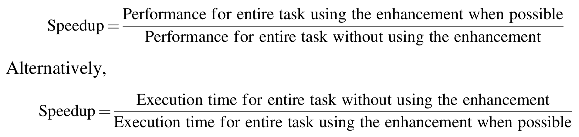
Quantitative Principles
Amdahl’s Law
Notes:
Amdahl’s law defines speedup
(A fundamental law, called Amdahl’s Law, can be used to quantify this principle. Amdahl’s Law states that the perfor- mance improvement to be gained from using some faster mode of execution is limited by the fraction of the time the faster mode can be used )

Slide 10

Amdahl’s Law: Two Factors
1. Fraction_{enhanced}:
e.g., 20/60 if 20 seconds out of a 60-second program to enhance
2. Speedup_{enhanced}:
e.g., 5/2 if enhanced to 2 seconds while originally 5 seconds
Notes:
Fraction-enhanced: The fraction of the computation time in the original computer that can be con- verted to take advantage of the enhancement;
Speedup-enhanced: The improvement gained by the enhanced execution mode, that is, how much faster the task would run if the enhanced mode were used for the entire program;
Then the execution time using the original computer with the enhanced mode will be the time spent using the unenhanced portion of the computer plus the time spent using the enhancement.

Slide 11
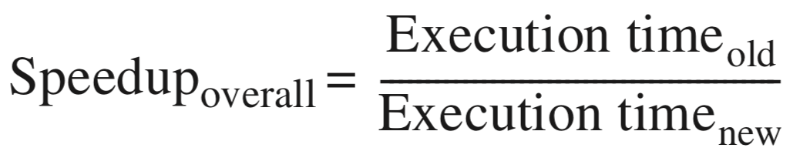
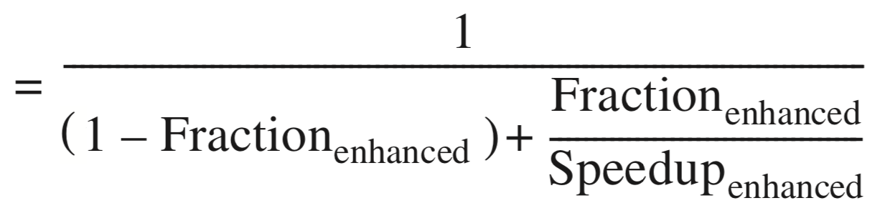
Amdahl’s Law
Multi-core parrallelism requires the restructuring of the application, a major new burden for programmers
Speedup Effect: Amdahl’s Law
limit:
1/(1-Fraction_{enhanced})
so not too many cores
Notes:
However, DLP, TLP, and request-level paral require the restructuring of the application, a major new burden for programmers
To what extent can parallelism speed up program?
Quantified by Amdahl’s Law: Equation
It prescribes practical limits to the number of useful cores per chip.
Example: If 10% of the task is serial, then the maximum performance benefit from parallelism is 10 no matter how many cores you put on the chip

Slide 12
Amdahl’s Law
Make common case fast
Example 1: speedup of 20 on 10% 1/(0.9+0.1/20) = 1.11
Example 2: speedup of 1.6 on 80% 1/(0.2+0.8/1.6) = 1.43

Slide 13
Lhadma’s Law
Yet uncomment case not so slow
Example: improvement of 2x on 90% slow down the rest by 10x speedup = 1/(0.1/0.1+0.9/2) = 0.69
Notes:
Lhadma's Law cautions that in pursuit of optimizing the common case, the uncommon case shouldn't be slowed down too much.

Slide 15
Lectures 04-05
Memory Hierarchy

Slide 16

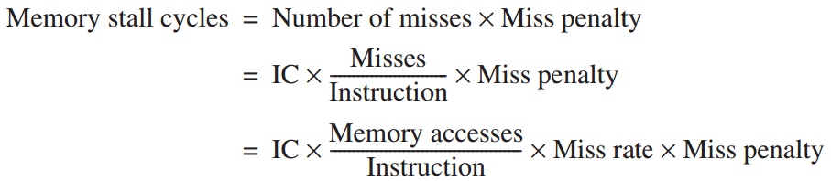

Cache Performance

Slide 17
Cache Performance
Memory stall cycles
the number of cycles during processor is stalled waiting for a mem access
Miss rate
number of misses over number of accesses
Miss penalty
the cost per miss (number of extra clock cycles to wait)

Slide 18


Block Placement
Direct Mapped
only one place
Fully Associative
anywhere
Set Associative
equally divide the cache into sets
anywhere within only one set
Notes:
A hybrid design: Set Associative
To reap the benefits of both

Slide 19
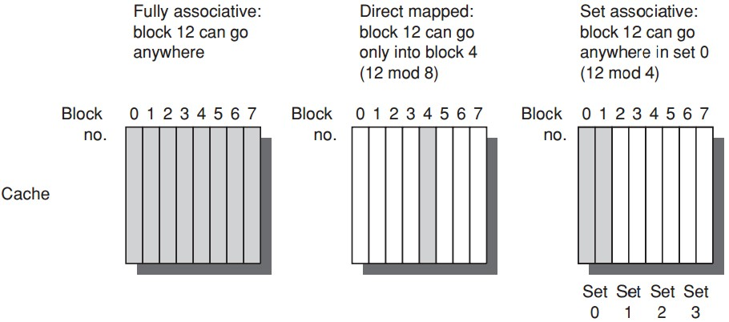
Block Placement
maximize
cache utilization
minimize
cache utilization
maximize
search speed
minimize
search speed
Notes:
for direct mapped, it’s easy to place and find a block, but low space usage efficiency;
for fully associative, it achieves the highest space efficiency, right, cause as long as there is an empty block, you can put your block there;
But, its down side is that you need to search over the entire cache to find a block.
A hybrid design, set associative.

Slide 20
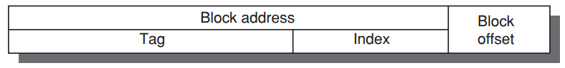
Block Identification
Block address: tag + index
Index: select the set
Tag: = block address
check all blocks in the set in parallel
Block offset: the address of the desired data/word within the block
Fully associative caches have no index field

Slide 21
Write Strategy
Options on a write hit
Write-through
info is written to both the block in the cache and to the block in the lower-level memory
Write-back
info is written only to the block in the cache;
to the main memory only when the modified cache block is replaced;

Slide 22
Write Strategy
Options on a write hit
Write-through
info is written to both the block in the cache and to the block in the lower-level memory
Write-back
info is written only to the block in the cache;
to the main memory only when the modified cache block is replaced;
require an extra dirty bit (or modify bit) to track modified block;

Slide 23
Write Strategy
Options on a write hit
Write-through
info is written to both the block in the cache and to the block in the lower-level memory
Write-back
info is written only to the block in the cache;
to the main memory only when the modified cache block is replaced;
use only valid bit;
in-cache content per block: v-bit + tag + data
use both valid bits and dirty/modify bits;
in-cache content per block: v-bit + d/m-bit + tag + data

Slide 24
Write Strategy
Options on a write miss
Write allocate
the block is allocated on a write miss
No-write allocate
write miss not affect the cache;
the block is modified in the lower-level memory;
until the program tries to read the block;

Slide 25
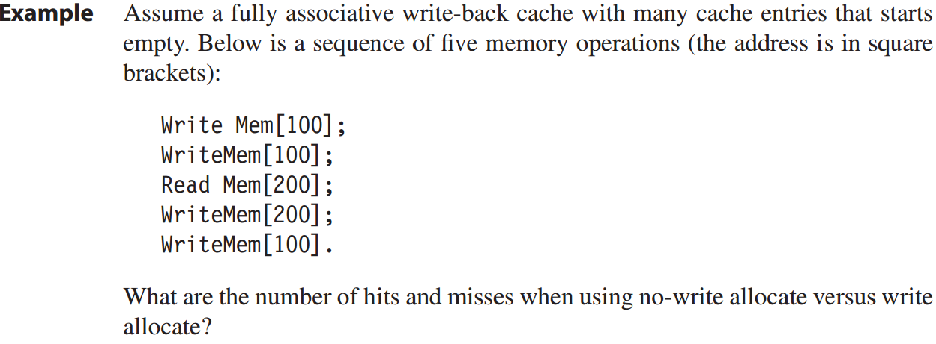
Write Strategy: Example
M
M
M
H
M
No-write allocate: 4 misses + 1 hit
cache not affected- address 100 not in the cache;
read [200] miss, block replaced, then write [200] hits;

Slide 26
Write Strategy: Example
M
H
M
H
H
Write allocate: 2 misses + 3 hits

Slide 27
Avg Mem Access Time
Average memory access time
=Hit time + Miss rate x Miss penalty

Slide 28
Cache Performance: Example
Example
a computer with CPI=1 when cache hit;
50% instructions are loads and stores;
2% miss rate, 25 cc miss penalty;
Q: how much faster would the computer be if all instructions were cache hits?

Slide 29
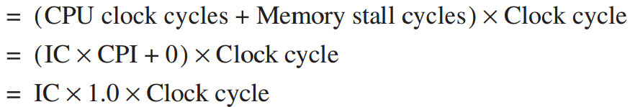
Cache Performance: Example
Answer
always hit:
CPU execution time

Slide 30
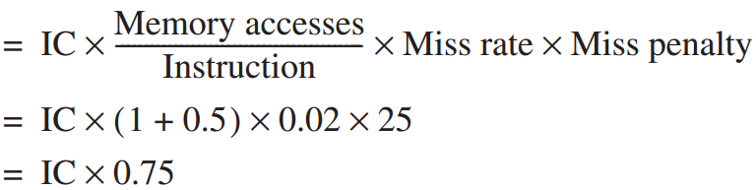
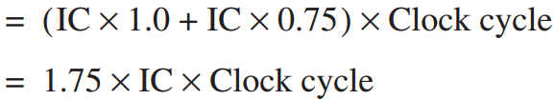
Cache Performance: Example
Answer
with misses:
Memory stall cycles
CPU execution time_{cache}

Slide 31
Cache Performance: Example
Answer
with misses:
Memory stall cycles
CPU execution time_{cache}

Slide 32

Cache Performance: Example
Answer
with misses:
Memory stall cycles
CPU execution time_{cache}
any instr: 1 mem access for instr fetch
mem instr: 1 more mem access for data fetch
50%x1 + 50%x2
=0.5+1

Slide 33
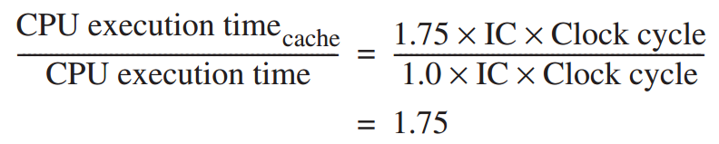
Cache Performance: Example
Answer

Slide 34
Root Causes of Miss Rates
Compulsory:
cold-start/first-reference misses;
Capacity
cache size limit;
blocks discarded and later retrieved;
Conflict
collision misses: associativity
direct mapped or set associative cache;
a block discarded and later retrieved in a set;
Notes:
To gain better insights into the causes of misses, we first start with a model that sorts all misses into three simple categories
Compulsory—The very first access to a block cannot be in the cache, so the block must be brought into the cache. These are also called cold-start misses or first-reference misses.
Capacity—If the cache cannot contain all the blocks needed during execution of a program, capacity misses (in addition to compulsory misses) will occur because of blocks being discarded and later retrieved.
Conflict—If the block placement strategy is set associative or direct mapped, conflict misses (in addition to compulsory and capacity misses) will occur because a block may be discarded and later retrieved if too many blocks map to its set. These misses are also called collision misses. The idea is that hits in a fully associative cache that become misses in an n-way set-associative cache are due to more than n requests on some popular sets.
Having identified the three C’s, what can a computer designer do about them? Conceptually, conflicts are the easiest: Fully associative placement avoids all conflict misses. Full associativity is expensive in hardware, however, and may slow the processor clock rate (see the example on page B-29), leading to lower overall performance.

Slide 35
Six Basic Cache Optimizations
1. larger block size
reduce miss rate; --- spatial locality;
reduce static power; --- lower tag #;
increase miss penalty, capacity/conflict misses;
2. bigger caches
reduce miss rate; --- capacity misses
increase hit time;
increase cost and (static & dynamic) power;
3. higher associativity
reduce miss rate; --- of conflict misses;
increase hit time;
increase power;

Slide 36
Six Basic Cache Optimizations
4. multilevel caches
reduce miss penalty;
reduce power;
average memory access time =
Hit time_{L1} + Miss rate_{L1} x
(Hit time_{L2} + Miss rate_{L2} x Miss penalty_{L2})
5. giving priority to read misses over writes
reduce miss penalty;
introduce write buffer;

Slide 37
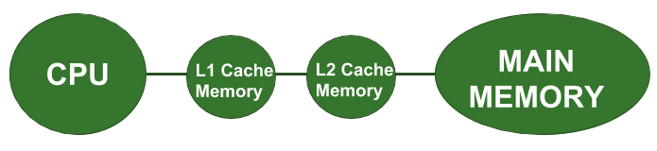
Opt #4: Multilevel Cache
Two-level cache
Add another level of cache between the original cache and memory
L1: small enough to match the clock cycle time of the fast processor;
L2: large enough to capture many accesses that would go to main memory, lessening miss penalty

Slide 38
Opt #4: Multilevel Cache
Average memory access time
=Hit time_{L1} + Miss rate_{L1} x Miss penalty_{L1}
=Hit time_{L1} + Miss rate_{L1}
x(Hit time_{L2}+Miss rate_{L2}xMiss penalty_{L2})
Average mem stalls per instruction
=Misses per instruction_{L1} x Hit time_{L2}
+ Misses per instr_{L2} x Miss penalty_{L2}

Slide 39
Opt #4: Multilevel Cache
Local miss rate
the number of misses in a cache
divided by the total number of mem accesses to this cache;
Miss rate_{L1}, Miss rate_{L2}
Global miss rates
the number of misses in the cache
divided by the number of mem accesses generated by the processor;
Miss rate_{L1}, Miss rate_{L1} x Miss rate_{L2}

Slide 40
Opt #4: Multilevel Cache
Example
1000 mem references -> 40 misses in L1 and 20 misses in L2;
miss penalty from L2 is 200 cc;
hit time of L2 is 10 cc;
hit time of L1 is 1 cc;
1.5 mem references per instruction;
Q: 1. various miss rates?
2. avg mem access time?
3. avg stall cycles per instruction?

Slide 41
Opt #4: Multilevel Cache
Answer
1. various miss rates?
L1: local = global
40/1000 = 4%
L2:
local: 20/40 = 50%
global: 20/10000 = 2%

Slide 42
Opt #4: Multilevel Cache
Answer
2. avg mem access time?
average memory access time
=Hit time_{L1} + Miss rate_{L1}
x(Hit time_{L2}+Miss rate_{L2}xMiss penalty_{L2})
=1 + 4% x (10 + 50% x 200)
=5.4

Slide 43
Opt #4: Multilevel Cache
Answer
3. avg stall cycles per instruction?
average stall cycles per instruction
=Misses per instruction_{L1} x Hit time_{L2}
+ Misses per instr_{L2} x Miss penalty_{L2}
=(1.5x40/1000)x10+(1.5x20/1000)x200
=6.6

Slide 44
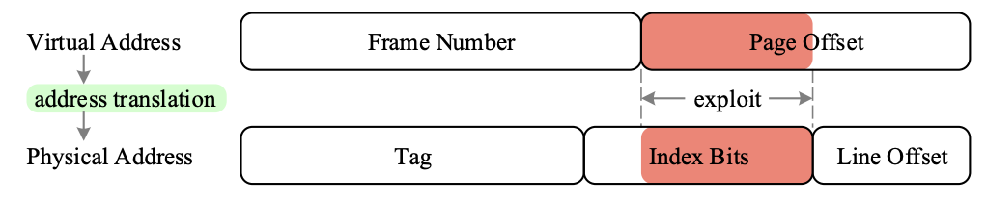
Six Basic Cache Optimizations
6. avoiding address translation during indexing of the cache
reduce hit time;
use page offset to index cache;
virtually indexed, physically tagged;
(indexing cache while querying TLB)

Slide 45
How virtual memory works?
Four Questions
Notes:
Based on these basics of virtual memory,
Now let’s discuss how exactly virtual memory works.

Slide 46
How virtual memory works?
Four Questions
Notes:
In particular, we’ll walk through its working principles via investigating four questions.

Slide 47
Four Mem Hierarchy Q’s
Q1. Where to place a block?
Fully associative strategy:
OS allows blocks to be placed anywhere in main memory
Because of high miss penalty by
access to a rotating magnetic storage device upon page/address fault
Notes:
The first question, block placement in memory.
Still remember block placement strategies when we discussed about cache?
For memory, block placement is fully associative, that is, the OS allows blocks to be placed anywhere in the memory.
The main reason is to load as more blocks as possible to memory, as access to a rotating disk upon memory miss causes high miss penalty.

Slide 48
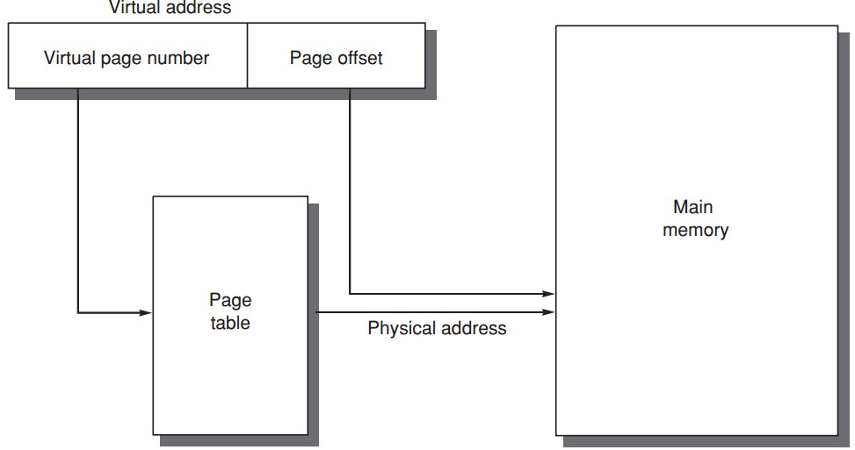
Four Mem Hierarchy Q’s
Q2. How to find a block?
table
entry
VPN PPN
PPN
offset
Notes:
So now a block could be placed anywhere in the memory, given a virtual address, how can we find the exact corresponding physical address?
The solution is using page table to track the mapping between virtual address and physical address.
Specifically, each entry of the page table records which physical page a virtual page maps to.
Then using the offset contained in virtual address, we can locate the exact data within the physical page.

Slide 49
Four Mem Hierarchy Q’s
Q2. How to find a block?
Access memory twice: one for accessing PTE address one for accessing data using phy addr
Cache/Memory
MMU
2. PTEA
CPU
1. VA
3. PTE
4. PA
5. Data
Notes:
So now a block could be placed anywhere in the memory, given a virtual address, how can we find the exact corresponding physical address?
The solution is using page table to track the mapping between virtual address and physical address.
Specifically, each entry of the page table records which physical page a virtual page maps to.
Then using the offset contained in virtual address, we can locate the exact data within the physical page.

Slide 50
Four Mem Hierarchy Q’s
Q2. How to find a block?
table
entry
VPN PPN
PPN
offset
What if vpn->ppn is not found (valid bit)?
Page fault (similar to cahe miss);
Fetch page from disk to memory, update page table, and re-query;
Notes:
So now a block could be placed anywhere in the memory, given a virtual address, how can we find the exact corresponding physical address?
The solution is using page table to track the mapping between virtual address and physical address.
Specifically, each entry of the page table records which physical page a virtual page maps to.
Then using the offset contained in virtual address, we can locate the exact data within the physical page.

Slide 51
Four Mem Hierarchy Q’s
Q2. How to find a block?
Processing a page fault
Page Fault Handler
4. Exception
Cache/
Memory
5. Victim Page
Disk
MMU
2. PTEA
CPU
1. VA
3. PTE
7. VA
6. New Page
Notes:
So now a block could be placed anywhere in the memory, given a virtual address, how can we find the exact corresponding physical address?
The solution is using page table to track the mapping between virtual address and physical address.
Specifically, each entry of the page table records which physical page a virtual page maps to.
Then using the offset contained in virtual address, we can locate the exact data within the physical page.

Slide 52
Four Memory Hierarchy Q’s
Q3. Which block to replace upon a virtual memory miss?
Least recently used (LRU) block
use/reference bit
--logically set whenever a page is accessed;
--OS periodically clears use bits and later records them to track the least recently referenced pages;
Notes:
But there should be cases when certain block cannot be found in memory, right?
In this case, we face with the third question, which block to replace upon memory miss.
The replacement strategy is to replace the least recently used block.
The idea is using a use bit to mark a block when it’s accessed. This way, blocks with use bits unset could be selected as targets for replacement.
More LRU design strategies:
With counters per block, e.g., 4-way set associative, then log4=2 bits per counter; https://www.youtube.com/watch?v=8CjifA2yw7s&list=PLAwxTw4SYaPn79fsplIuZG34KwbkYSedj&index=55
Then NMRU: not most recently used https://www.youtube.com/watch?v=8CjifA2yw7s&list=PLAwxTw4SYaPn79fsplIuZG34KwbkYSedj&index=56
Then PLRU: Pseudo LRU, one bit per cache line, as in the previous intro https://www.youtube.com/watch?v=8CjifA2yw7s&list=PLAwxTw4SYaPn79fsplIuZG34KwbkYSedj&index=57

Slide 53
Four Mem Hierarchy Q’s
Q4. What happens on a write?
Write-back strategy
as accessing rotating magnetic disk takes millions of clock cycles;
Dirty bit
write a block to disk only if it has been altered since being read from the disk;
Notes:
The fourth question, write strategy.
Virtual memory adopts write-back strategy, that is, data is first updated to memory, and then to disk upon replacing the data in memory.
The reason is the slow speed for accessing rotating disk; write-back strategy requires accessing disk for write only when necessary.
Virtual memory also uses a dirty bit to track their integrity. For a block read from disk to memory, they will be written back to disk only if it has been modified.

Slide 54
well…tell me more
Address Translation
Notes:
Certainly we need more details to understand virtual memory, right?

Slide 55
well…tell me more
Address Translation
Notes:
Now let’s proceed to detail the entire process of translating virtual address to physical address.

Slide 56
Page Table ?
physical page number || page offset = physical address
page
table
Notes:
As we mentioned, address translation relies heavily on page table, which records the mapping from virtual page number to physical page number.
Given a virtual address, we first use its virtual page number as index to query the page table and find its corresponding physical page number.
Then concatenating the physical page number with the page offset in virtual address, we get the physical address.

Slide 57
Page Table ?
Page tables are often large
32-bit virtual address, 4KB pages,
4 bytes per page table entry.
page table size:
(2³²/2¹²) x 2² = 2²² bytes = 4 MB
Notes:
Page tables are often large in size,
For example, given a 32-bit virtual address, 4-kilobyte page, and 4-byte page table entry,
The size of corresponding page table would be as large as 4 megabyte.

Slide 58
Page Table ?
Page tables are stored in main memory
Logically two memory accesses for
data access:
one to obtain the physical address from page table;
one to get the data from the physical address;
Access time doubled
How to be faster?
Notes:
Page tables are stored in main memory;
This costs each data access two memory accesses:
One to obtain the physical address from the page table, and one to get the data from the physical address;
Obviously, this doubles access time; so how to be faster?

Slide 59
Translation lookaside buffer (TLB)
/translation buffer (TB)
a special cache!
that keeps (prev) address translations
TLB entry
--tag: portions of the virtual address;
--data: a physical page frame number, protection field, valid bit, use bit, dirty bit;
Notes:
Use cache, right?

Slide 60
Learn from History
Translation lookaside buffer (TLB)
/translation buffer (TB)
a special cache!
that keeps (prev) address translations
TLB entry
--tag: portions of the virtual address;
--data: a physical page frame number, protection field, valid bit, use bit, dirty bit;
Notes:
We introduce a special cache called TLB to cache previous address translations;
Each entry in TLB records a previous mapping from a virtual page number to a physical page number.
Specifically, two major parts of each entry work for this:
The tag part records virtual page number while the virtual address part records the physical page number.
Use bit to track accessed pages;
Dirty bit to track modified pages;
Valid bit: the tag of a tlb entry must be marked valid to allow a match;

Slide 61
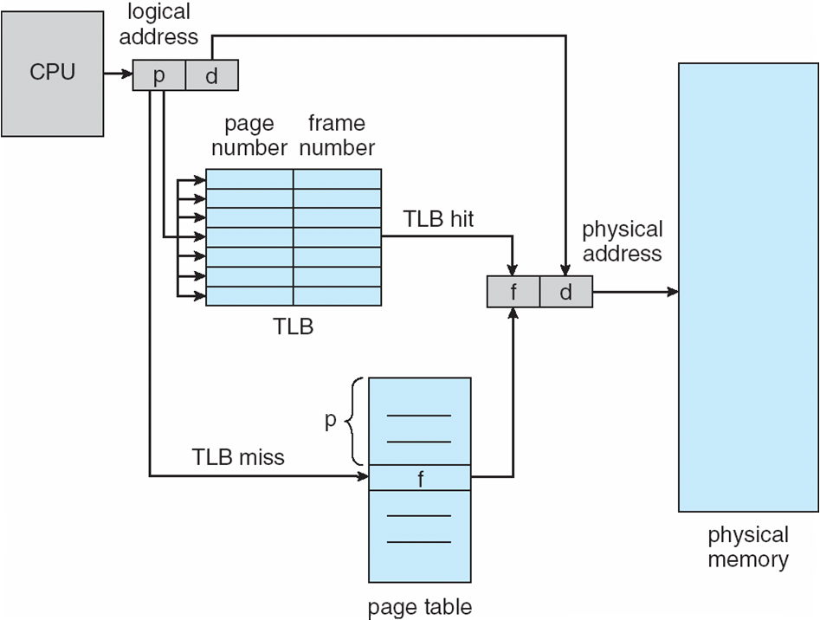
TLB

Slide 62
Address Translation:
one more time, with cache
Notes:
So let’s review address translation once again, but with cache jumping in this time

Slide 63
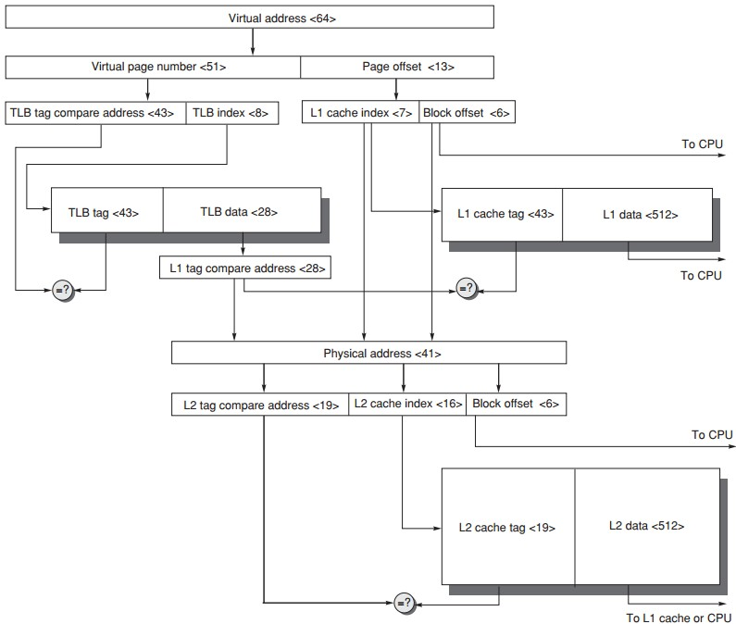
Address Translation
64-bit virtual address
41-bit physical address
page size: 8KB
two-level direct-mapped caches
64-byte blocks
L1: 8KB
L2: 4MB
TLB 256 entries
Notes:
TLB index for set?
With virtual memory, TLBs, first-level caches, and second-level caches all map- ping portions of the virtual and physical address space, it can get confusing what bits go where. Figure B.25 gives a hypothetical example going from a 64-bit vir- tual address to a 41-bit physical address with two levels of cache. This L1 cache is virtually indexed, physically tagged since both the cache size and the page size are 8 KB. The L2 cache is 4 MB. The block size for both is 64 bytes.

Slide 64
Address Translation
2¹³ = 8KB page
64-bit virtual address
41-bit physical address
page size: 8KB
two-level direct-mapped caches
64-byte blocks
L1: 8KB
L2: 4MB
TLB 256 entries

Slide 65
Address Translation
2⁸ = 256 entries
64-bit virtual address
41-bit physical address
page size: 8KB
two-level direct-mapped caches
64-byte blocks
L1: 8KB
L2: 4MB
TLB 256 entries

Slide 66
Address Translation
2⁶ = 64byte block
= 41 - 13
28
64-bit virtual address
41-bit physical address
page size: 8KB
two-level direct-mapped caches
64-byte blocks
L1: 8KB
L2: 4MB
TLB 256 entries
Notes:
41-bit physical address
13-bit offset
Tag = 41– 28 bits, which is the data field of TLB entry

Slide 67
Address Translation
2⁶ = 64byte block
2¹³ = 8KB L1 cache
2⁶ = 64byte block
2⁷ = 2¹³/2⁶
28
64-bit virtual address
41-bit physical address
page size: 8KB
two-level direct-mapped caches
64-byte blocks
L1: 8KB
L2: 4MB
TLB 256 entries

Slide 68
Address Translation
28
64-bit virtual address
41-bit physical address
page size: 8KB
two-level direct-mapped caches
64-byte blocks
L1: 8KB
L2: 4MB
TLB 256 entries
2⁶ = 64byte block
2²² = 4MB L2 cache
2⁶ = 64byte block
2¹⁶ = 2²²/2⁶

Slide 69
Physically vs Virtually Tagged
Pysically tagged
given that each data block has a
unique physical address;
match tags using physical addresses;
Virtually tagged
index cache sets and match tags using
virtual address;
shared data may have different virtual
addresses: aliasing
Notes:
Alternatively, the processor can index the cache with an address that is completely or partially virtual. This is called a virtually addressed cache, and it uses tags that are virtual addresses; hence, such a cache is virtually indexed and virtually tagged. In such caches, the address translation hardware (TLB) is unused during the normal cache access, since the cache is accessed with a virtual address that has not been trans- lated to a physical address. This takes the TLB out of the critical path, reducing cache
latency. When a cache miss occurs, however, the processor needs to translate the address to a physical address so that it can fetch the cache block from main memory.
When the cache is accessed with a virtual address and pages are shared between programs (which may access them with different virtual addresses), there is the possi- bility of aliasing. Aliasing occurs when the same object has two names—in this case, two virtual addresses for the same page. This ambiguity creates a problem because a word on such a page may be cached in two different locations, each corresponding to different virtual addresses. This ambiguity would allow one program to write the data without the other program being aware that the data had changed. Completely virtually addressed caches either introduce design limitations on the cache and TLB to reduce aliases or require the operating system, and possibly the user, to take steps to ensure that aliases do not occur.

Slide 70
Ten Advanced Cache Opts
Goal: average memory access time
Metrics to reduce/optimize
hit time
miss rate
miss penalty
cache bandwidth
power consumption
Notes:
Their goal is still to reduce average memory access time.
Besides hit time, miss rate, and miss penalty, they also try to increase cache bandwidth and reduce power consumption.

Slide 71
Ten Advanced Cache Opts
Reduce hit time
small and simple first-level caches;
way prediction;
decrease power;
Increase cache bandwidth
pipelined/multibanked/nonblocking cache;
Reduce miss penalty
critical word first;
merging write buffers;
Reduce miss rate
compiler optimizations; decrease power;
Reduce miss penalty/rate via parallelism
hardware/compiler prefetching; increase power;
Notes:
Here’s an overview of which optimizations to enhance which metrics.
Now let’s discuss each one in detail.

Slide 72
Opt #1: Small and Simple First-Level Caches
Small size
support a fast clock cycle
reduce power
Lower associativity
reduce both hit time and power
(direct-mapped caches can overlap the tag check with the transmission of the data,
there’s only one piece of data for each index)
Notes:
The first optimization advocates small and simple first-level caches.
When the cache is small enough, it delivers fast hit time to support a fast clock cycle. Meanwhile, it reduces power consumption.
By simple, it advocates lower associativity. This also reduces both hit time and power.
The critical timing path in a cache hit is the three-step process of addressing the tag memory using the index portion of the address, comparing the read tag value to the address, and setting the multiplexor to choose the correct data item if the cache is set associative. Direct-mapped caches can overlap the tag check with the transmis- sion of the data, effectively reducing hit time. Furthermore, lower levels of associa- tivity will usually reduce power because fewer cache lines must be accessed.

Slide 73
Opt #2: Way Prediction
Reduce conflict misses and hit time
Way prediction
block predictor bits are added to each block to predict the way/block within the set of the next cache access
the multiplexor is set early to select the desired block;
only a single tag comparison is performed in parallel with cache reading;
a miss results in checking the other blocks for matches in the next clock cycle;
Notes:
An extended form of way prediction can also be used to reduce power con- sumption by using the way prediction bits to decide which cache block to actu- ally access (the way prediction bits are essentially extra address bits); this approach, which might be called way selection, saves power when the way pre- diction is correct but adds significant time on a way misprediction, since the access, not just the tag match and selection, must be repeated. Such an optimiza- tion is likely to make sense only in low-power processors.

Slide 74
Opt #3: Pipelined Access
Increase cache bandwidth
Higher latency
Greater penalty on mispredicted branches and more clock cycles between issuing load and using data

Slide 75
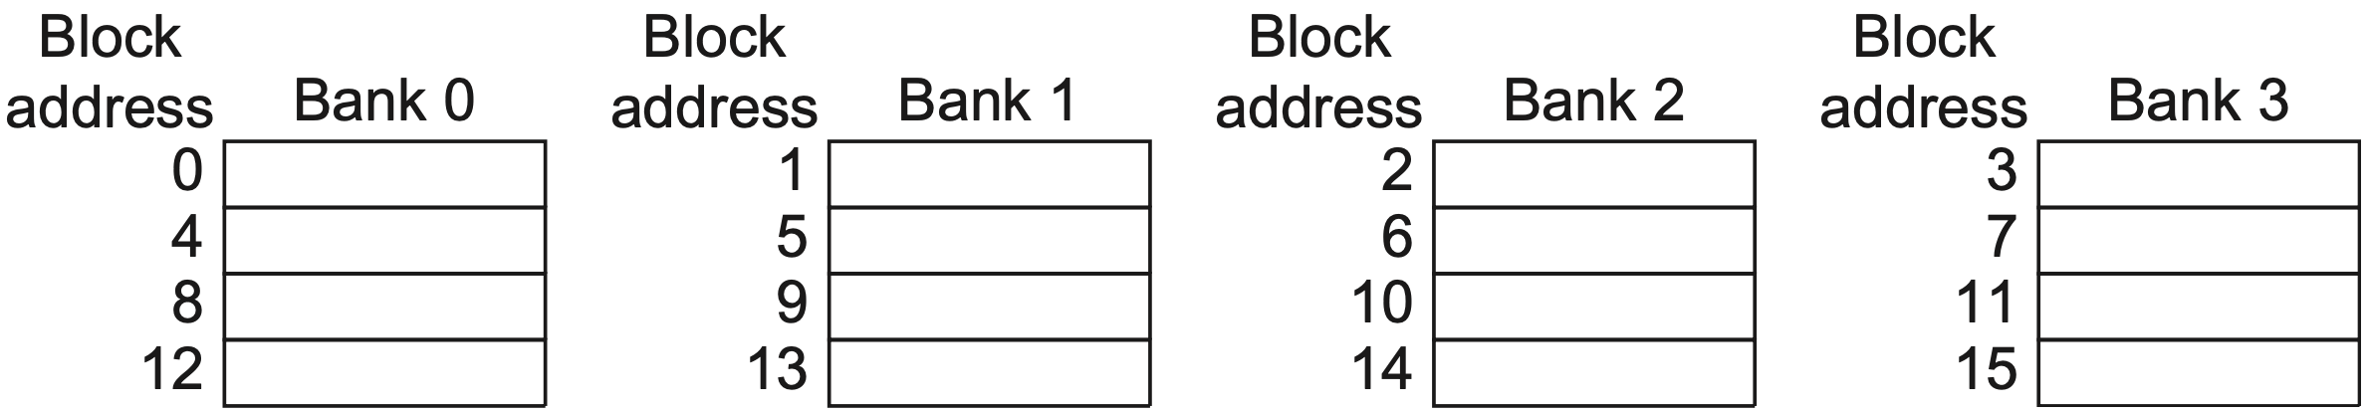
Opt #3: Multibanked Caches
Increase cache bandwidth
Divide cache into independent banks that support simultaneous accesses
Sequential interleaving
spread the addresses of blocks sequentially across the banks
Notes:
Clearly, banking works best when the accesses naturally spread themselves across the banks, so the mapping of addresses to banks affects the behavior of the memory system. A simple mapping that works well is to spread the addresses of the block sequentially across the banks, called sequential interleaving. For example, if there are four banks, bank 0 has all blocks whose address modulo 4 is 0, bank 1 has all blocks whose address modulo 4 is 1, and so on.

Slide 76
Opt #4: Nonblocking Caches
Increase cache bandwidth
Nonblocking/lockup-free cache
leverage out-of-order execution
allows data cache to continue to supply cache hits during a miss;
hit under miss;
miss under miss;
hit under multiple misses;
Notes:
More details in next chapter:
When a miss returns, the processor must know which load or store caused the miss, so that instruction can now go forward; and it must know where in the cache the data should be placed (as well as the setting of tags for that block). In recent processors, this information is kept in a set of registers, typically called the Miss Status Handling Registers (MSHRs). If we allow n outstanding misses, there will be n MSHRs, each holding the information about where a miss goes in the cache and the value of any tag bits for that miss, as well as the information indicating which load or store caused the miss (in the next chapter, you will see how this is tracked). Thus, when a miss occurs, we allocate an MSHR for handling that miss, enter the appropriate information about the miss, and tag the memory request with the index of the MSHR. The memory system uses that tag when it returns the data, allowing the cache system to transfer the data and tag information to the appropri- ate cache block and “notify” the load or store that generated the miss that the data is now available and that it can resume operation. Nonblocking caches clearly require extra logic and thus have some cost in energy. It is difficult, however, to assess their energy costs exactly because they may reduce stall time, thereby decreasing execution time and resulting energy consumption.

Slide 77
Opt #5: Critical Word First
Reduce miss penalty
Motivation: processor normally needs just one word of the block at a time
Critical word first
request the missed word first from the memory and send it to the processor as soon as it arrives;
processor continues execution while filling the rest of the words in the block

Slide 78
Opt #5: Early Restart
Reduce miss penalty
Motivation: processor normally needs just one word of the block at a time
Early restart
fetch the words in normal order,
as soon as the requested word arrives send it to the processor
let the processor continue execution

Slide 79
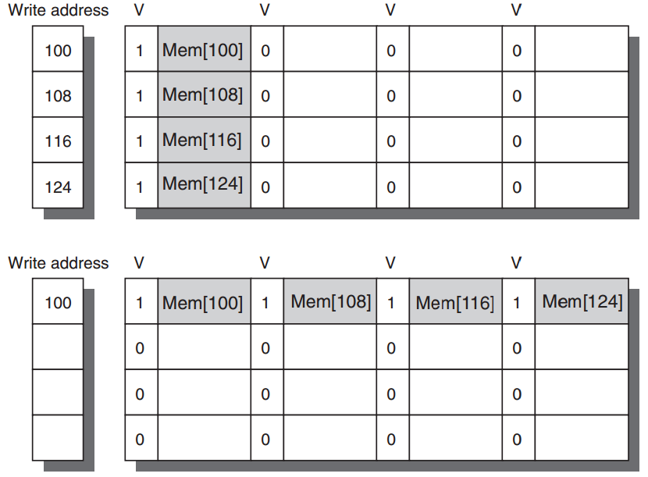
Opt #6: Merging Write Buffer
Reduce miss penalty
Write merging merges four entries (with sequential addresses)
into a single buffer entry
Notes:
Figure2.12 In this illustration of write merging, the write buffer on top does not use write merging while the write buffer on the bottom does. The four writes are merged into a single buffer entry with write merging; without it, the buffer is full even though three-fourths of each entry is wasted. The buffer has four entries, and each entry holds four 64-bit words. The address for each entry is on the left, with a valid bit (V) indicating whether the next sequential 8 bytes in this entry are occupied. (Without write merging, the words to the right in the upper part of the figure would be used only for instructions that wrote multiple words at the same time.)

Slide 80
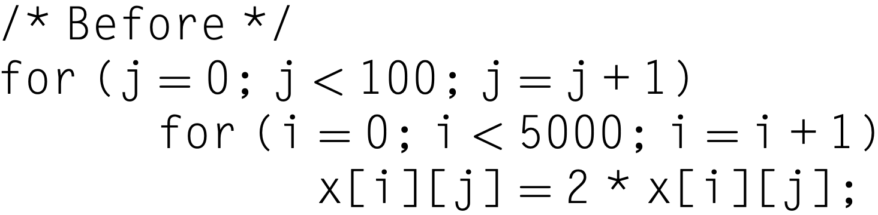
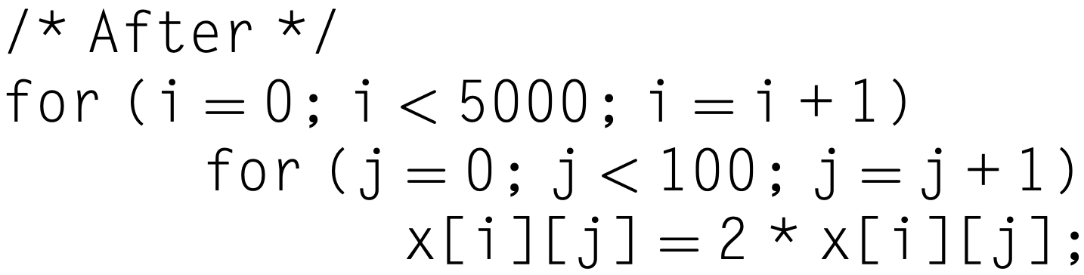
Opt #7: Compiler Optimization
Reduce miss rates, w/o hw changes
Tech 1: Loop interchange
exchange the nesting of the loops to make the code access the data in the order in which they are stored
x[i,j] and x[i,j+1] are adjacent
Notes:
Without hardware changes

Slide 81
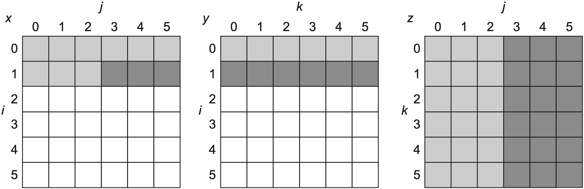
Opt #7: Compiler Optimization
Reduce miss rates, w/o hw changes
Tech 2: Blocking
x = y*z; both row&column accesses
before
older access
newer access
not yet touched
Notes:
This optimization tries to reduce misses via improved temporal locality. We are
again dealing with multiple arrays, with some arrays accessed by rows and some
by columns. Storing the arrays row by row (row major order) or column by column
(column major order) does not solve the problem because both rows and
columns are used in every iteration of the loop. Such orthogonal accesses mean
the transformations such as loop interchange are not helpful.
Instead of operating on entire rows or columns of an array, blocked algorithms
operate on submatrices or blocks. The goal is to maximize accesses to the data
loaded into the cache before the data are replaced.

Slide 82
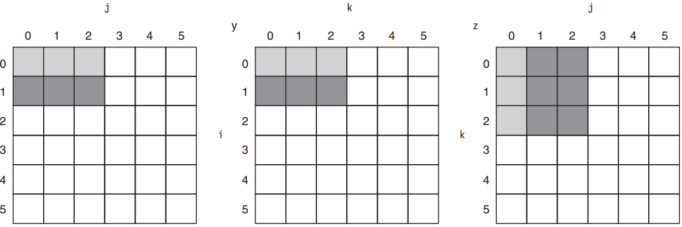
Opt #7: Compiler Optimization
Reduce miss rates, w/o hw changes
Tech 2: Blocking
x = y*z; compute using submatrices
after; maximize accesses to loaded data before they are replaced
Notes:
More in textbook;

Slide 83
Opt #7: Compiler Optimization
Reduce miss rates, w/o hw changes
Tech 2: Blocking
x = y*z; compute using blocks
after; maximize accesses to loaded data before they are replaced
Notes:
More in textbook;

Slide 84
Opt #8: Hardware Prefetching
Reduce miss penalty/rate
Prefetch items before the processor requests them, into the cache or external buffer

Slide 85
Opt #8: Hardware Prefetching
Instruction prefetch
fetch two blocks on a miss:
requested one into cache
next consecutive one into instruction stream buffer
If requested block is in stream buffer:
cancel the original cache request
read the block from stream buffer
issue next prefetch request

Slide 86
Opt #8: Hardware Prefetching
Instruction prefetch
fetch two blocks on a miss:
requested one into cache
next consecutive one into instruction stream buffer
Similar Data prefetch approaches

Slide 87
Opt #9: Compiler Prefetching
Reduce miss penalty/rate
Compiler to insert prefetch instructions to request data before the processor needs it
Register prefetch
load the value into a register
Cache prefetch
load data into the cache

Slide 88
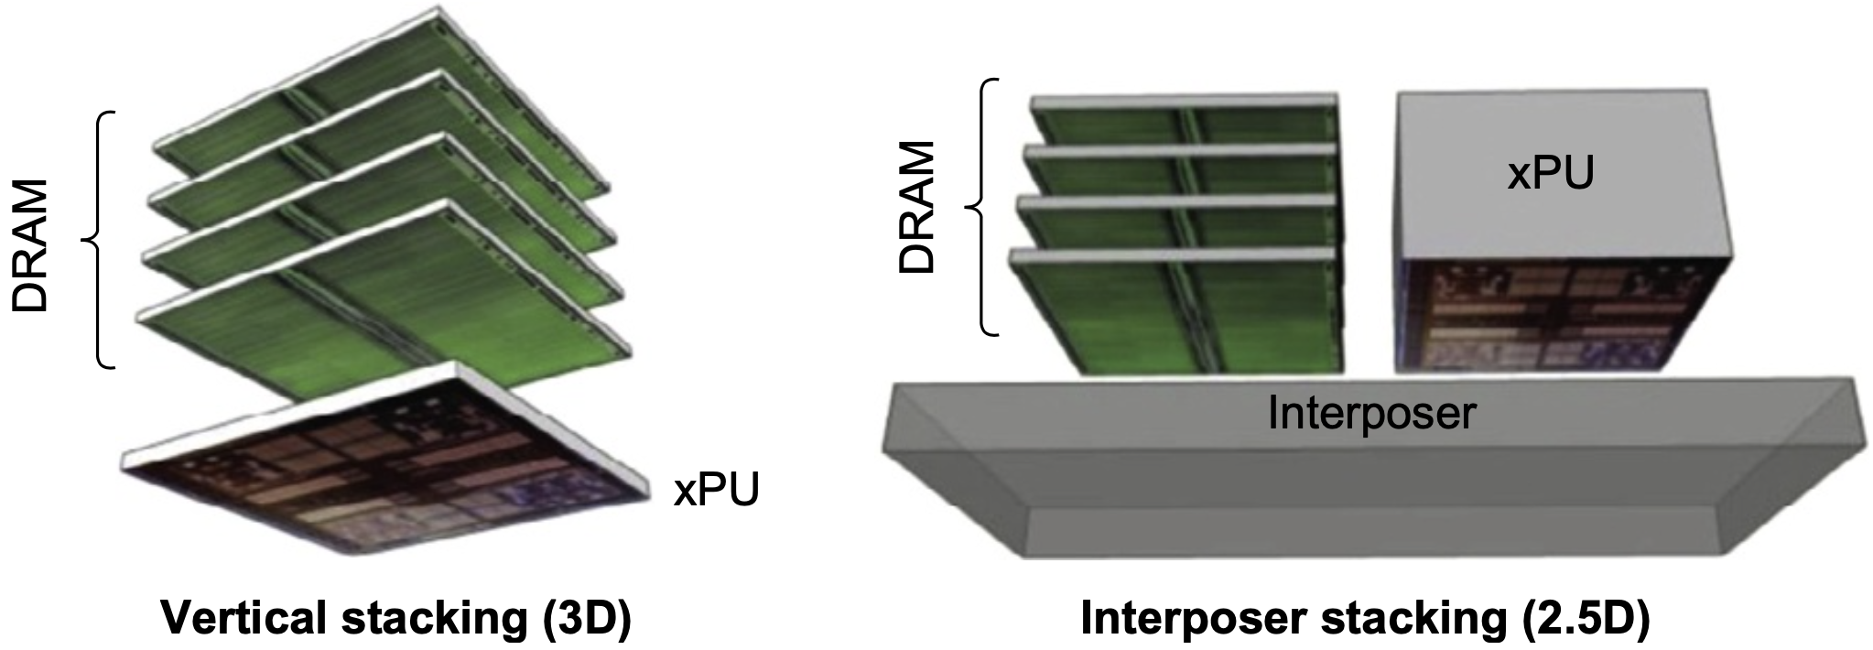
Opt #10: HBM
Use HBM as L4 cache
Notes:
New to 6th Edition

Slide 89
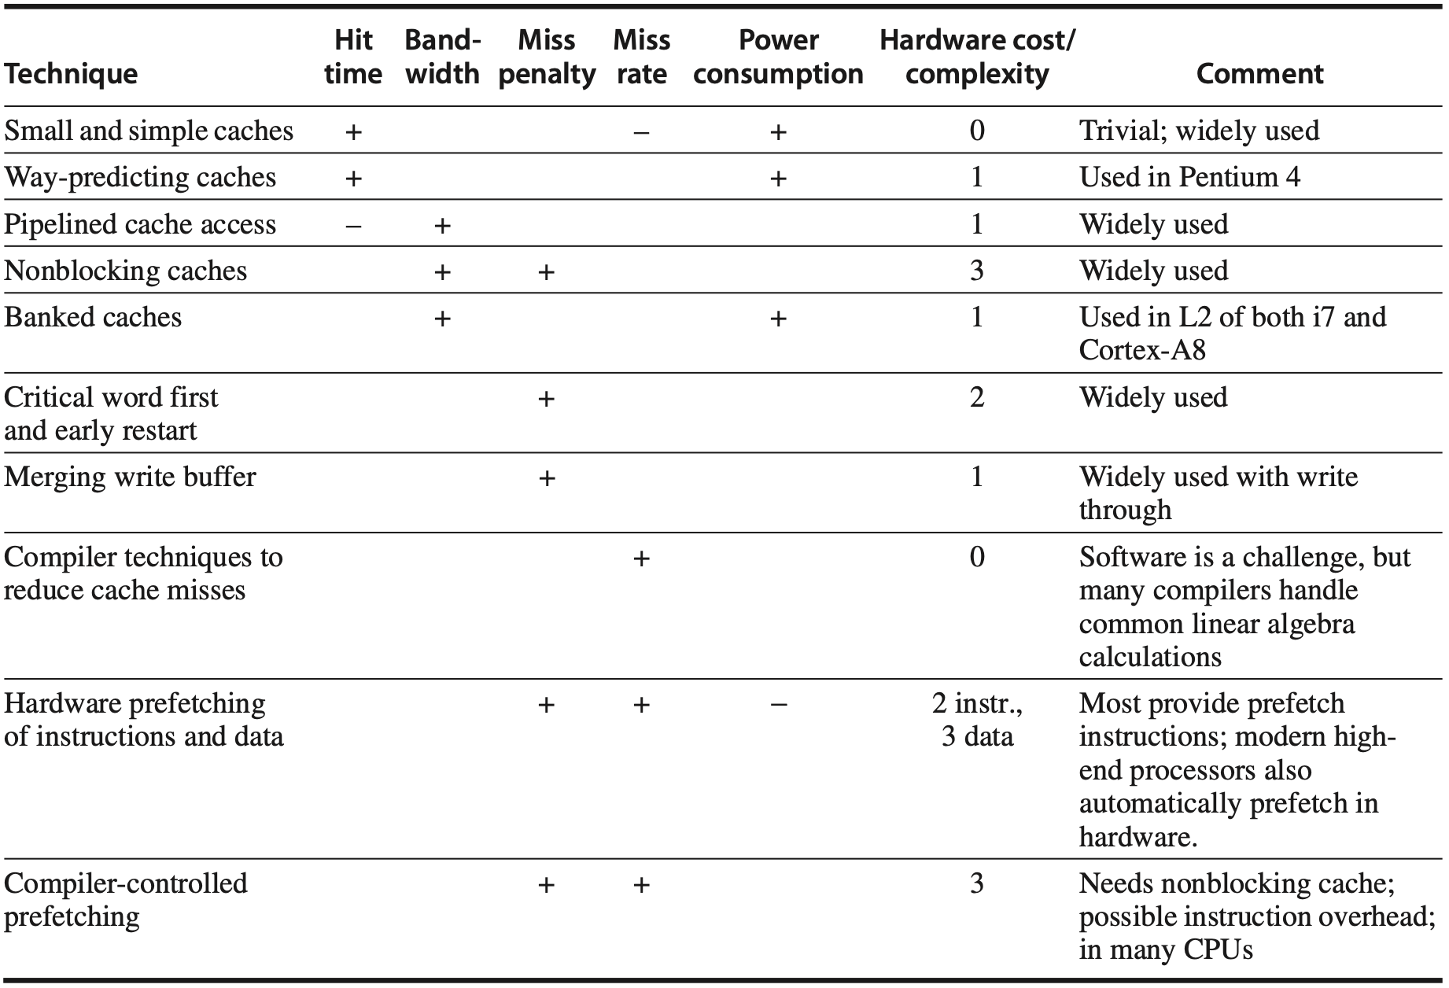
Summary of Cache Opt
Notes:
Figure 2.18 Summary of 10 advanced cache optimizations showing impact on cache performance, power consumption, and complexity. Although generally a technique helps only one factor, prefetching can reduce misses if donesufficientlyearly;ifnot,itcanreducemisspenalty.+meansthatthetechniqueimprovesthefactor,% means it hurts that factor, and blank means it has no impact. The complexity measure is subjective, with 0 being the easiest and 3 being a challenge.

Slide 91
Lectures 06-08
Instruction-Level Parallelism

Slide 92
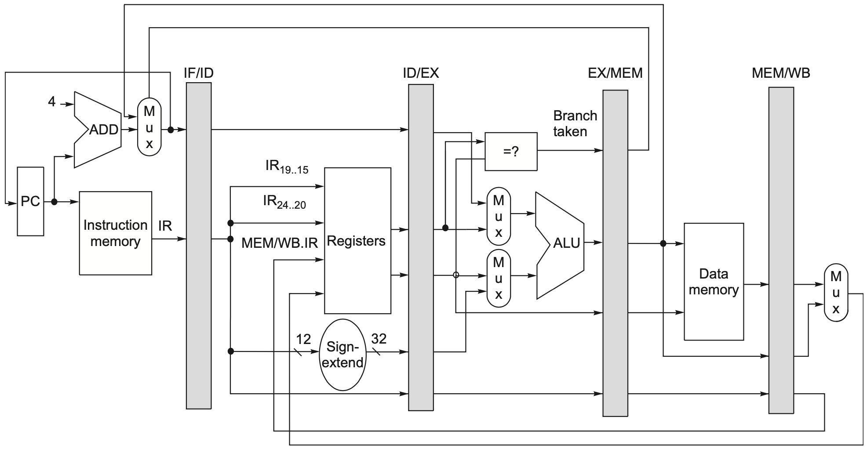
Example RISC-V Data Path
Pipelined
Notes:
Figure C.19 The data path is pipelined by adding a set of registers, one between each pair of pipe stages. The registers serve to convey values and control information from one stage to the next. We can also think of the PC as a pipeline register, which sits before the IF stage of the pipeline, leading to one pipeline register for each pipe stage. Recall that the PC is an edge-triggered register written at the end of the clock cycle; hence, there is no race condition in writing the PC. The selection multiplexer for the PC has been moved so that the PC is written in exactly one stage (IF). If we didn’t move it, there would be a conflict when a branch occurred, because two instructions would try to write different values into the PC. Most of the data paths flow from left to right, which is from earlier in time to later. The paths flowing from right to left (which carry the register write-back information and PC information on a branch) introduce complications into our pipeline.
To control this simple pipeline we need only determine how to set the con- trol for the four multiplexers in the data path of Figure C.19. The two multi- plexers in the ALU stage are set depending on the instruction type, which is dictated by the IR field of the ID/EX register. The top ALU input multiplexer is set by whether the instruction is a branch or not, and the bottom multiplexer is set by whether the instruction is a register-register ALU operation or any other type of operation. The multiplexer in the IF stage chooses whether to use the value of the incremented PC or the value of the EX/MEM.ALUOutput (the branch target) to write into the PC. This multiplexer is controlled by the field EX/MEM.cond. The fourth multiplexer is controlled by whether the instruction in the WB stage is a load or an ALU operation. In addition to these four mul- tiplexers, there is one additional multiplexer needed that is not drawn in Figure C.19, but whose existence is clear from looking at the WB stage of an ALU operation. The destination register field is in one of two different places depending on the instruction type (register-register ALU versus either ALU immediate or load). Thus, we will need a multiplexer to choose the correct por- tion of the IR in the MEM/WB register to specify the register destination field, assuming the instruction writes a register.

Slide 93
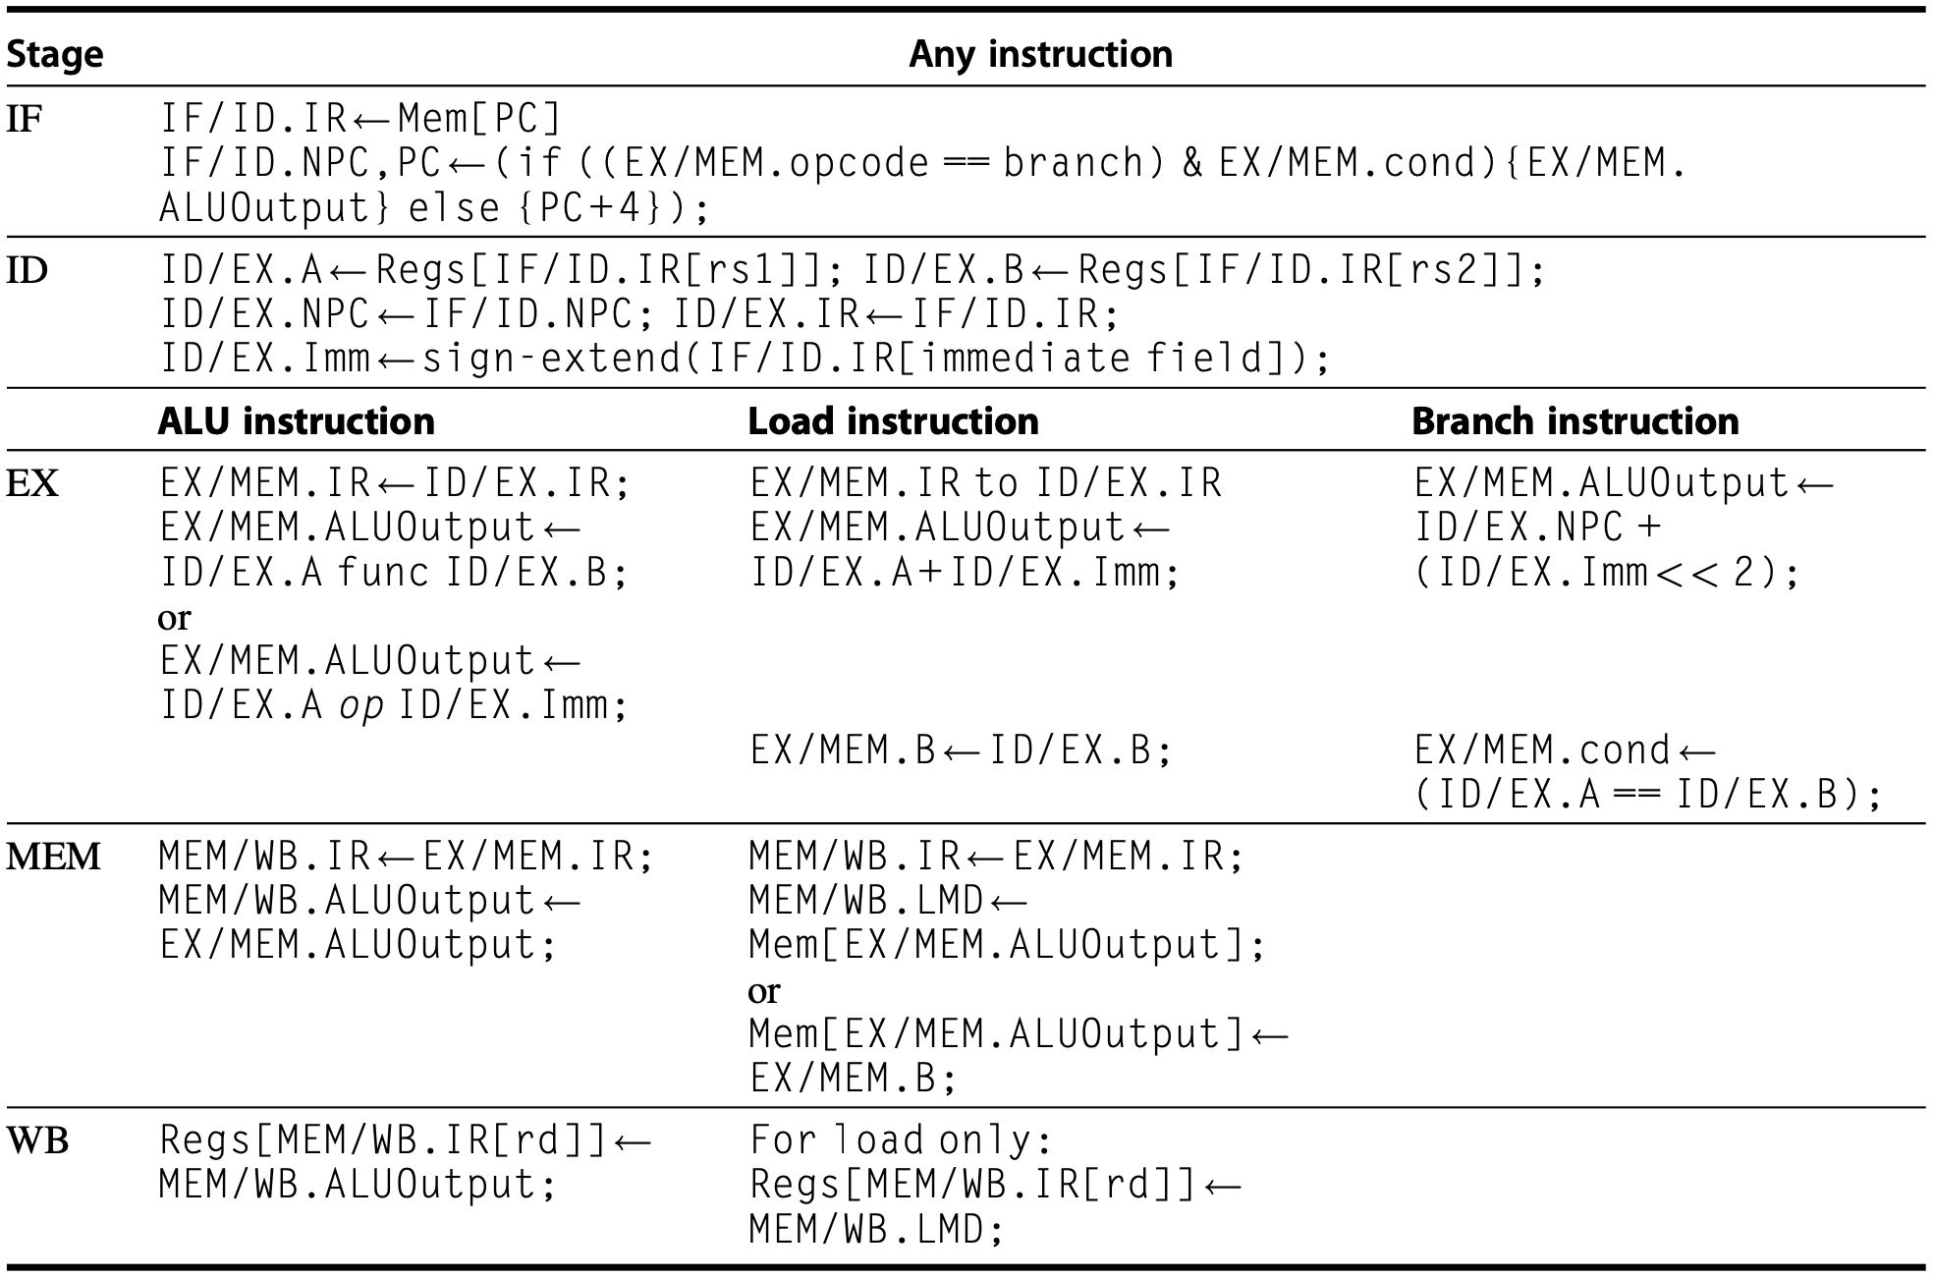
Example RISC-V Data Path
Pipelined
Notes:
FigureC.20 EventsoneverypipestageoftheRISCVpipeline.Let’sreviewtheactionsinthestagesthatarespecific to the pipeline organization. In IF, in addition to fetching the instruction and computing the new PC, we store the incremented PC both into the PC and into a pipeline register (NPC) for later use in computing the branch-target address. This structure is the same as the organization in Figure C.19, where the PC is updated in IF from one of two sources. In ID, we fetch the registers, extend the sign of the 12 bits of the IR (the immediate field), and pass along the IR and NPC. During EX, we perform an ALU operation or an address calculation; we pass along the IR and the B register (if the instruction is a store). We also set the value of cond to 1 if the instruction is a taken branch. During the MEM phase, we cycle the memory, write the PC if needed, and pass along values needed in the final pipe stage. Finally, during WB, we update the register field from either the ALU output or the loaded value. For simplicity we always pass the entire IR from one stage to the next, although as an instruction proceeds down the pipeline, less and less of the IR is needed.

Slide 94
Pipeline Hazards
Hazards: situations that prevent the next instruction from executing in the designated clock cycle.
3 classes of hazards:
structural hazard – resource conflicts
data hazard – data dependency
control hazard – pc changes
(e.g., branches)
Notes:
Specifically, pipeline hazards are situations that prevent the next instruction from executing in the designated clock cycle.
There are 3 classes of hazards. Structural hazard due to resource conflicts, data hazard due to data dependency, and control hazard due to pc changes.

Slide 95
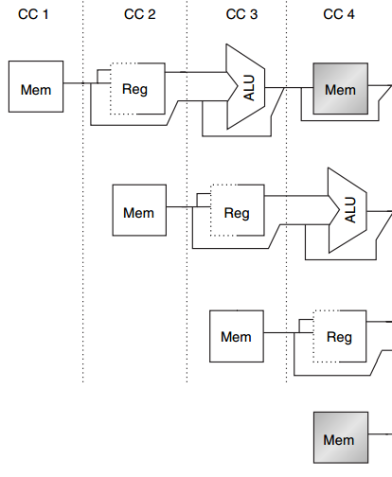
Structural Hazard
MEM
Example
1 mem port
mem conflict
data access
vs
instr fetch
load
instr i+1
instr i+2
IF
instr i+3
Notes:
Here’s an example of structural hazard due to memory conflict.
Assume the processor has only memory port.
A structural hazard will arise in clock cycle 4 when the load instruction reads data from memory and instruction i plus 3 fetches instruction from memory.

Slide 96
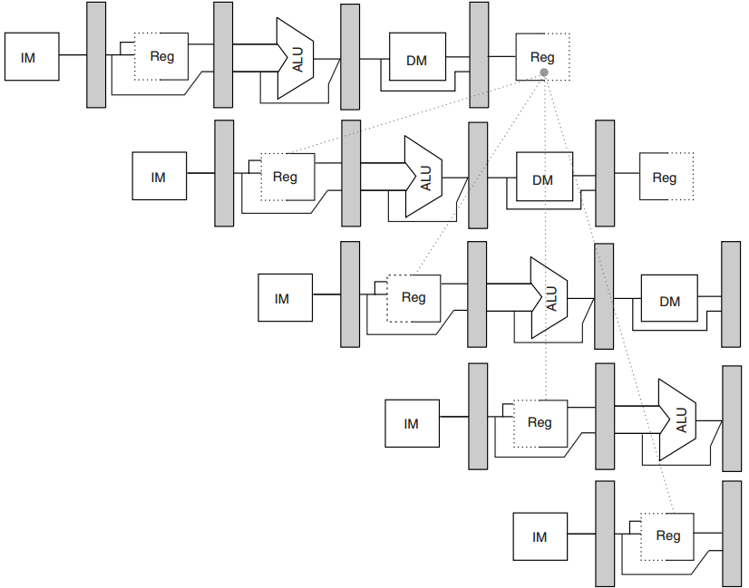
Data Hazard
R1
add
x1, x2, x3
sub
x4, x1, x5
and
x6, x1, x7
No hazard
1st half cycle: w
2nd half cycle: r
Write-then-Read in 1 CC
::Double Bump
or
x8, x1, x9
xor
x10, x1, x11
Notes:
In this example, the subtract and AND instructions need R1 before the add instruction prepares it. So R1 causes a data hazard that prevents normal pipelining of the subtract and AND instructions.
Note that the OR instruction has no hazard because the add instruction prepares R1 in the first half of the clock cycle while the OR instruction needs R1 till the second half.

Slide 97
how much ILP in a program?

Slide 98
Parallel Instructions
Two instructions that can execute simultaneously in a pipeline of arbitrary depth without causing any stalls, assuming sufficient resources and thus no structural hazards
Notes:
If two instructions are parallel, they can execute simultaneously in a pipeline of arbitrary depth without causing any stalls, assuming the pipeline has sufficient resources (and thus no structural hazards exist).

Slide 99
Dependent Instructions
Two instructions that are not parallel
Must be executed in order
May often be partially overlapped
Notes:
If two instructions are dependent, they are not parallel and must be executed in order, although they may often be partially overlapped. The key in both cases is to determine whether an instruction is dependent on another instruction.

Slide 100
Dependence
Data dependence
Name dependence
Control dependence
Notes:
There are three different types of dependences: data dependences (also called true data dependences), name dependences, and control dependences.

Slide 101
Data Dependence
An instruction j is data-independent on instruction i if either of the following holds:
Instruction i produces a result that may be used by instruction j;
Instruction j is data-dependent on instruction k, and instruction k is data dependent on i;

Slide 102
Data Dependence
An instruction j is data-independent on instruction i if either of the following holds:
Instruction i produces a result that may be used by instruction j;
Instruction j is data-dependent on instruction k, and instruction k is data dependent on i; (Dependence within a single instr is not considered as a dep: add x1, x1, x1)
Notes:
Note that a depen- dence within a single instruction (such as add x1,x1,x1) is not considered a dependence.

Slide 103
Data Dependence
f0, 0(x1)
f4, f0, f2
f4, 0(x1)
x1, x1, -8
x1, x2, Loop
Example code sequence
Loop:
fld
fadd.d
fsd
addi
bne
Notes:
fadd.d: add double-precision floating-point numbers
For example, consider the following RISC-V code sequence that increments a vector of values in memory (starting at 0(x1) ending with the last element at 0(x2)) by a scalar in register f2.

Slide 104
Data Dependence
f0, 0(x1)
f4, f0, f2
f4, 0(x1)
x1, x1, -8
x1, x2, Loop
Example code sequence
Loop:
Write → Read
fld
fadd.d
fsd
addi
bne
Notes:
fadd.d: add double-precision floating-point numbers
For example, consider the following RISC-V code sequence that increments a vector of values in memory (starting at 0(x1) ending with the last element at 0(x2)) by a scalar in register f2.

Slide 105
Name Dependence
Two instructions use the same register or memory location (name), but there is no flow of data between instructions associated w/ that name
Read → Write or Write → Write

Slide 106
Name Dependence
An instruction i that precedes instr j in program order:
Antidependence: Read → Write
instruction j writes a register or
memory location that instruction i
reads
Output dependence: Write → Write
instruction i and instruction j write
the same register or memory location
Notes:
The second type of dependence is a name dependence. A name dependence occurs when two instructions use the same register or memory location, called a name, but there is no flow of data between the instructions associated with that name. There are two types of name dependences between an instruction i that precedes instruc- tion j in program order:
1. An antidependence between instruction i and instruction j occurs when instruc- tion j writes a register or memory location that instruction i reads. The original ordering must be preserved to ensure that i reads the correct value. In the example
on page 171, there is an antidependence between fsd and addi on register x1.
2. Anoutputdependenceoccurswheninstructioniandinstructionjwritethesame register or memory location. The ordering between the instructions must be preserved to ensure that the value finally written corresponds to instruction j.

Slide 107
Name Dependence
f0, 0(x1)
f0, f1, f2
f4, 0(x1)
x1, x1, -8
x1, x2, Loop
Example code sequence
Loop:
x1: Read → Write, antidependence
fld
fadd.d
fsd
addi
bne

Slide 108
Name Dependence
f0, 0(x1)
f0, f1, f2
f4, 0(x1)
x1, x1, -8
x1, x2, Loop
Example code sequence
Loop:
x1: Read → Write, antidependence
f0: Write → Write, output dependence
fld
fadd.d
fsd
addi
bne

Slide 109
Name Dependence
Register Renaming: change the name (register number or memory location) used in name-dependent instructions such that the instructions do not conflict
Statically by compiler or dynamically by hardware
Renamed instructions can execute simultaneously or be reordered
Notes:
more in subsequent lectures

Slide 110
Data Hazard
Hazard exists whenever
1) there is a name/data dependence between instructions;
2) they are close enough; AND
3) the overlap during execution would change the order of access to the operand involved in the dependence
Notes:
A hazard exists whenever there is a name or data dependence between instructions, and they are close enough that the overlap during execution would change the order of access to the operand involved in the dependence. Because of the depen- dence, we must preserve what is called program order—that is, the order that the instructions would execute in if executed sequentially one at a time as determined by the original source program. The goal of both our software and hardware tech- niques is to exploit parallelism by preserving program order only where it affects the outcome of the program. Detecting and avoiding hazards ensures that neces- sary program order is preserved.

Slide 111
Data Hazard
Read After Write (RAW) j reads a source before i writes it, j incorrectly gets the old value
Write After Write (WAW) j writes a destination before i writes it, leaving the value written by i but not j
Write After Read (WAR) j writes a destination before i reads it, i incorrectly gets the new value
Notes:
Reader After Write is what it should be enforced by program order, then the associated data hazard is when instruction execution violates this order → read before write / write after read (for example)

Slide 112
Control Dependences
Two types:
An instruction that is control dependent on a branch cannot be moved before the branch so that its execution is no longer controlled by the branch.
An instruction that is not control dependent on a branch cannot be moved after the branch so that its execution is controlled by the branch.

Slide 113
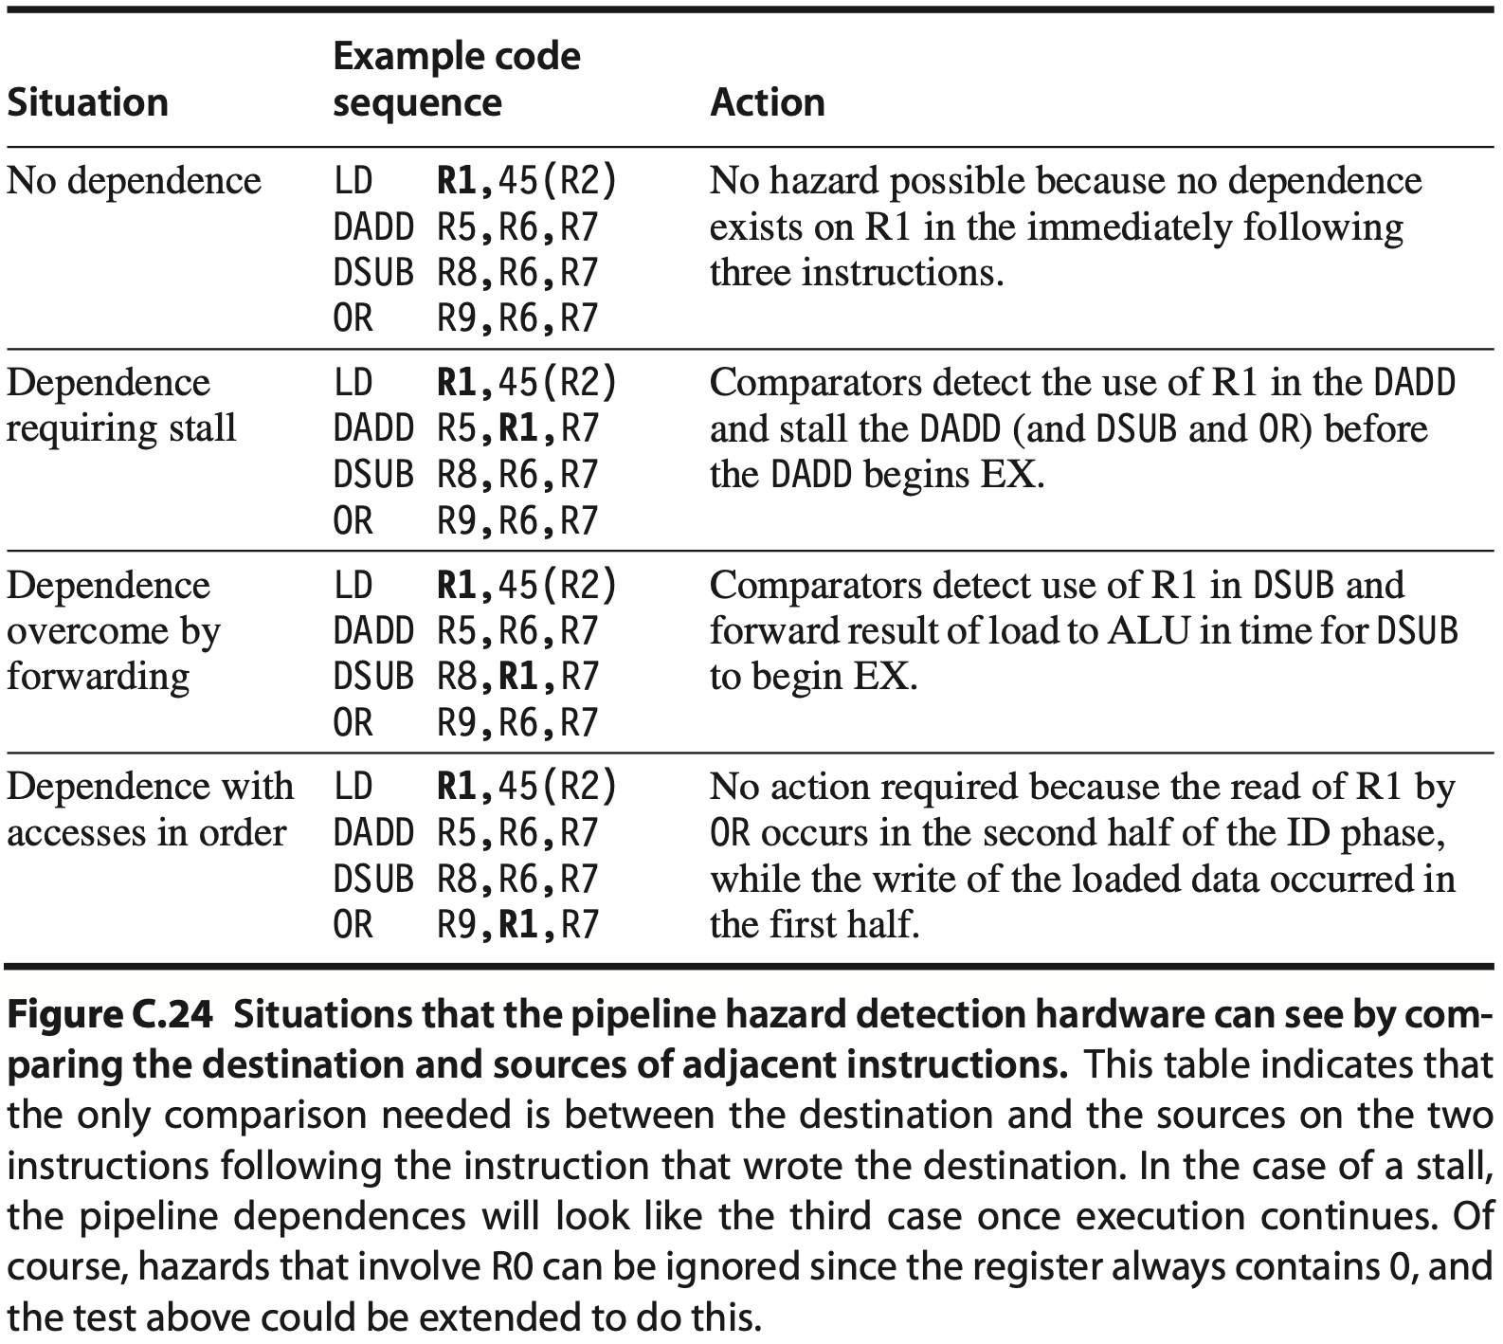
Dependences vs Hazards

Slide 114
Instruction
Execution
exception detected?
no
yes
Cause
EPC
yes
terminate?
end
no
no
Exception Handling Instructions
terminate?
yes
end
Notes:
The basic action that the processor must perform when an exception occurs is to save the address of the offending instruction in the exception program counter (EPC) and then transfer control to the operating system at some specified address.
The operating system can then take the appropriate action, which may involve providing some service to the user program, taking some predefined action in response to an overflow, or stopping the execution of the program and reporting an error. After performing whatever action is required because of the exception, the operating system can terminate the program or may continue its execution, using the EPC to determine where to restart the execution of the program.

Slide 115
Instruction
Execution
Examples:
undefined instruction in ID
arithmetic Overflow in ALU
exception detected?
no
yes
Cause
EPC
yes
terminate?
end
no
no
Exception Handling Instructions
terminate?
yes
end

Slide 116
Instruction
Execution
exception detected?
no
yes
register:
cause of exception
register:
exception program counter;
Cause
EPC
address of offending instruction + 4;
yes
terminate?
end
no
no
Exception Handling Instructions
terminate?
yes
end
Notes:
We can perform the processing required for exceptions by adding a few extra registers and control signals to our basic implementation and by slightly extending control. We will need to add two additional registers to our current MIPS implementation:
EPC: A 32-bit register used to hold the address of the affected instruction. (Such a register is needed even when exceptions are vectored.)
(The final step is to save the address of the offending instruction in the exception program counter (EPC). In reality, we save the address +4, so the exception handling the software routine must first subtract 4 from the saved value. )
Cause: A register used to record the cause of the exception. In the MIPS architecture, this register is 32 bits, although some bits are currently unused. Assume there is a five-bit field that encodes the two possible exception sources mentioned above, with 10 representing an undefined instruction and 12 representing arithmetic overflow.
Cause register records all possible exceptions in a clock cycle, so the exception software must match the exception to the instruction. An important clue is knowing in which pipeline stage a type of exception can occur. For example, an undefined instruction is discovered in the ID stage, and invoking the operating system occurs in the EX stage. Exceptions are collected in the Cause register in a pending exception field so that the hardware can interrupt based on later exceptions, once the earliest one has been serviced.

Slide 117
Instruction
Execution
exception detected?
no
yes
Cause
EPC
yes
terminate?
end
no
no
Exception Handling Instructions
terminate?
yes
end
predefined address;
determined by cause of exception;
Notes:
We can perform the processing required for exceptions by adding a few extra registers and control signals to our basic implementation and by slightly extending control. We will need to add two additional registers to our current MIPS implementation:
EPC: A 32-bit register used to hold the address of the affected instruction. (Such a register is needed even when exceptions are vectored.)
(The final step is to save the address of the offending instruction in the exception program counter (EPC). In reality, we save the address +4, so the exception handling the software routine must first subtract 4 from the saved value. )
Cause: A register used to record the cause of the exception. In the MIPS architecture, this register is 32 bits, although some bits are currently unused. Assume there is a five-bit field that encodes the two possible exception sources mentioned above, with 10 representing an undefined instruction and 12 representing arithmetic overflow.

Slide 118
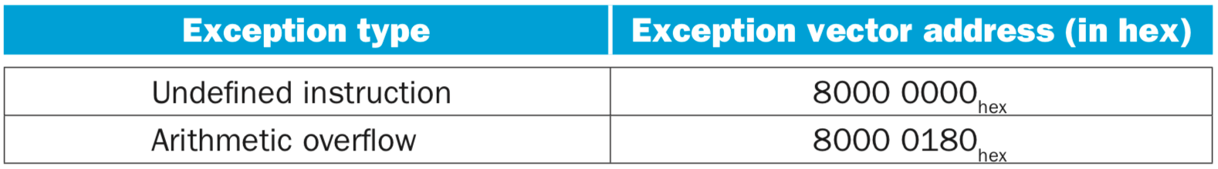
Instruction
Execution
exception detected?
no
yes
Cause
EPC
yes
vectored interrupts:
terminate?
end
no
no
Exception Handling Instructions
terminate?
yes
end
predefined address;
determined by cause of exception;
Notes:
In a vectored interrupt, the address to which control is transferred is determined by the cause of the exception. For example, to accommodate the two exception types listed above, we might define the following two exception vector addresses: (in the table)
The operating system knows the reason for the exception by the address at which it is initiated. The addresses are separated by 32 bytes or eight instructions, and the operating system must record the reason for the exception and may perform some limited processing in this sequence. When the exception is not vectored, a single entry point for all exceptions can be used, and the operating system decodes the status register to find the cause.

Slide 119
Treat exceptions as control hazards;
Flush instructions that follow the offending instruction;
Fetch instructions from
the new address;
similar to taken branches
Instruction
Execution
exception detected?
no
yes
Cause
EPC
yes
terminate?
end
no
no
Exception Handling Instructions
terminate?
yes
end
Notes:
Exceptions in a Pipelined Implementation
A pipelined implementation treats exceptions as another form of control hazard. For example, suppose there is an arithmetic overflow in an add instruction. Just as we did for the taken branch in the previous section, we must flush the instructions that follow the add instruction from the pipeline and begin fetching instructions from the new address. We will use the same mechanism we used for taken branches, but this time the exception causes the deasserting of control lines.

Slide 120
Treat exceptions as control hazards;
Flush instructions that follow the offending instruction;
Fetch instructions from
the new address;
similar to taken branches
Instruction
Execution
exception detected?
no
yes
Cause
EPC
RFE: privileged instruction
(Return From Exception)
yes
terminate?
end
no
no
Exception Handling Instructions
terminate?
yes
end
Notes:
After the exception has been handled, special instructions return the proces- sor from the exception by reloading the PCs and restarting the instruction stream (using the instruction RFE in MIPS).
RFE (Return From Exception) is a privileged trap instruction that is executed when exception occurs, so an exception is not allowed to execute.

Slide 121
Exceptions
Type
I/O device request
invoking os service from user program
tracing instruction execution
breakpoint
integer arithmetic overflow
FP arithmetic anomaly
page fault
misaligned memory address
memory protection violation
using undefined/unimplemented instruction
hardware malfunctions
power failure

Slide 122
Exceptions: Requirements
Synchronous vs Asynchronous
User requested vs Coerced
User maskable vs User nonmaskable
Within vs Between instructions
Resume vs Terminate
Precise vs Imprecise

Slide 123
Sync vs Asynch
Synchronous
event occurs at the same place every time the program is executed with the same data and memory allocation
Asynchronous
caused by devices external to the CPU and memory

Slide 124
User requested vs Coerced
User requested
the user task directly asks for it
Coerced
caused by some hardware event that is not under the control of the user program

Slide 125
User non/maskable
User maskable
an event can / cannot be be masked or disabled by a user task

Slide 126
Within vs Between instr
Whether the event prevents intruction completion by occurring in the middle of execution (within) or is recognized between instructions

Slide 127
Resume vs Terminate
Resume
the program’s execution continues after the interrupt
Terminate
the program’s execution always stops after the interrupt

Slide 128
Precise vs Imprecise
Precise
all instructions before the faulting instruction are committed and those after it can be restarted from scratch
Imprecise
the pipeline may have already completed instructions that are later in program order than the instruction causing the exception, or
the pipeline may have not yet completed some instructions that are earlier in program order than the instruction causing the exception.

Slide 129
CSR: Control Status Register
csr | name
mtvec | machine trap-vector base-address register
mcause | machine casue register
mtval | machine trap value register
mepc | machine exception program counter
mstatus | machine status registers
mie | machine interrupt enable register
mip | machine interrupt pending register

Slide 130
how to handle branches?

Slide 131
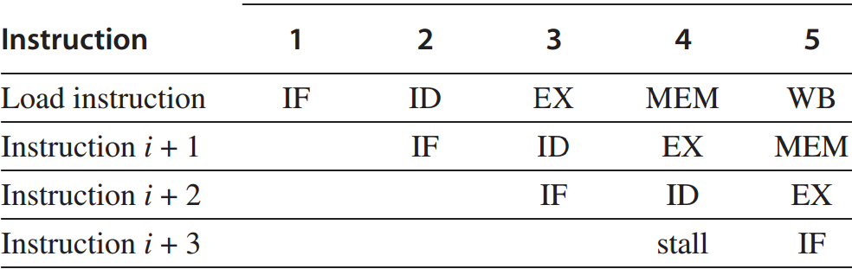
Control Hazard
branches and jumps
Branch hazard
a branch may or may mot change PC to other values other than PC+4;
taken branch: changes PC to its target address;
untaken branch: falls through to PC+4;
PC is not changed till the end of ID;
Notes:
A control hazard happens to branches and jumps. In this lecture, we focus only on branches.
Its main reason is that a branch may or may not change program counter to other values other than PC+4 but the change is available till the end of ID clock cycle.
If a branch instruction changes PC to its target address, it’s called a taken branch. Otherwise, it’s called untaken and falls through directly to the next instruction.

Slide 132
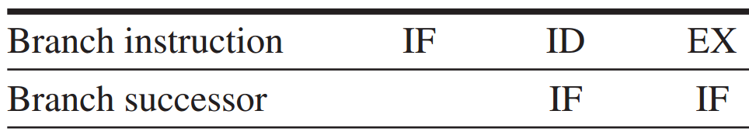
Branch Hazard
Redo IF
If the branch is untaken,
the stall is unnecessary.
essentially a stall
Notes:
Therefore, the IF running in parallel with the branch’s ID clock cycle may fetch a wrong instruction.
A simple solution is to redo IF, which is essentially a stall. However, if the branch is untaken, the stall is absolutely unnecessary.

Slide 133
Branch Hazard
Redo IF
If the branch is untaken,
the stall is unnecessary.
One stall cycle per branch leads to a 10%~30% perf loss.
essentially a stall
Notes:
One stall cycle for every branch will yield a performance loss of 10% to 30% depending on the branch frequency.
So we need to examine some techniques to deal with this loss.

Slide 134
Branch Hazard: Solutions
4 simple compile time schemes – 1
Freeze or flush the pipeline
hold or delete any instructions after the branch till the branch dst is known;
Notes:
There are four more solutions to branch hazard.
The first one is freeze or flush the pipeline. It simply holds or deletes any instruction after the branch till the branch destination is known.
In this case, the branch penalty is fixed and cannot be reduced by software.

Slide 135
Branch Hazard: Solutions
4 simple compile time schemes – 1
Freeze or flush the pipeline
hold or delete any instructions after the branch till the branch dst is known;
fixed penalty regardless of branch effectiveness;
Notes:
There are four more solutions to branch hazard.
The first one is freeze or flush the pipeline. It simply holds or deletes any instruction after the branch till the branch destination is known.
In this case, the branch penalty is fixed and cannot be reduced by software.

Slide 136
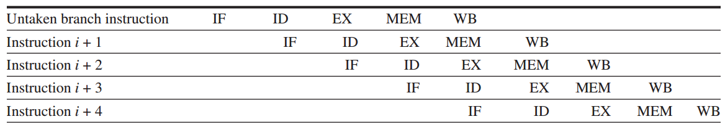
Branch Hazard: Solutions
4 simple compile time schemes – 2
Predicted-untaken / not-taken
simply treat every branch as untaken;
Notes:
The second scheme is predicated-untaken. It simply treats every branch as untaken.
When the branch is really untaken, the pipelining proceeds as if no hazard exists.

Slide 137
Branch Hazard: Solutions
4 simple compile time schemes – 2
Predicted-untaken / not-taken
simply treat every branch as untaken;
when the branch is untaken,
pipelining as if no hazard.
Notes:
The second scheme is predicated-untaken. It simply treats every branch as untaken.
When the branch is really untaken, the pipelining proceeds as if no hazard exists.

Slide 138
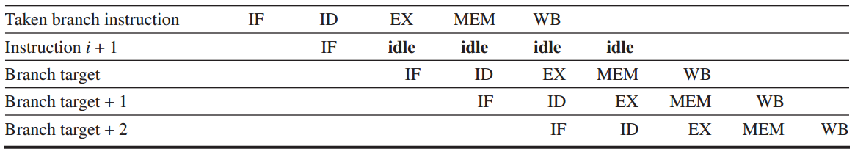
Branch Hazard: Solutions
4 simple compile time schemes – 2
Predicted-untaken
but if the branch is taken:
turn fetched instr into a no-op (idle);
restart the IF at the branch target addr
Notes:
But if the branch is taken, the processor will idle the fetched instruction and continue to process the instruction at the branch target address.

Slide 139
Branch Hazard: Solutions
4 simple compile time schemes – 3
Predicted-taken
simply treat every branch as taken;
what decides its effectiveness?
Notes:
Opposite to predicted-untaken, another scheme is predicted-taken. It simply treats every branch as taken.
It doesn’t apply to the five-stage pipeline, so we don’t cover its details in this lecture.
What decides its effectiveness:
i.e., what behavior of branch decides whether predicted-taken strategy benefits program execution speed?
(at least branch target should be known for early action on branches)

Slide 140
Branch Hazard: Solutions
4 simple compile time schemes – 3
Predicted-taken
simply treat every branch as taken;
not apply to the five-stage pipeline (with branches completed in ID as in 5th ed);
Notes:
Opposite to predicted-untaken, another scheme is predicted-taken. It simply treats every branch as taken.
It doesn’t apply to the five-stage pipeline that completes branch in ID, so we don’t cover its details in this lecture.

Slide 141
Branch Hazard: Solutions
4 simple compile time schemes – 3
Predicted-taken
simply treat every branch as taken;
apply to scenarios when branch target addr is known before branch outcome (e.g., test branch condition in EX – ALU as in 6th ed);
Notes:
Opposite to predicted-untaken, another scheme is predicted-taken. It simply treats every branch as taken.
It doesn’t apply to the five-stage pipeline that completes branch in ID, so we don’t cover its details in this lecture.

Slide 142
Branch Hazard: Solutions
4 simple compile time schemes – 4
Delayed branch
delay the branch execution after the next instruction;
pipelining sequence:
branch instruction
sequential successor
branch target if taken
Branch delay slot
the next instruction
that is independent of
the branch target
executed whether or not the branch is taken
Notes:
The fourth scheme is delayed branch.
It directly delays the branch execution after the next instruction. In other words, it executes the next instruction first whether or not the branch is taken.

Slide 143
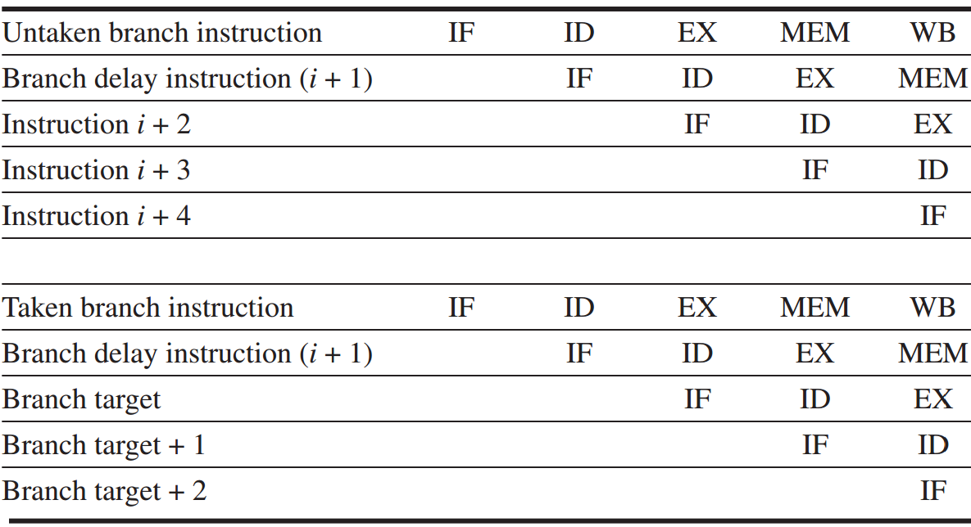
Branch Hazard: Solutions
Delayed branch
Notes:
Here are examples of delaying an untaken branch and a taken branch.
We can see that they have the same pipelining efficiency, because the sequential successor in the branch delay slot is executed whether or not the branch is taken.

Slide 144
how to handle data hazard?
fsub.d is, however, not data-dependent
on either fdiv.d or fadd.d
fdiv.d
fadd.d
fsub.d
f0, f2, f4
f10, f0, f8
f12, f8, f14
Notes:
A simple statically scheduled pipeline fetches an instruction and issues it, unless there is a data dependence between an instruction already in the pipeline and the fetched instruction that cannot be hidden with bypassing or forwarding. (Forward- ing logic reduces the effective pipeline latency so that the certain dependences do not result in hazards.) If there is a data dependence that cannot be hidden, then the hazard detection hardware stalls the pipeline starting with the instruction that uses the result. No new instructions are fetched or issued until the dependence is cleared.
A major limitation of simple pipelining techniques is that they use in-order instruc- tion issue and execution: instructions are issued in program order, and if an instruc- tion is stalled in the pipeline, no later instructions can proceed. Thus, if there is a dependence between two closely spaced instructions in the pipeline, it will lead to a hazard, and a stall will result. If there are multiple functional units, these units could lie idle. If instruction j depends on a long-running instruction i, currently in execution in the pipeline, then all instructions after j must be stalled until i is finished and j can execute. For example, consider this code:
fdiv.d f0,f2,f4
fadd.d f10,f0,f8
fsub.d f12,f8,f14
The fsub.d instruction cannot execute because the dependence of fadd.d on fdiv.d causes the pipeline to stall; yet, fsub.d is not data-dependent on any- thing in the pipeline. This hazard creates a performance limitation that can be elim- inated by not requiring instructions to execute in program order.

Slide 145
break the rule
fsub.d is executed while fadd.d waits for
fdiv.d to produce f0
fdiv.d
fadd.d
fsub.d
f0, f2, f4
f10, f0, f8
f12, f8, f14
Notes:
A simple statically scheduled pipeline fetches an instruction and issues it, unless there is a data dependence between an instruction already in the pipeline and the fetched instruction that cannot be hidden with bypassing or forwarding. (Forward- ing logic reduces the effective pipeline latency so that the certain dependences do not result in hazards.) If there is a data dependence that cannot be hidden, then the hazard detection hardware stalls the pipeline starting with the instruction that uses the result. No new instructions are fetched or issued until the dependence is cleared.
A major limitation of simple pipelining techniques is that they use in-order instruc- tion issue and execution: instructions are issued in program order, and if an instruc- tion is stalled in the pipeline, no later instructions can proceed. Thus, if there is a dependence between two closely spaced instructions in the pipeline, it will lead to a hazard, and a stall will result. If there are multiple functional units, these units could lie idle. If instruction j depends on a long-running instruction i, currently in execution in the pipeline, then all instructions after j must be stalled until i is finished and j can execute. For example, consider this code:
fdiv.d f0,f2,f4
fadd.d f10,f0,f8
fsub.d f12,f8,f14
The fsub.d instruction cannot execute because the dependence of fadd.d on fdiv.d causes the pipeline to stall; yet, fsub.d is not data-dependent on any- thing in the pipeline. This hazard creates a performance limitation that can be elim- inated by not requiring instructions to execute in program order.

Slide 146
dynamic scheduling
hardware reorders the instruction execution
to reduce the stalls while maintaining
data flow and exception behavior
***for dynamic scheduling, please also
review related slides from other classes
Notes:
In this section, we explore dynamic scheduling, a technique by which the hard- ware reorders the instruction execution to reduce the stalls while maintaining data flow and exception behavior.
Dynamic scheduling offers several advantages. First, it allows code that was compiled with one pipeline in mind to run efficiently on a different pipeline, eliminating the need to have multiple binaries and recompile for a different microarchitecture. In today’s computing environment, where much of the software is from third parties and distributed in binary form, this advantage is sig- nificant. Second, it enables handling some cases when dependences are unknown at compile time; for example, they may involve a memory reference or a data- dependent branch, or they may result from a modern programming environment that uses dynamic linking or dispatching. Third, and perhaps most importantly, it allows the processor to tolerate unpredictable delays, such as cache misses, by executing other code while waiting for the miss to resolve.

Slide 147
Dynamic Scheduling
Enable out-of-order execution (and thus out-of-order completion)
Split ID into two stages: Issue: decode instructions, check for structural hazards Read operands: wait until no data hazards, then read operands
IF Issue Read-Operands EX MEM WB

Slide 148
Dynamic Scheduling
Issue from IF: in order
Read operands to EX: out of order when there are sufficient resources and no data dependences
Scheduling policy: upon stalling instr, issue other instructions if they do not depend on any active or stalled instruction

Slide 149
Dynamic Scheduling
Issue from IF: in order
Read operands to EX: out of order when there are sufficient resources and no data dependences
Scheduling policy: upon stalling instr, issue other instructions if they do not depend on any active or stalled instruction
How to schedule: use a centralized hazard detection and resolution unit
Notes:
when the next instruction to execute is stalled, other instructions can be issued and executed if they do not depend on any active or stalled instruction.

Slide 150
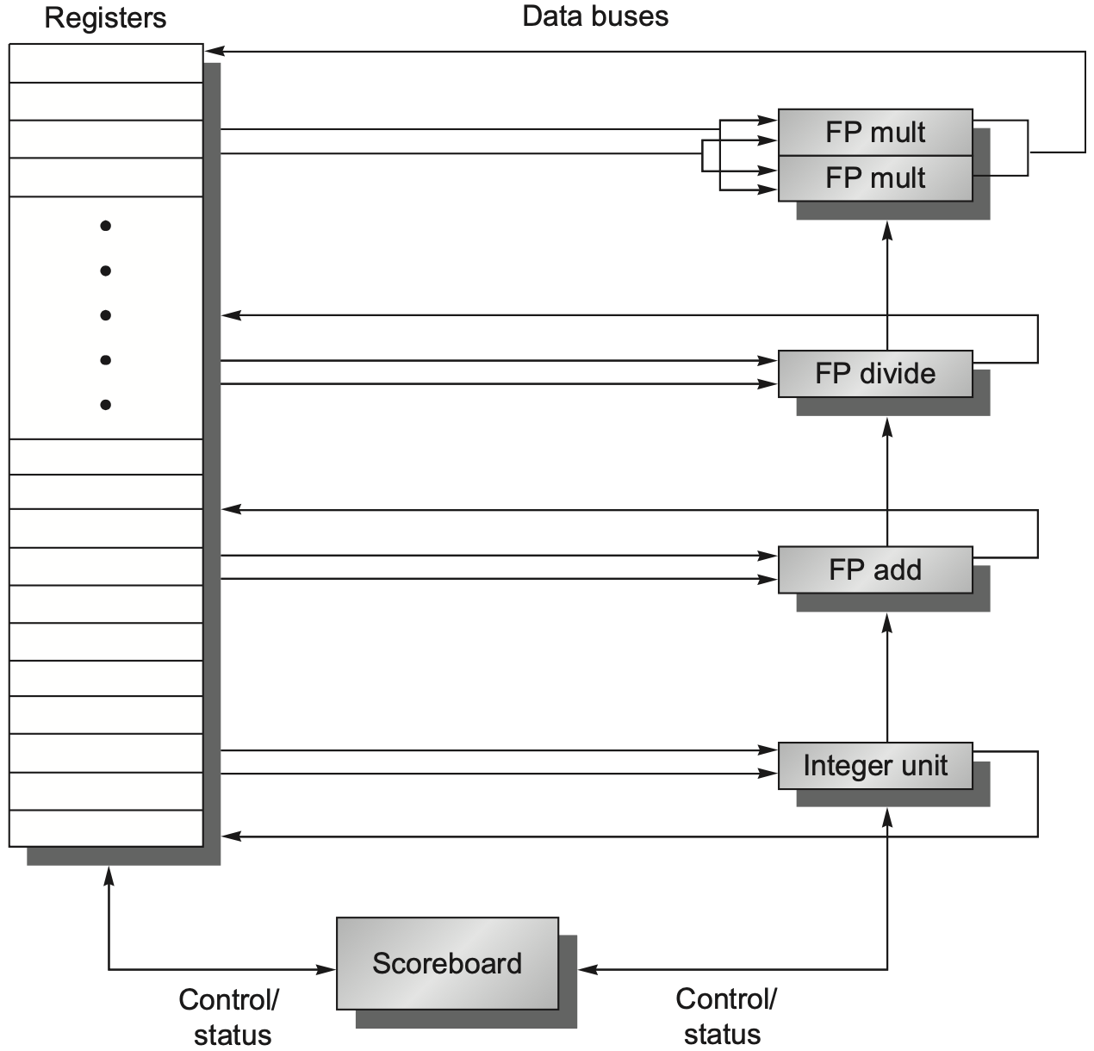
Scoreboarding
Scoreboard controls the instruction progression from one step to the next by communicating with functional units
Three parts: Instruction status Functional unit status Register result status
Notes:
Scoreboard-ing is a technique for allowing instructions to execute out of order when there are sufficient resources and no data dependences; it is named after the CDC 6600 scoreboard, which developed this capability.

Slide 151
Instruction Status
Indicate which of the four steps the instruction is in
Four steps: issue, read operands, execution, write back
Omit memory access because the out-of-order focuses more on FP operations

Slide 152
Instruction Status
Issue If a functional unit for the instruction is free (no structural hazard) and no other active instruction has the same destination register (no WAW hazard), the scoreboard issues the instruction to the functional unit and updates its internal data structure.

Slide 153
Instruction Status
Read operands The scoreboard monitors the availability of the source operands. A source operand is available if no earlier issued active instruction is going to write it. When the source operands are available, the scoreboard tells the functional unit to proceed to read the operands from the registers and begin (ooo) execution.
Notes:
ooo: out of order

Slide 154
Instruction Status
Execution The functional unit begins execution upon receiving operands. When the result is ready, it notifies the scoreboard that it has completed execution.
Notes:
ooo: out of order

Slide 155
Instruction Status
Write result Once the scoreboard is aware that the functional unit has completed execution, the scoreboard checks for WAR hazards and stalls the completing instruction, if necessary.
Notes:
ooo: out of order

Slide 156
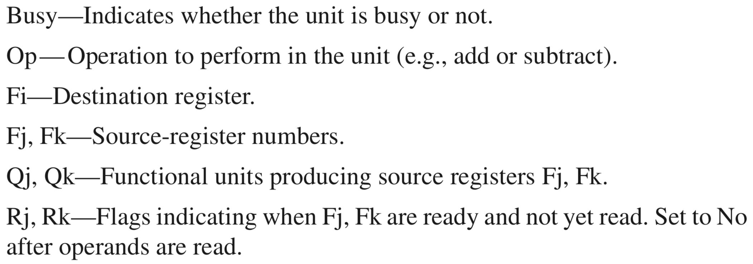
Functional Unit Status
Indicate the state of the functional unit
Nine fields per functional unit (FU)
Notes:
Rj, Rk: how to set if Not Ready?

Slide 157
Register Result Status
Indicate which functional unit will write each register, if an active instruction has the register as its destination
Set to blank whenever no pending instructions will wirte that register

Slide 158
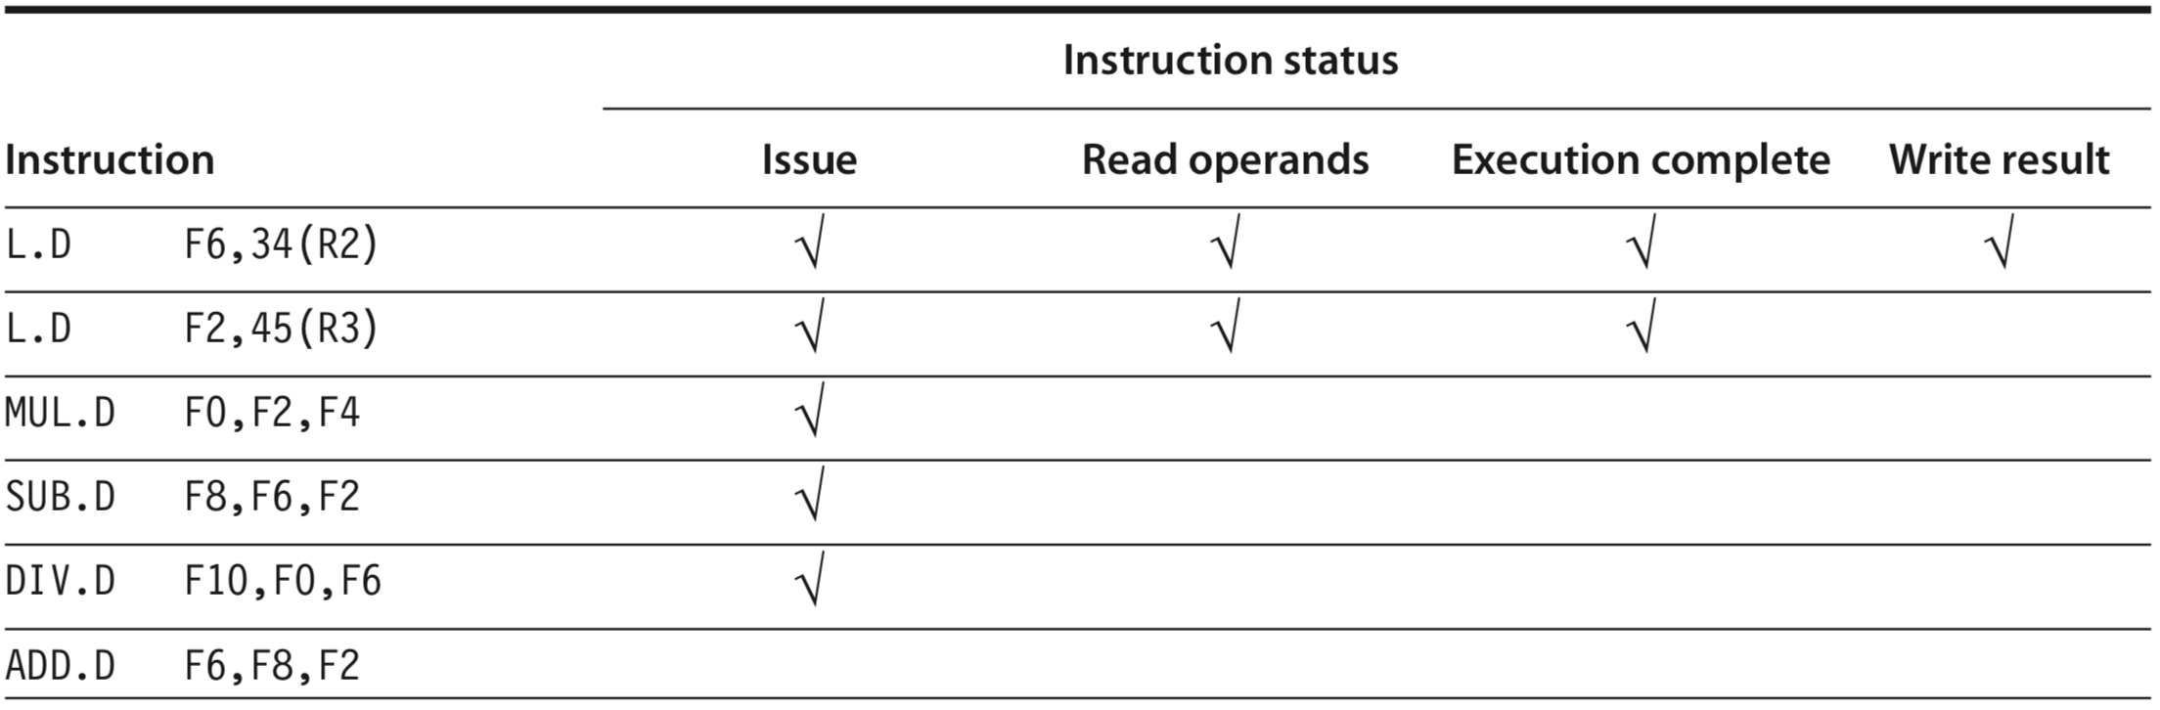
Scoreboard Example
all instructions
in scoreboard
stalled due to structural hazard with SUB.D
2nd L.D is ready to write result
Notes:
5th edition, C.7
MUL.D depends on L.D for F2, so upon L.D completes preparing F2, MUL.D is yet to read it, so its Read Operands stantus is not ready
Components of the scoreboard. Each instruction that has issued or is pending issue has an entry in the instruction status table.
The instruction status table says that: (1) the first L.D has completed and written its result, and (2) the second L.D has completed execution but has not yet written its result. The MUL.D, SUB.D, and DIV.D have all issued but are stalled, waiting for their operands.
The ADD.D instruc- tion is stalled because of a structural hazard; it will clear when the SUB.D completes. If an entry in one of these score- board tables is not being used, it is left blank. For example, the Rk field is not used on a load and the Mult2 unit is unused, hence their fields have no meaning. Also, once an operand has been read, the Rj and Rk fields are set to No. Figure C.58 shows why this last step is crucial.

Slide 159
Scoreboard Example
wait for F2
wait for F2
wait for F0
stalled due to structural hazard with SUB.D
2nd L.D is ready to write result
Notes:
5th edition, C.7
MUL.D depends on L.D for F2, so upon L.D completes preparing F2, MUL.D is yet to read it, so its Read Operands stantus is not ready
Components of the scoreboard. Each instruction that has issued or is pending issue has an entry in the instruction status table. There is one entry in the functional unit status table for each functional unit. Once an instruction issues, the record of its operands is kept in the functional unit status table. Finally, the register result table indicates which unit will produce each pending result; the number of entries is equal to the number of registers. The instruction status table says that: (1) the first L.D has completed and written its result, and (2) the second L.D has completed execution but has not yet written its result. The MUL.D, SUB.D, and DIV.D have all issued but are stalled, waiting for their operands.

Slide 160
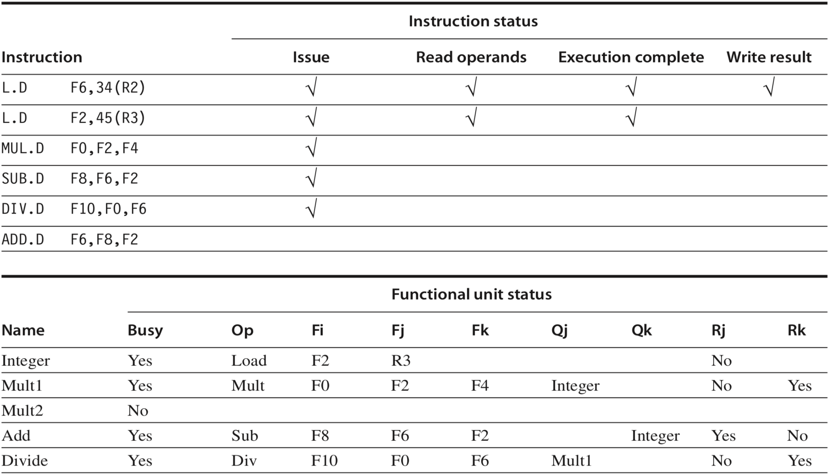
Scoreboard Example
Notes:
Indicate the state of the functional unit
Nine fields per functional unit (FU)
Busy—Indicates whether the unit is busy or not.
Op — Operation to perform in the unit (e.g., add or subtract).
Fi—Destination register.
Fj, Fk—Source-register numbers.
Qj, Qk—Functional units producing source registers Fj, Fk.
Rj, Rk—Flags indicating when Fj, Fk are ready and not yet read. Set to No after operands are read.
There is one entry in the functional unit status table for each functional unit. Once an instruction issues, the record of its operands is kept in the functional unit status table.
The functional unit status says that the first multiply unit is waiting for the integer unit, the add unit is waiting for the integer unit, and the divide unit is waiting for the first multiply unit.

Slide 161
Scoreboard Example

Slide 162
Scoreboard Example
dest
s1
s2
s1-src
s2-src

Slide 163
Scoreboard Example
dest
s1
s2
s1-src
s2-src
F2 from 2nd L.D

Slide 164
Scoreboard Example
dest
s1
s2
s1-src
s2-src
F2 from 2nd L.D

Slide 165
Scoreboard Example
dest
s1
s2
s1-src
s2-src
F0 from MUL.D

Slide 166
Scoreboard Example
dest
s1
s2
s1-src
s2-src
these No’s for ops Not Ready?
F0 from MUL.D

Slide 167
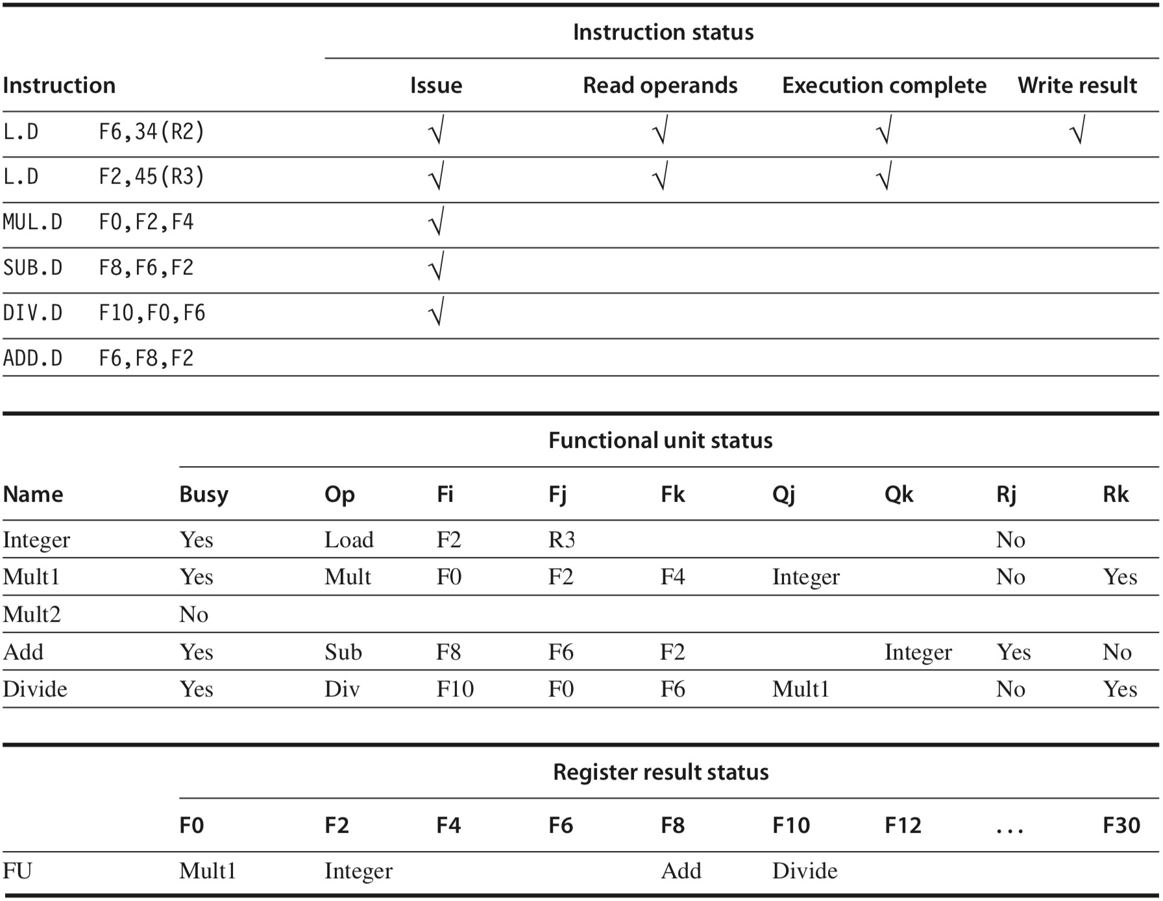
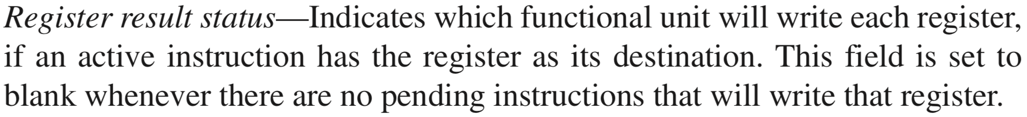
Scoreboard Example
check destination registers
Notes:
Finally, the register result table indicates which unit will produce each pending result; the number of entries is equal to the number of registers.

Slide 168
Scoreboard Example
check corresponding functional units
check destination registers

Slide 169
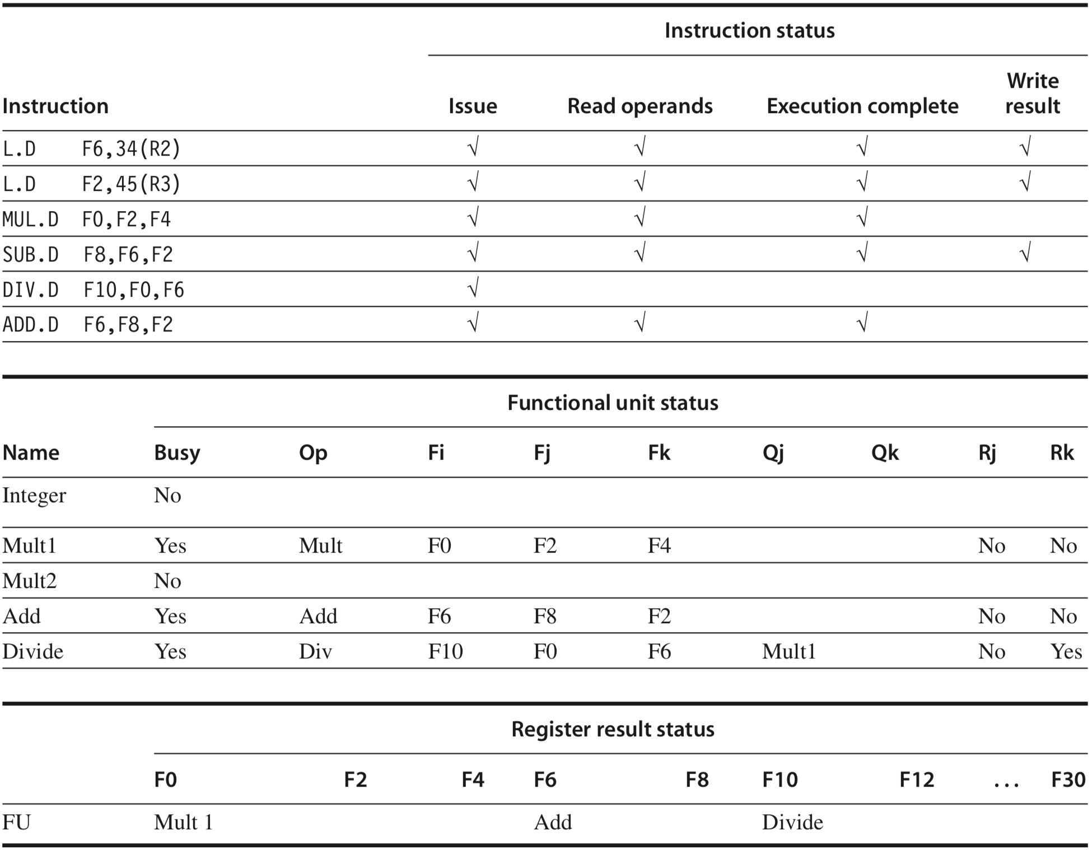
Scoreboard Example
MUL.D is ready to write result
dest
s1
s2
s1-src
s2-src
Notes:
SUB.D has also completed to release the Adder functional unit for ADD.D to use.
The ADD.D has read its operands and is in execution, although it was forced to wait until the SUB.D finished to get the functional unit. ADD.D cannot proceed to write result because of the WAR hazard on F6, which is used by the DIV.D.
Scoreboard tables just before the MUL.D goes to write result. The DIV.D has not yet read either of its operands, since it has a dependence on the result of the multiply. The ADD.D has read its operands and is in execu- tion, although it was forced to wait until the SUB.D finished to get the functional unit. ADD.D cannot proceed to write result because of the WAR hazard on F6, which is used by the DIV.D. The Q fields are only relevant when a functional unit is waiting for another unit.

Slide 170
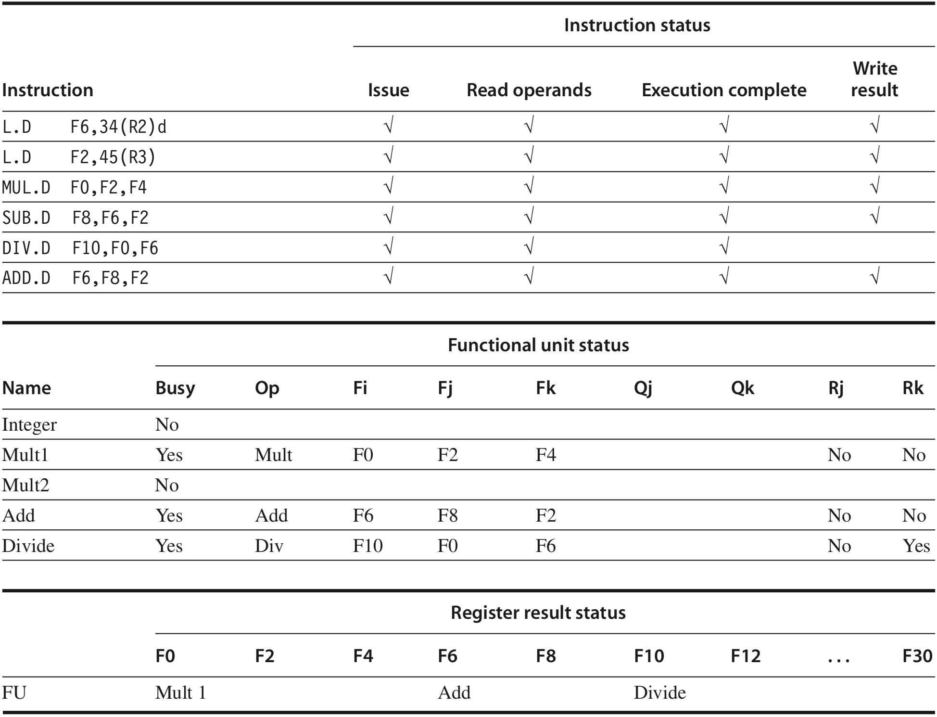
Scoreboard Example
DIV.D is ready to write result
dest
s1
s2
s1-src
s2-src
F6 already read?
Notes:
ADD.D was able to complete as soon as DIV.D passed through read operands and got a copy of F6. Only the DIV.D remains to finish.
Figure C.57 Scoreboard tables just before the DIV.D goes to write result. ADD.D was able to complete as soon as DIV.D passed through read operands and got a copy of F6. Only the DIV.D remains to finish.

Slide 171
Tomasulo’s Algorithm
Two major advantages over scoreboard:
Distribution of hazard detection logic across load/store buffers and reservation stations
Elimination of stalls for WAW and WAR hazards through
Register Renaming

Slide 172
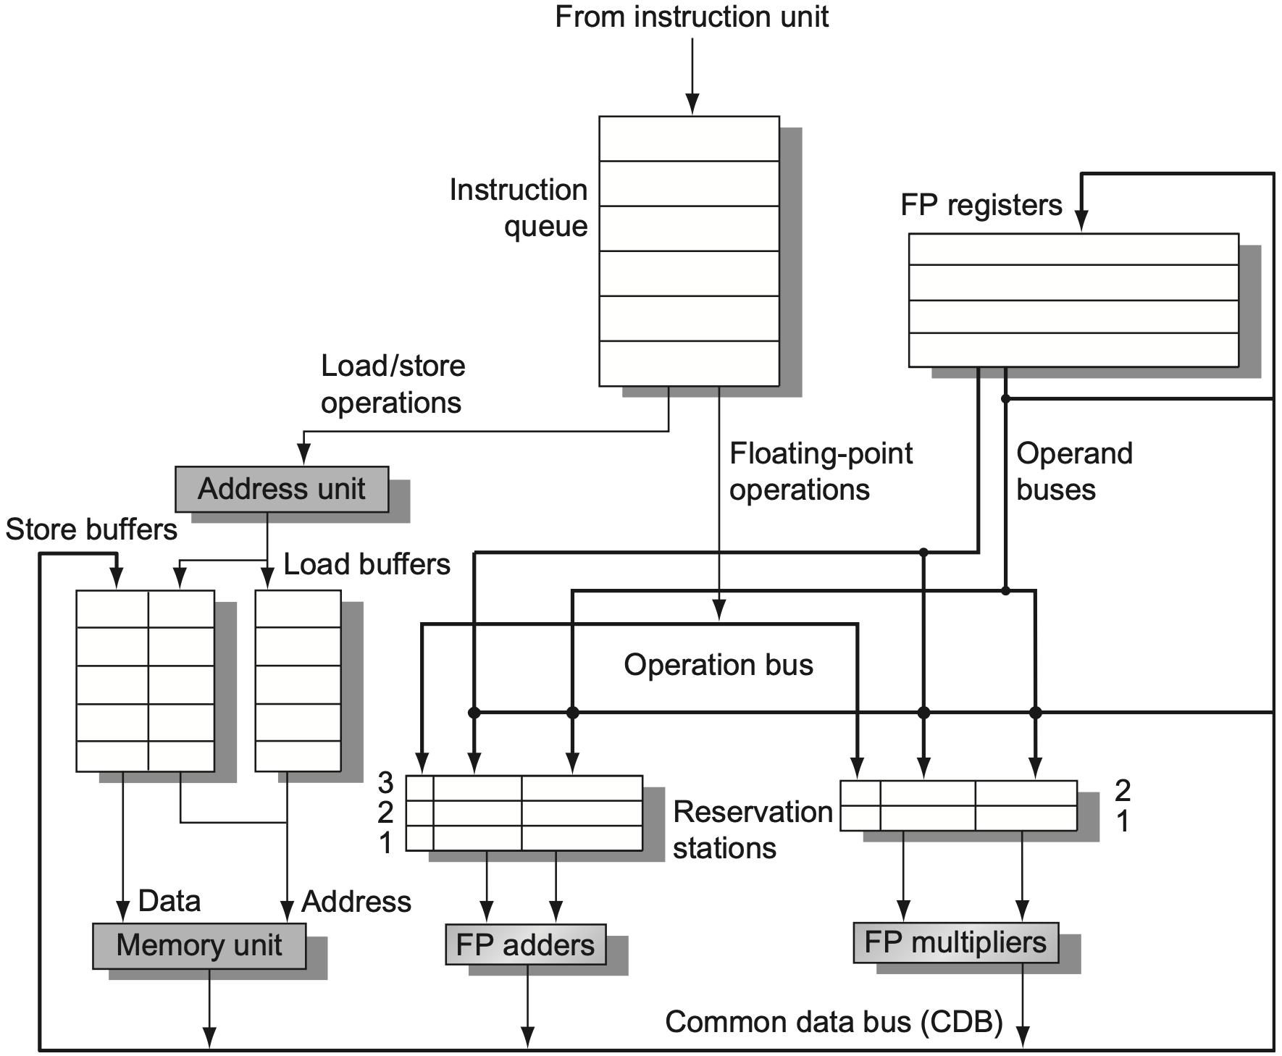
Tomasulo’s Algorithm
Notes:
Figure 3.10 The basic structure of a RISC-V floating-point unit using Tomasulo’s algorithm. Instructions are sent from the instruction unit into the instruction queue from which they are issued in first-in, first-out (FIFO) order. The reservation stations include the operation and the actual operands, as well as information used for detecting and resolving hazards. Load buffers have three functions: (1) hold the components of the effective address until it is com- puted, (2) track outstanding loads that are waiting on the memory, and (3) hold the results of completed loads that are waiting for the CDB. Similarly, store buffers have three functions: (1) hold the components of the effective address until it is computed, (2) hold the destination memory addresses of outstanding stores that are waiting for the data value to store, and (3) hold the address and value to store until the memory unit is available. All results from either the FP units or the load unit are put on the CDB, which goes to the FP register file as well as to the reservation stations and store buffers. The FP adders implement addition and subtraction, and the FP multipliers do multiplication and division.

Slide 173
queue fetched instructions;
issue an instruction if no structural hazard;

Slide 174
queue fetched instructions;
issue an instruction if no structural hazard;

Slide 175
hold effective address related info;
track outstanding loads that are waiting on mem;
hold results of completed loads that are waiting for CDB (common data bus, broadcast);
Notes:
Load buffers have three functions:
hold the components of the effective address until it is computed,
track outstanding loads that are waiting on the memory, and
hold the results of completed loads that are waiting for the CDB.

Slide 176
hold effective address related info;
hold dest mem addr of outstanding stores that are waiting for data value to store;
hold address and value to store until memory is available;
Notes:
Similarly, store buffers have three functions:
hold the components of the effective address until it is computed,
hold the destination memory addresses of outstanding stores that are waiting for the data value to store, and
hold the address and value to store until the memory unit is available.

Slide 177
hold operation info;
hold actual operands;
hold info for detecting and resolving hazards;
Notes:
The reservation stations include the operation and the actual operands, as well as information used for detecting and resolving hazards.

Slide 178
execute upon FP units and operands are available;
get actual operands from reservation stations (instead of registers);
Notes:
The FP adders implement addition and subtraction, and
the FP multipliers do multiplication and division.

Slide 179
load upon memory and address are available;
store upon memory, data, address are available;
Notes:
Similarly, for load/store

Slide 180
for all load/store and FP operations

Slide 181
for all load/store and FP operations
results are put on CDB, which broadcasts results to FP registers, reservation stations, store buffers
Notes:
All results from either the FP units or the load unit are put on the CDB, which goes to the FP register file as well as to the reservation stations and store buffers.

Slide 182
Register Renaming
Eliminate WAW and WAR hazards
Rename related destination registers, including those with a pending read or write for an earlier instruction
Enable out-of-order write that does not affect any instructions depending on an earlier value of an operand
Notes:
RAW hazards are avoided by executing an instruction only when its operands are available, which is exactly what the simpler scoreboarding approach provides.
WAR and WAW hazards, which arise from name dependences, are eliminated by register renaming. Register renaming eliminates these hazards by renaming all destination registers, including those with a pending read or write for an earlier instruction, so that the out-of-order write does not affect any instructions that depend on an earlier value of an operand.

Slide 183
Register Renaming
f0, f2, f4
f6, f0, f8
f6, 0(x1)
f8, f10, f14
f6, f10, f8
Example code sequence
fdiv.d
fadd.d
fsd
fsub.d
fmul.d

Slide 184
RAW Hazard
f0, f2, f4
f6, f0, f8
f6, 0(x1)
f8, f10, f14
f6, f10, f8
Example code sequence
fdiv.d
fadd.d
fsd
fsub.d
fmul.d

Slide 185
RAW Hazard
f0, f2, f4
f6, f0, f8
f6, 0(x1)
f8, f10, f14
f6, f10, f8
Example code sequence
Execute an instruction only when its operands are available
fdiv.d
fadd.d
fsd
fsub.d
fmul.d

Slide 186
WAR Hazard
f0, f2, f4
f6, f0, f8
f6, 0(x1)
f8, f10, f14
f6, f10, f8
Example code sequence
fdiv.d
fadd.d
fsd
fsub.d
fmul.d

Slide 187
WAW Hazard
f0, f2, f4
f6, f0, f8
f6, 0(x1)
f8, f10, f14
f6, f10, f8
Example code sequence
fdiv.d
fadd.d
fsd
fsub.d
fmul.d

Slide 188
WAR/WAW Hazard
f0, f2, f4
f6, f0, f8
f6, 0(x1)
f8, f10, f14
f6, f10, f8
Example code sequence
fdiv.d
fadd.d
fsd
fsub.d
fmul.d

Slide 189
how to rename registers?

Slide 190
how to rename registers?
an extended set of physical registers is used to hold both the architecturally visible
registers (x0,…x31 and f0,…f31) as well as temporary values;
Notes:
Part of Chapter 3.9 on Page 234

Slide 191
how to rename registers?
if a given physical register does not appear as a source and it is not designated as arch,
alternatively, another instruction that writes the same architectural reg commits,
it may be reclaimed and reallocated;
Notes:
With register renaming, deallocating registers is more complex, since before we free up a physical register, we must know that it no longer corresponds to an architectural register and that no further uses of the physical register are outstand- ing. A physical register corresponds to an architectural register until the architec- tural register is rewritten, causing the renaming table to point elsewhere. That is, if no renaming entry points to a particular physical register, then it no longer cor- responds to an architectural register. There may, however, still be uses of the physical register outstanding. The processor can determine whether this is the case by examining the source register specifiers of all instructions in the func- tional unit queues. If a given physical register does not appear as a source and it is not designated as an architectural register, it may be reclaimed and reallocated.
Alternatively, the processor can simply wait until another instruction that writes the same architectural register commits. At that point, there can be no fur- ther uses of the older value outstanding. Although this method may tie up a phys- ical register slightly longer than necessary, it is easy to implement and is used in most recent superscalars.

Slide 192
WAR/WAW Hazard
f0, f2, f4
f6, f0, f8
f6, 0(x1)
f8, f10, f14
f6, f10, f8
Example code sequence
WAR: rename latter/destination
WAW: rename former
fdiv.d
fadd.d
fsd
fsub.d
fmul.d
guarantee program order
Notes:
Toward out-of-order execution
That is, if WAR/WAW is not addressed via register renaming, fsub.d that writes to f8 cannot be executed prior to fadd.d that reads from f8, as such rearrangement violates program order, albeit it does not have to be;
So, after renaming the latter fsub.d with f8 as detination, say T in the next slide, fsub.d can be execution anytime right after both values in f10 and f14 are ready, regardless of whether fadd.d has already read out of the value from f8.

Slide 193
WAR/WAW Hazard
f0, f2, f4
f6, f0, f8
f6, 0(x1)
f8, f10, f14
f6, f10, f8
Example code sequence
WAR: rename latter/destination
WAW: rename former
after rename dest, rename later source
fdiv.d
fadd.d
fsd
fsub.d
fmul.d
guarantee program order

Slide 194
WAR/WAW Hazard
f0, f2, f4
f6, f0, f8
f6, 0(x1)
T, f10, f14
f6, f10, T
Example code sequence
WAR: rename latter/destination
WAW: rename former
after rename dest, rename later source
fdiv.d
fadd.d
fsd
fsub.d
fmul.d
guarantee program order

Slide 195
WAR/WAW Hazard
f0, f2, f4
S, f0, f8
S, 0(x1)
T, f10, f14
f6, f10, T
Example code sequence
WAR: rename latter/destination
WAW: rename former
after rename dest, rename later source
fdiv.d
fadd.d
fsd
fsub.d
fmul.d
guarantee program order

Slide 196
WAR/WAW Hazard
f0, f2, f4
S, f0, f8
S, 0(x1)
T, f10, f14
f6, f10, T
Example code sequence
WAR: rename latter/destination
WAW: rename former
after rename dest, rename later source
fdiv.d
fadd.d
fsd
fsub.d
fmul.d
guarantee program order

Slide 197
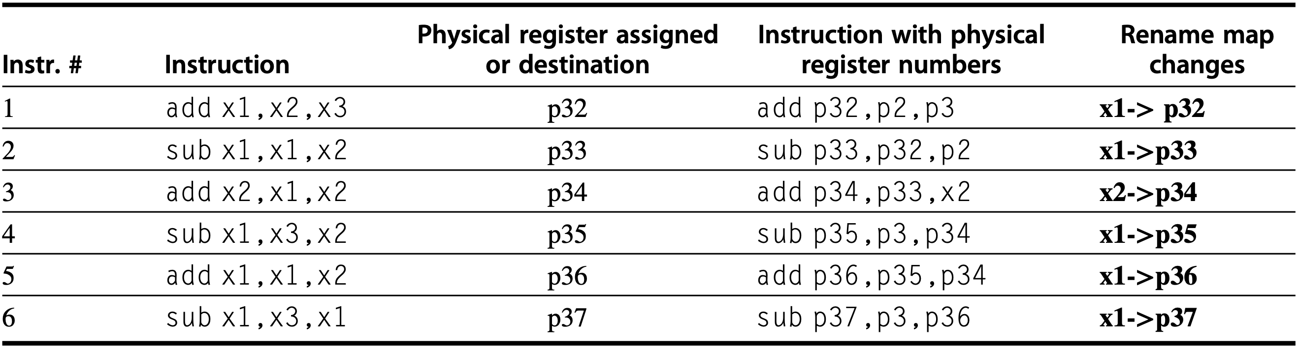
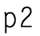
Register Renaming
Example: six-instruction code sequence
Architectural registers x1, x2, and x3 are initially held by physical registers p1, p2, and p3, respectively
Notes:
Figure 3.29 An example of six instructions to be issued in the same clock cycle and what has to happen. The instructions are shown in program order: 1–6; they are, however, issued in 1 clock cycle! The notation pi is used to refer to a physical register; the contents of that register at any point is determined by the renaming map. For sim- plicity, we assume that the physical registers holding the architectural registers x1, x2, and x3 are initially p1, p2, and p3 (they could be any physical register). The instructions are issued with physical register numbers, as shown in column four. The rename map, which appears in the last column, shows how the map would change if the instruc- tions were issued sequentially. The difficulty is that all this renaming and replacement of architectural registers by physical renaming registers happens effectively in 1 cycle, not sequentially. The issue logic must find all the depen- dences and “rewrite” the instruction in parallel.

Slide 198
Register Renaming
Example: six-instruction code sequence
Architectural registers x1, x2, and x3 are initially held by physical registers p1, p2, and p3, respectively
Notes:
Figure 3.29 An example of six instructions to be issued in the same clock cycle and what has to happen. The instructions are shown in program order: 1–6; they are, however, issued in 1 clock cycle! The notation pi is used to refer to a physical register; the contents of that register at any point is determined by the renaming map. For sim- plicity, we assume that the physical registers holding the architectural registers x1, x2, and x3 are initially p1, p2, and p3 (they could be any physical register). The instructions are issued with physical register numbers, as shown in column four. The rename map, which appears in the last column, shows how the map would change if the instruc- tions were issued sequentially. The difficulty is that all this renaming and replacement of architectural registers by physical renaming registers happens effectively in 1 cycle, not sequentially. The issue logic must find all the depen- dences and “rewrite” the instruction in parallel.

Slide 199
Register Renaming
Example: six-instruction code sequence
Architectural registers x1, x2, and x3 are initially held by physical registers p1, p2, and p3, respectively
Notes:
Figure 3.29 An example of six instructions to be issued in the same clock cycle and what has to happen. The instructions are shown in program order: 1–6; they are, however, issued in 1 clock cycle! The notation pi is used to refer to a physical register; the contents of that register at any point is determined by the renaming map. For sim- plicity, we assume that the physical registers holding the architectural registers x1, x2, and x3 are initially p1, p2, and p3 (they could be any physical register). The instructions are issued with physical register numbers, as shown in column four. The rename map, which appears in the last column, shows how the map would change if the instruc- tions were issued sequentially. The difficulty is that all this renaming and replacement of architectural registers by physical renaming registers happens effectively in 1 cycle, not sequentially. The issue logic must find all the depen- dences and “rewrite” the instruction in parallel.

Slide 200
Register Renaming
Example: six-instruction code sequence
Architectural registers x1, x2, and x3 are initially held by physical registers p1, p2, and p3, respectively
Notes:
Figure 3.29 An example of six instructions to be issued in the same clock cycle and what has to happen. The instructions are shown in program order: 1–6; they are, however, issued in 1 clock cycle! The notation pi is used to refer to a physical register; the contents of that register at any point is determined by the renaming map. For sim- plicity, we assume that the physical registers holding the architectural registers x1, x2, and x3 are initially p1, p2, and p3 (they could be any physical register). The instructions are issued with physical register numbers, as shown in column four. The rename map, which appears in the last column, shows how the map would change if the instruc- tions were issued sequentially. The difficulty is that all this renaming and replacement of architectural registers by physical renaming registers happens effectively in 1 cycle, not sequentially. The issue logic must find all the depen- dences and “rewrite” the instruction in parallel.

Slide 201
Register Renaming
Example: six-instruction code sequence
Architectural registers x1, x2, and x3 are initially held by physical registers p1, p2, and p3, respectively
Notes:
Figure 3.29 An example of six instructions to be issued in the same clock cycle and what has to happen. The instructions are shown in program order: 1–6; they are, however, issued in 1 clock cycle! The notation pi is used to refer to a physical register; the contents of that register at any point is determined by the renaming map. For sim- plicity, we assume that the physical registers holding the architectural registers x1, x2, and x3 are initially p1, p2, and p3 (they could be any physical register). The instructions are issued with physical register numbers, as shown in column four. The rename map, which appears in the last column, shows how the map would change if the instruc- tions were issued sequentially. The difficulty is that all this renaming and replacement of architectural registers by physical renaming registers happens effectively in 1 cycle, not sequentially. The issue logic must find all the depen- dences and “rewrite” the instruction in parallel.

Slide 202
Register Renaming
More examples:
add
sub
xor
mul
add
x1, x2, x3
x4, x1, x5
x6, x7, x8
x5, x8, x9
x4, x8, x9
Notes:
Figure 3.29 An example of six instructions to be issued in the same clock cycle and what has to happen. The instructions are shown in program order: 1–6; they are, however, issued in 1 clock cycle! The notation pi is used to refer to a physical register; the contents of that register at any point is determined by the renaming map. For sim- plicity, we assume that the physical registers holding the architectural registers x1, x2, and x3 are initially p1, p2, and p3 (they could be any physical register). The instructions are issued with physical register numbers, as shown in column four. The rename map, which appears in the last column, shows how the map would change if the instruc- tions were issued sequentially. The difficulty is that all this renaming and replacement of architectural registers by physical renaming registers happens effectively in 1 cycle, not sequentially. The issue logic must find all the depen- dences and “rewrite” the instruction in parallel.

Slide 203
Register Renaming
More examples:
add
sub
xor
mul
add
x1, x2, x3
x4, x1, x5
x6, x7, x8
x5, x8, x9
x4, x8, x9
add
sub
xor
mul
add
p1, x2, x3
p2, p1, x5
p3, x7, x8
p4, x8, x9
p5, x8, x9
Notes:
Figure 3.29 An example of six instructions to be issued in the same clock cycle and what has to happen. The instructions are shown in program order: 1–6; they are, however, issued in 1 clock cycle! The notation pi is used to refer to a physical register; the contents of that register at any point is determined by the renaming map. For sim- plicity, we assume that the physical registers holding the architectural registers x1, x2, and x3 are initially p1, p2, and p3 (they could be any physical register). The instructions are issued with physical register numbers, as shown in column four. The rename map, which appears in the last column, shows how the map would change if the instruc- tions were issued sequentially. The difficulty is that all this renaming and replacement of architectural registers by physical renaming registers happens effectively in 1 cycle, not sequentially. The issue logic must find all the depen- dences and “rewrite” the instruction in parallel.

Slide 204
Register Renaming
More examples:
add
sub
xor
mul
add
x1, x2, x3
x4, x1, x5
x6, x7, x8
x5, x8, x9
x4, x8, x9
add
sub
xor
mul
add
p1, x2, x3
p2, p1, x5
p3, x7, x8
p4, x8, x9
p5, x8, x9
follow default allocation
Notes:
Figure 3.29 An example of six instructions to be issued in the same clock cycle and what has to happen. The instructions are shown in program order: 1–6; they are, however, issued in 1 clock cycle! The notation pi is used to refer to a physical register; the contents of that register at any point is determined by the renaming map. For sim- plicity, we assume that the physical registers holding the architectural registers x1, x2, and x3 are initially p1, p2, and p3 (they could be any physical register). The instructions are issued with physical register numbers, as shown in column four. The rename map, which appears in the last column, shows how the map would change if the instruc- tions were issued sequentially. The difficulty is that all this renaming and replacement of architectural registers by physical renaming registers happens effectively in 1 cycle, not sequentially. The issue logic must find all the depen- dences and “rewrite” the instruction in parallel.

Slide 205
Register Renaming
More examples:
add
sub
xor
mul
add
x1, x2, x3
x4, x1, x5
x6, x7, x8
x5, x8, x9
x4, x8, x9
add
sub
xor
mul
add
p1, p12, p13
p2, p1, p15
p3, p17, p18
p4, p18, p19
p5, p18, p19
follow default allocation
Notes:
Figure 3.29 An example of six instructions to be issued in the same clock cycle and what has to happen. The instructions are shown in program order: 1–6; they are, however, issued in 1 clock cycle! The notation pi is used to refer to a physical register; the contents of that register at any point is determined by the renaming map. For sim- plicity, we assume that the physical registers holding the architectural registers x1, x2, and x3 are initially p1, p2, and p3 (they could be any physical register). The instructions are issued with physical register numbers, as shown in column four. The rename map, which appears in the last column, shows how the map would change if the instruc- tions were issued sequentially. The difficulty is that all this renaming and replacement of architectural registers by physical renaming registers happens effectively in 1 cycle, not sequentially. The issue logic must find all the depen- dences and “rewrite” the instruction in parallel.

Slide 206
Register Renaming
More examples:
mul
add
mul
add
mul
add
x2, x2, x2
x1, x1, x2
x2, x4, x4
x3, x3, x2
x2, x6, x6
x5, x5, x2
Notes:
Figure 3.29 An example of six instructions to be issued in the same clock cycle and what has to happen. The instructions are shown in program order: 1–6; they are, however, issued in 1 clock cycle! The notation pi is used to refer to a physical register; the contents of that register at any point is determined by the renaming map. For sim- plicity, we assume that the physical registers holding the architectural registers x1, x2, and x3 are initially p1, p2, and p3 (they could be any physical register). The instructions are issued with physical register numbers, as shown in column four. The rename map, which appears in the last column, shows how the map would change if the instruc- tions were issued sequentially. The difficulty is that all this renaming and replacement of architectural registers by physical renaming registers happens effectively in 1 cycle, not sequentially. The issue logic must find all the depen- dences and “rewrite” the instruction in parallel.

Slide 207
Register Renaming
More examples:
mul
add
mul
add
mul
add
x2, x2, x2
x1, x1, x2
x2, x4, x4
x3, x3, x2
x2, x6, x6
x5, x5, x2
x1 | x2 | x3 | x4 | x5 | x6
p1 | p2 | p3 | p4 | p5 | p6
Notes:
Figure 3.29 An example of six instructions to be issued in the same clock cycle and what has to happen. The instructions are shown in program order: 1–6; they are, however, issued in 1 clock cycle! The notation pi is used to refer to a physical register; the contents of that register at any point is determined by the renaming map. For sim- plicity, we assume that the physical registers holding the architectural registers x1, x2, and x3 are initially p1, p2, and p3 (they could be any physical register). The instructions are issued with physical register numbers, as shown in column four. The rename map, which appears in the last column, shows how the map would change if the instruc- tions were issued sequentially. The difficulty is that all this renaming and replacement of architectural registers by physical renaming registers happens effectively in 1 cycle, not sequentially. The issue logic must find all the depen- dences and “rewrite” the instruction in parallel.

Slide 208
Register Renaming
More examples:
mul
add
mul
add
mul
add
x2, x2, x2
x1, x1, x2
x2, x4, x4
x3, x3, x2
x2, x6, x6
x5, x5, x2
mul
p7, p2, p2
x1 | x2 | x3 | x4 | x5 | x6
p1 | p7 | p3 | p4 | p5 | p6
Notes:
Figure 3.29 An example of six instructions to be issued in the same clock cycle and what has to happen. The instructions are shown in program order: 1–6; they are, however, issued in 1 clock cycle! The notation pi is used to refer to a physical register; the contents of that register at any point is determined by the renaming map. For sim- plicity, we assume that the physical registers holding the architectural registers x1, x2, and x3 are initially p1, p2, and p3 (they could be any physical register). The instructions are issued with physical register numbers, as shown in column four. The rename map, which appears in the last column, shows how the map would change if the instruc- tions were issued sequentially. The difficulty is that all this renaming and replacement of architectural registers by physical renaming registers happens effectively in 1 cycle, not sequentially. The issue logic must find all the depen- dences and “rewrite” the instruction in parallel.

Slide 209
Register Renaming
More examples:
mul
add
mul
add
mul
add
x2, x2, x2
x1, x1, x2
x2, x4, x4
x3, x3, x2
x2, x6, x6
x5, x5, x2
mul
add
p7, p2, p2
p8, p1, p7
x1 | x2 | x3 | x4 | x5 | x6
p8 | p7 | p3 | p4 | p5 | p6
Notes:
Figure 3.29 An example of six instructions to be issued in the same clock cycle and what has to happen. The instructions are shown in program order: 1–6; they are, however, issued in 1 clock cycle! The notation pi is used to refer to a physical register; the contents of that register at any point is determined by the renaming map. For sim- plicity, we assume that the physical registers holding the architectural registers x1, x2, and x3 are initially p1, p2, and p3 (they could be any physical register). The instructions are issued with physical register numbers, as shown in column four. The rename map, which appears in the last column, shows how the map would change if the instruc- tions were issued sequentially. The difficulty is that all this renaming and replacement of architectural registers by physical renaming registers happens effectively in 1 cycle, not sequentially. The issue logic must find all the depen- dences and “rewrite” the instruction in parallel.

Slide 210
Register Renaming
More examples:
mul
add
mul
add
mul
add
x2, x2, x2
x1, x1, x2
x2, x4, x4
x3, x3, x2
x2, x6, x6
x5, x5, x2
mul
add
mul
p7, p2, p2
p8, p1, p7
p9, p4, p4
x1 | x2 | x3 | x4 | x5 | x6
p8 | p7→p9 | p3 | p4 | p5 | p6
Notes:
Figure 3.29 An example of six instructions to be issued in the same clock cycle and what has to happen. The instructions are shown in program order: 1–6; they are, however, issued in 1 clock cycle! The notation pi is used to refer to a physical register; the contents of that register at any point is determined by the renaming map. For sim- plicity, we assume that the physical registers holding the architectural registers x1, x2, and x3 are initially p1, p2, and p3 (they could be any physical register). The instructions are issued with physical register numbers, as shown in column four. The rename map, which appears in the last column, shows how the map would change if the instruc- tions were issued sequentially. The difficulty is that all this renaming and replacement of architectural registers by physical renaming registers happens effectively in 1 cycle, not sequentially. The issue logic must find all the depen- dences and “rewrite” the instruction in parallel.

Slide 211
Register Renaming
More examples:
mul
add
mul
add
mul
add
x2, x2, x2
x1, x1, x2
x2, x4, x4
x3, x3, x2
x2, x6, x6
x5, x5, x2
mul
add
mul
add
p7, p2, p2
p8, p1, p7
p9, p4, p4
p10, p3, p9
x1 | x2 | x3 | x4 | x5 | x6
p8 | p9 | p10 | p4 | p5 | p6
Notes:
Figure 3.29 An example of six instructions to be issued in the same clock cycle and what has to happen. The instructions are shown in program order: 1–6; they are, however, issued in 1 clock cycle! The notation pi is used to refer to a physical register; the contents of that register at any point is determined by the renaming map. For sim- plicity, we assume that the physical registers holding the architectural registers x1, x2, and x3 are initially p1, p2, and p3 (they could be any physical register). The instructions are issued with physical register numbers, as shown in column four. The rename map, which appears in the last column, shows how the map would change if the instruc- tions were issued sequentially. The difficulty is that all this renaming and replacement of architectural registers by physical renaming registers happens effectively in 1 cycle, not sequentially. The issue logic must find all the depen- dences and “rewrite” the instruction in parallel.

Slide 212
Register Renaming
More examples:
mul
add
mul
add
mul
add
x2, x2, x2
x1, x1, x2
x2, x4, x4
x3, x3, x2
x2, x6, x6
x5, x5, x2
mul
add
mul
add
mul
p7, p2, p2
p8, p1, p7
p9, p4, p4
p10, p3, p9
p11, p6, p6
x1 | x2 | x3 | x4 | x5 | x6
p8 |  | p10 | p4 | p5 | p6
p9→p11
Notes:
Figure 3.29 An example of six instructions to be issued in the same clock cycle and what has to happen. The instructions are shown in program order: 1–6; they are, however, issued in 1 clock cycle! The notation pi is used to refer to a physical register; the contents of that register at any point is determined by the renaming map. For sim- plicity, we assume that the physical registers holding the architectural registers x1, x2, and x3 are initially p1, p2, and p3 (they could be any physical register). The instructions are issued with physical register numbers, as shown in column four. The rename map, which appears in the last column, shows how the map would change if the instruc- tions were issued sequentially. The difficulty is that all this renaming and replacement of architectural registers by physical renaming registers happens effectively in 1 cycle, not sequentially. The issue logic must find all the depen- dences and “rewrite” the instruction in parallel.

Slide 213
Register Renaming
More examples:
mul
add
mul
add
mul
add
x2, x2, x2
x1, x1, x2
x2, x4, x4
x3, x3, x2
x2, x6, x6
x5, x5, x2
mul
add
mul
add
mul
add
p7, p2, p2
p8, p1, p7
p9, p4, p4
p10, p3, p9
p11, p6, p6
p12, p5, p11
x1 | x2 | x3 | x4 | x5 | x6
p8 | p11 | p10 | p4 | p12 | p6
Notes:
Figure 3.29 An example of six instructions to be issued in the same clock cycle and what has to happen. The instructions are shown in program order: 1–6; they are, however, issued in 1 clock cycle! The notation pi is used to refer to a physical register; the contents of that register at any point is determined by the renaming map. For sim- plicity, we assume that the physical registers holding the architectural registers x1, x2, and x3 are initially p1, p2, and p3 (they could be any physical register). The instructions are issued with physical register numbers, as shown in column four. The rename map, which appears in the last column, shows how the map would change if the instruc- tions were issued sequentially. The difficulty is that all this renaming and replacement of architectural registers by physical renaming registers happens effectively in 1 cycle, not sequentially. The issue logic must find all the depen- dences and “rewrite” the instruction in parallel.

Slide 214
in-order vs out-of-order!
for in-order execution, all instructions after a stalled instruction cannot proceed
Notes:
Part of Chapter 3.9 on Page 234

Slide 215
how to tomasulo?
Notes:
https://www.youtube.com/watch?v=PZZvhqnch5o&list=PLAwxTw4SYaPkNw98-MFodLzKgi6bYGjZs&index=27

Slide 216
Notes:
Figure 3.10 The basic structure of a RISC-V floating-point unit using Tomasulo’s algorithm. Instructions are sent from the instruction unit into the instruction queue from which they are issued in first-in, first-out (FIFO) order. The reservation stations include the operation and the actual operands, as well as information used for detecting and resolving hazards. Load buffers have three functions: (1) hold the components of the effective address until it is com- puted, (2) track outstanding loads that are waiting on the memory, and (3) hold the results of completed loads that are waiting for the CDB. Similarly, store buffers have three functions: (1) hold the components of the effective address until it is computed, (2) hold the destination memory addresses of outstanding stores that are waiting for the data value to store, and (3) hold the address and value to store until the memory unit is available. All results from either the FP units or the load unit are put on the CDB, which goes to the FP register file as well as to the reservation stations and store buffers. The FP adders implement addition and subtraction, and the FP multipliers do multiplication and division.

Slide 217
write results on CDB, which broadcasts results to FP registers, reservation stations, store buffers
issue an instruction if no structural hazard;
execute upon FP units and operands are available;
Notes:
Figure 3.10 The basic structure of a RISC-V floating-point unit using Tomasulo’s algorithm. Instructions are sent from the instruction unit into the instruction queue from which they are issued in first-in, first-out (FIFO) order. The reservation stations include the operation and the actual operands, as well as information used for detecting and resolving hazards. Load buffers have three functions: (1) hold the components of the effective address until it is com- puted, (2) track outstanding loads that are waiting on the memory, and (3) hold the results of completed loads that are waiting for the CDB. Similarly, store buffers have three functions: (1) hold the components of the effective address until it is computed, (2) hold the destination memory addresses of outstanding stores that are waiting for the data value to store, and (3) hold the address and value to store until the memory unit is available. All results from either the FP units or the load unit are put on the CDB, which goes to the FP register file as well as to the reservation stations and store buffers. The FP adders implement addition and subtraction, and the FP multipliers do multiplication and division.

Slide 218
Tomasulo’s Algorithm
Issue
Execute
Write result
Notes:
Before we describe the details of the reservation stations and the algorithm, let’s look at the steps an instruction goes through. There are only three steps, although each one can now take an arbitrary number of clock cycles:
Issue, Execute, Write Result

Slide 219
Tomasulo’s Algorithm
Issue/Dispatch get next instr from instr queue head upon empty reservation-station/buffer; rename registers if necessary;
Execute
Write result
Notes:
1. Issue—Getthenextinstructionfromtheheadoftheinstructionqueue,whichis maintained in FIFO order to ensure the maintenance of correct data flow. If there is a matching reservation station that is empty, issue the instruction to the station with the operand values, if they are currently in the registers. If there is not an empty reservation station, then there is a structural hazard, and the instruction issue stalls until a station or buffer is freed. If the operands are not in the reg- isters, keep track of the functional units that will produce the operands. This step renames registers, eliminating WAR and WAW hazards. (This stage is some- times called dispatch in a dynamically scheduled processor.)

Slide 220
Tomasulo’s Algorithm
Issue
Execute when all operands are available, execute the operation at functional unit; no instr is allowed to execute until a branch that preceds the instruction in program order has completed;
Write result
Notes:
2. Execute—If one or more of the operands is not yet available, monitor the com- mon data bus while waiting for it to be computed. When an operand becomes available, it is placed into any reservation station awaiting it. When all the oper- ands are available, the operation can be executed at the corresponding functional unit. By delaying instruction execution until the operands are available, RAW hazards are avoided. (Some dynamically scheduled processors call this step “issue,” but we use the name “execute,” which was used in the first dynamically scheduled processor, the CDC 6600.)
Notice that several instructions could become ready in the same clock cycle for the same functional unit. Although independent functional units could begin execution in the same clock cycle for different instructions, if more than one instruction is ready for a single functional unit, the unit will have to choose among them. For the floating-point reservation stations, this choice may be made arbitrarily; loads and stores, however, present an additional complication.
Loads and stores require a two-step execution process. The first step com- putes the effective address when the base register is available, and the effective address is then placed in the load or store buffer. Loads in the load buffer exe- cute as soon as the memory unit is available. Stores in the store buffer wait for the value to be stored before being sent to the memory unit. Loads and stores are maintained in program order through the effective address calculation, which will help to prevent hazards through memory.
To preserve exception behavior, no instruction is allowed to initiate execu- tion until a branch that precedes the instruction in program order has completed. This restriction guarantees that an instruction that causes an exception during execution really would have been executed. In a processor using branch predic- tion (as all dynamically scheduled processors do), this means that the processor must know that the branch prediction was correct before allowing an instruction after the branch to begin execution. If the processor records the occurrence of the exception, but does not actually raise it, an instruction can start execution but not stall until it enters Write Result.
Speculation provides a more flexible and more complete method to handle exceptions, so we will delay making this enhancement and show how specula- tion handles this problem later.

Slide 221
Tomasulo’s Algorithm
Issue
Execute
Write result when the result is available, write it on CDB, which broadcasts it to registers, reservation stations, and store buffers
Notes:
3. Write result—When the result is available, write it on the CDB and from there into the registers and into any reservation stations (including store buffers) wait- ing for this result. Stores are buffered in the store buffer until both the value to be stored and the store address are available; then the result is written as soon as the memory unit is free.

Slide 222
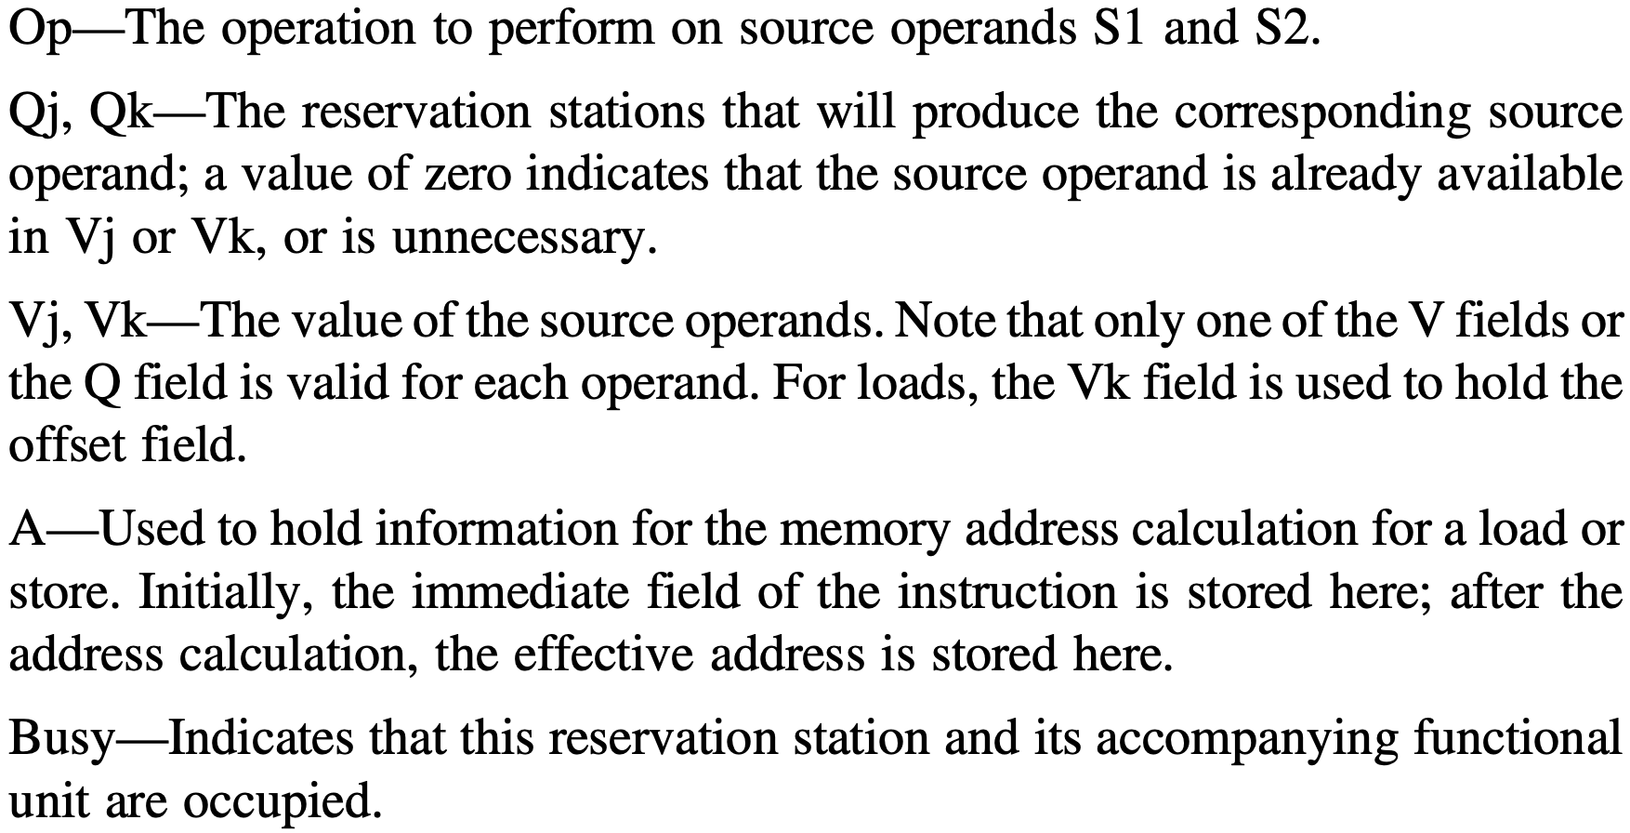
Reservation Station Status
Seven fields:

Slide 223
Reservation Station Status
Seven fields:
for load/store buffer

Slide 224
Register File Status
One field Qi: number of the researvation station that contains the operation whose result should be stored into this register; set to blank or 0 if no currently active instruction is computing a result destined for this register → the value is simply the register contents
Notes:
The register file has a field, Qi:
Qi—The number of the reservation station that contains the operation whose result should be stored into this register. If the value of Qi is blank (or 0), no currently active instruction is computing a result destined for this register,
meaning that the value is simply the register contents.

Slide 225
Load/Store Buffer Status
One field A: hold the result of the effective address once the first step of execution has been completed; as for load/store, effective address is computed in the execution stage
Notes:
The load and store buffers each have a field, A, which holds the result of the effec- tive address once the first step of execution has been completed.

Slide 226
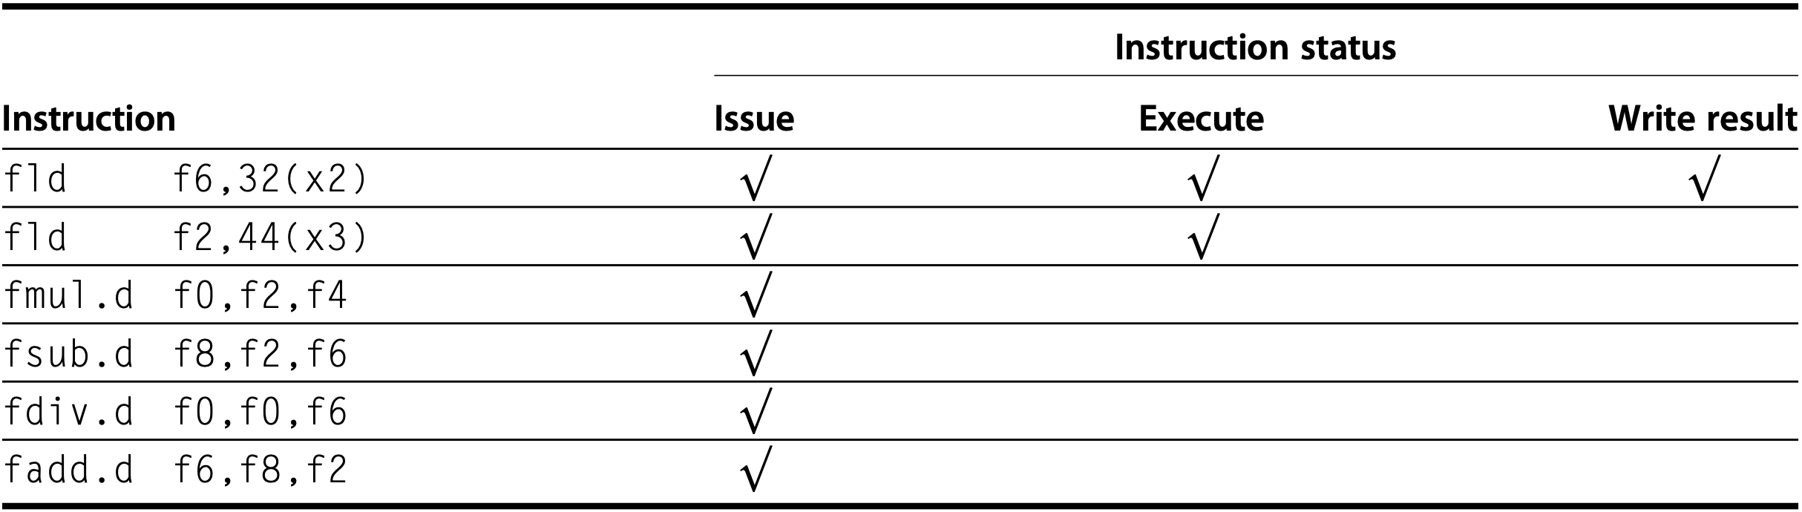
Tomasulo Example
f10
1st fld has completed and written
2nd fld has executed

Slide 227
Tomasulo Example
f6 ready
f2 not ready
f10
1st fld has completed and written
2nd fld has executed

Slide 228
Tomasulo Example
f6 ready
f2 not ready
f10
1st fld has completed and written
2nd fld has executed
fmul/fsub/fadd cannot execute

Slide 229
Tomasulo Example
f6 ready
f2 not ready
f0 not ready
f10
1st fld has completed and written
2nd fld has executed
fmul/fsub/fadd cannot execute

Slide 230
Tomasulo Example
f6 ready
f2 not ready
f0 not ready
f10
1st fld has completed and written
2nd fld has executed
fmul/fsub/fadd cannot execute
fdiv cannot execute

Slide 231
Tomasulo Example
f6 ready
f2 not ready
f0 not ready
f10
f6 WAR: fsub.d/fdiv.d → fadd.d
why co-issued?

Slide 232
Tomasulo Example
f6 ready
f2 not ready
f0 not ready
f10
f6 WAR: fsub.d/fdiv.d → fadd.d
why co-issued?
fmul/fsub/fadd cannot execute
fdiv cannot execute

Slide 233
Tomasulo Example
f6 ready
f2 not ready
f0 not ready
f10
f6 WAR: fsub.d/fdiv.d → fadd.d
why co-issued: register renaming
fsub/fdiv get f6 from fld buffer
fadd latter write wins

Slide 234
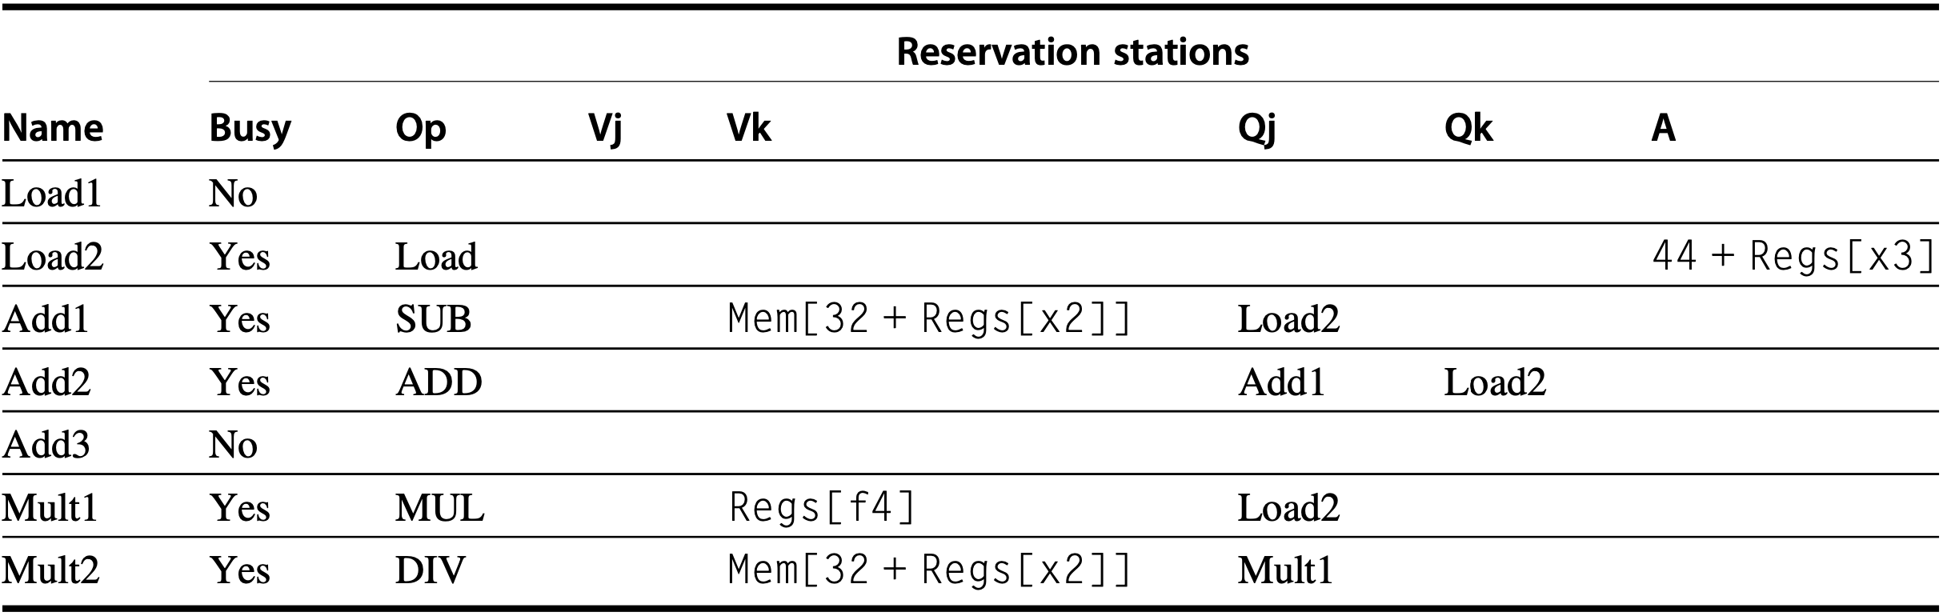
Tomasulo Example

Slide 235
Tomasulo Example
f10

Slide 236
Tomasulo Example
f10
fld has completed and written

Slide 237
Tomasulo Example
f10
computed effective address
fld has completed and written

Slide 238
Tomasulo Example
f10
fld has completed and written
directly from f4
computed effective address
wait for f2 from fld

Slide 239
Tomasulo Example
f10
directly from f4
Load1
wait for f2 from fld

Slide 240
Tomasulo Example
f10
directly from f4
Load1
wait for f2 from fld
f0 ← fmul

Slide 241
Tomasulo Example
f10
f0 ← fmul
wait for f2 from fld
wait for f8 from fsub
Notes:
Reservation station status form is filled with the help of register status, that is, to determine which reservation stations that Qj and Qk relate to;

Slide 242


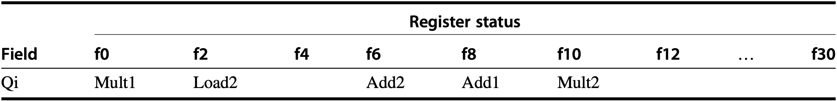
Tomasulo Example
f10

Slide 243
Tomasulo Example
check destination registers
f10

Slide 244
Tomasulo Example
check destination registers
f10
check corresponding instructions and reservation stations
and buffers

Slide 245



Tomasulo Example
fmul.d is ready to write result
f10

Slide 246
how to tomasulo with static?

Slide 247
Tomasulo & Loop Unrolling
f0, 0(x1)
f4, f0, f2
f4, 0(x1)
x1, x1, -8
x1, x2, Loop
Example code sequence
Loop:
fld
fmul.d
fsd
addi
bne
Notes:
To understand the full power of eliminating WAW and WAR hazards through dynamic renaming of registers, we must look at a loop. Consider the following sim- ple sequence for multiplying the elements of an array by a scalar in f2:
If we predict that branches are taken, using reservation stations will allow multiple executions of this loop to proceed at once. This advantage is gained without changing the code—in effect, the loop is unrolled dynamically by the hard- ware using the reservation stations obtained by renaming to act as additional registers.
Let’s assume we have issued all the instructions in two successive iterations of the loop, but none of the floating-point load/stores or operations have com- pleted. Figure 3.14 shows reservation stations, register status tables, and load and store buffers at this point.

Slide 248



Tomasulo & Loop Unrolling
two iterations & no complete instr
Notes:
Figure 3.14 Two active iterations of the loop with no instruction yet completed. Entries in the multiplier reser- vation stations indicate that the outstanding loads are the sources. The store reservation stations indicate that the multiply destination is the source of the value to store.
(The integer ALU operation is ignored, and it is assumed the branch was predicted as taken.) Once the system reaches this state, two copies of the loop could be sustained with a CPI close to 1.0, provided the multiplies could complete in four clock cycles. With a latency of six cycles, additional iterations will need to be processed before the steady state can be reached. This requires more reservation stations to hold instructions that are in execution. As we will see later in this chapter, when extended with multiple issue instructions, Tomasulo’s approach can sustain more than one instruction per clock.

Slide 249
how to tomasulo with static?
remember branch prediction:
while resolving branch, fetch&issue instr
if correct prediction, continue execution
if misprediction, re-fetch instructions

Slide 250
how to tomasulo with static?
if correct prediction, continue execution
Notes:
As we try to exploit more instruction-level parallelism, maintaining control depen- dences becomes an increasing burden. Branch prediction reduces the direct stalls attributable to branches, but for a processor executing multiple instructions per clock, just predicting branches accurately may not be sufficient to generate the desired amount of instruction-level parallelism. A wide-issue processor may need to execute a branch every clock cycle to maintain maximum performance. Thus exploiting more parallelism requires that we overcome the limitation of control dependence.

Slide 251
how to exec before resolved?
if correct prediction, continue execution

Slide 252
how to exec before resolved?
if correct prediction, continue execution
speculate on branch outcome
execute program as if guesses are correct
Notes:
Overcoming control dependence is done by speculating on the outcome of branches and executing the program as if our guesses are correct. This mech- anism represents a subtle, but important, extension over branch prediction with dynamic scheduling.

Slide 253
how to exec before resolved?
if correct prediction, continue execution
fetch, issue, and execute instructions as if
branch predictions are always correct;
commit results till prediction is determined;
undo effects by misprediction;
Notes:
In particular, with speculation, we fetch, issue, and exe- cute instructions, as if our branch predictions are always correct; dynamic scheduling only fetches and issues such instructions. Of course, we need mech- anisms to handle the situation where the speculation is incorrect. Appendix H discusses a variety of mechanisms for supporting speculation by the compiler. In this section, we explore hardware speculation, which extends the ideas of dynamic scheduling.

Slide 254
Hardware Speculation
out-of-order execution&in-order commit
Instruction Commit allow an instruction to update register file or memory until the instruction is no longer speculative
Reorder Buffer (ROB) additional set of hardware buffers to hold the results of instructions that have finished execution but have not committed
Notes:
Hardware-based speculation combines three key ideas:
dynamic branch prediction to choose which instructions to execute,
speculation to allow the execution of instructions before the control dependences are resolved (with the ability to undo the effects of an incorrectly speculated sequence), and
dynamic scheduling to deal with the scheduling of different combinations of basic blocks. (In comparison, dynamic scheduling without speculation only partially overlaps basic blocks because it requires that a branch be resolved before actually executing any instructions in the successor basic block.).
The key idea behind implementing speculation is to allow instructions to exe- cute out of order but to force them to commit in order and to prevent any irrevo- cable action (such as updating state or taking an exception) until an instruction commits. Therefore, when we add speculation, we need to separate the process of completing execution from instruction commit, because instructions may finish execution considerably before they are ready to commit. Adding this commit phase to the instruction execution sequence requires an additional set of hardware buffers that hold the results of instructions that have finished execution but have not com- mitted. This hardware buffer, which we call the reorder buffer, is also used to pass results among instructions that may be speculated.

Slide 255
Hardware Speculation
out-of-order execution&in-order commit
Instruction Commit allow an instruction to update register file or memory until the instruction is no longer speculative
Reorder Buffer (ROB) similar to stations/buffers in Tomasulo, act as a source of operands for instr; results updated to registers/memory until instruction commits;
Reorder Buffer (ROB)
Notes:
The reorder buffer (ROB) provides additional registers in the same way as the reservation stations in Tomasulo’s algorithm extend the register set. The ROB holds the result of an instruction between the time the operation associated with the instruction completes and the time the instruction commits. The ROB therefore is a source of operands for instructions, just as the reservation stations provide operands in Tomasulo’s algorithm. The key difference is that in Tomasulo’s algo- rithm, once an instruction writes its result, all subsequently issued instructions will find the result in the register file. With speculation, the register file is not updated until the instruction commits (and we know definitively that the instruction should execute); thus, the ROB supplies operands in the interval between completion of instruction execution and instruction commit. The ROB is similar to the store buffer in Tomasulo’s algorithm, and we integrate the function of the store buffer into the ROB for simplicity.

Slide 256

Hardware Speculation
Reorder Buffer (ROB)
Notes:
Figure 3.15 The basic structure of a FP unit using Tomasulo’s algorithm and extended to handle speculation. Comparing this to Figure 3.10 on page 198, which implemented Tomasulo’s algorithm, we can see that the major change is the addition of the ROB and the elimination of the store buffer, whose function is integrated into the ROB. This mechanism can be extended to allow multiple issues per clock by making the CDB wider to allow for mul- tiple completions per clock.

Slide 257
Hardware Speculation
Reorder Buffer (ROB)
results from CDB to:
ROB instead of directly to registers
Notes:
Figure 3.15 The basic structure of a FP unit using Tomasulo’s algorithm and extended to handle speculation. Comparing this to Figure 3.10 on page 198, which implemented Tomasulo’s algorithm, we can see that the major change is the addition of the ROB and the elimination of the store buffer, whose function is integrated into the ROB. This mechanism can be extended to allow multiple issues per clock by making the CDB wider to allow for mul- tiple completions per clock.

Slide 258
Hardware Speculation
Reorder Buffer (ROB)
results from ROB to:
registers upon commit;
stations/memory as source op;
Notes:
Figure 3.15 The basic structure of a FP unit using Tomasulo’s algorithm and extended to handle speculation. Comparing this to Figure 3.10 on page 198, which implemented Tomasulo’s algorithm, we can see that the major change is the addition of the ROB and the elimination of the store buffer, whose function is integrated into the ROB. This mechanism can be extended to allow multiple issues per clock by making the CDB wider to allow for mul- tiple completions per clock.

Slide 259
Hardware Speculation
Reorder Buffer (ROB)
store buffers subsumed to:
ROB
Notes:
Figure 3.15 The basic structure of a FP unit using Tomasulo’s algorithm and extended to handle speculation. Comparing this to Figure 3.10 on page 198, which implemented Tomasulo’s algorithm, we can see that the major change is the addition of the ROB and the elimination of the store buffer, whose function is integrated into the ROB. This mechanism can be extended to allow multiple issues per clock by making the CDB wider to allow for mul- tiple completions per clock.
The ROB subsumes the store buffers. Stores still execute in two steps, but the second step is performed by instruction commit. Although the renaming function of the reservation stations is replaced by the ROB, we still need a place to buffer oper- ations (and operands) between the time they issue and the time they begin execution. This function is still provided by the reservation stations. Because every instruction has a position in the ROB until it commits, we tag a result using the ROB entry number rather than using the reservation station number. This tagging requires that the ROB assigned for an instruction must be tracked in the reservation station. Later in this sec- tion, we will explore an alternative implementation that uses extra registers for renam- ing and a queue that replaces the ROB to decide when instructions can commit.

Slide 260
Hardware Speculation
Reorder Buffer (ROB) entry fields:
Instruction type
Destination
Value
Ready
Reorder Buffer (ROB)
Notes:
Specifically, each entry in the ROB contains four fields: the instruction type, the destination field, the value field, and the ready field. The instruction type field indicates whether the instruction is a branch (and has no destination result), a store (which has a mem- ory address destination), or a register operation (ALU operation or load, which has register destinations). The destination field supplies the register number (for loads and ALU operations) or the memory address (for stores) where the instruction result should be written. The value field is used to hold the value of the instruction result until the instruction commits. We will see an example of ROB entries shortly. Finally, the ready field indicates that the instruction has completed execution, and the value is ready.

Slide 261
Hardware Speculation
Reorder Buffer (ROB) entry fields:
Instruction type branch, store, register op (ALU/load)
Destination register # for loads and ALU operations memory address for stores
Value hold insr result until instruction commits
Ready: execution complete, value ready
Reorder Buffer (ROB)
Notes:
Specifically, each entry in the ROB contains four fields: the instruction type, the destination field, the value field, and the ready field. The instruction type field indicates whether the instruction is a branch (and has no destination result), a store (which has a mem- ory address destination), or a register operation (ALU operation or load, which has register destinations). The destination field supplies the register number (for loads and ALU operations) or the memory address (for stores) where the instruction result should be written. The value field is used to hold the value of the instruction result until the instruction commits. We will see an example of ROB entries shortly. Finally, the ready field indicates that the instruction has completed execution, and the value is ready.

Slide 262
Hardware Speculation
Issue
Execute
Write result
Commit
Notes:
Here are the four steps involved in instruction execution:

Slide 263
Hardware Speculation
Issue get next instr from instr queue head upon empty reservation-station buffer & empty ROB entry; send operands to station if available in either registers or ROB; correlate station with ROB entry #;
Execute
Write result
Commit
Notes:
1. Issue—Get an instruction from the instruction queue. Issue the instruction if there is an empty reservation station and an empty slot in the ROB; send the operands to the reservation station if they are available in either the registers or the ROB. Update the control entries to indicate the buffers are in use. The number of the ROB entry allocated for the result is also sent to the reservation station so that the number can be used to tag the result when it is placed on the CDB. If either all reservations are full or the ROB is full, then the instruction issue is stalled until both have available entries.

Slide 264
Hardware Speculation
Issue
Execute when both operands are available, execute the operation at functional unit; stores only need base register for effective address calculation;
Write result
Commit
Notes:
2. Execute—If one or more of the operands is not yet available, monitor the CDB while waiting for the register to be computed. This step checks for RAW haz- ards. When both operands are available at a reservation station, execute the operation. Instructions may take multiple clock cycles in this stage, and loads still require two steps in this stage. Stores only need the base register at this step, because execution for a store at this point is only effective address calculation.

Slide 265
Hardware Speculation
Issue
Execute
Write result when the result is available, write it on CDB (with ROB entry #), which broadcasts it to ROB and stations
Commit
Notes:
3. Write result—When the result is available, write it on the CDB (with the ROB tag sent when the instruction issued) and from the CDB into the ROB, as well as to any reservation stations waiting for this result. Mark the reservation station as available. Special actions are required for store instructions. If the value to be stored is available, it is written into the Value field of the ROB entry for the store. If the value to be stored is not available yet, the CDB must be monitored until that value is broadcast, at which time the Value field of the ROB entry of the store is updated. For simplicity we assume that this occurs during the Write Result stage of a store; we discuss relaxing this requirement later.

Slide 266
Hardware Speculation
Issue
Execute
Write result when the result is available, write it on CDB (with ROB entry #), which broadcasts it to ROB and stations
Commit
not directly to registers/memory
Notes:
3. Write result—When the result is available, write it on the CDB (with the ROB tag sent when the instruction issued) and from the CDB into the ROB, as well as to any reservation stations waiting for this result. Mark the reservation station as available. Special actions are required for store instructions. If the value to be stored is available, it is written into the Value field of the ROB entry for the store. If the value to be stored is not available yet, the CDB must be monitored until that value is broadcast, at which time the Value field of the ROB entry of the store is updated. For simplicity we assume that this occurs during the Write Result stage of a store; we discuss relaxing this requirement later.

Slide 267
Hardware Speculation
Issue
Execute
Write result
Commit: Completion/Graduation branch with incorrect prediction store normal commit
Notes:
4. Commit—This is the final stage of completing an instruction, after which only its result remains. (Some processors call this commit phase “completion” or “graduation.”) There are three different sequences of actions at commit depend- ing on whether the committing instruction is a branch with an incorrect predic- tion, a store, or any other instruction (normal commit). The normal commit case occurs when an instruction reaches the head of the ROB and its result is present in the buffer; at this point, the processor updates the register with the result and removes the instruction from the ROB. Committing a store is similar except that memory is updated rather than a result register. When a branch with incorrect prediction reaches the head of the ROB, it indicates that the speculation was wrong. The ROB is flushed and execution is restarted at the correct successor of the branch. If the branch was correctly predicted, the branch is finished. Once an instruction commits, its entry in the ROB is reclaimed, and the register or memory destination is updated, eliminating the need for the ROB entry. If the ROB fills, we simply stop issuing instructions until an entry is made free.

Slide 268
Hardware Speculation
Issue
Execute
Write result
Commit: Completion/Graduation branch with incorrect prediction store / normal commit: instruction reaches ROB head and its result is available; write result to dest register / memory; remove instruction from ROB;
Notes:
4. Commit—This is the final stage of completing an instruction, after which only its result remains. (Some processors call this commit phase “completion” or “graduation.”) There are three different sequences of actions at commit depend- ing on whether the committing instruction is a branch with an incorrect predic- tion, a store, or any other instruction (normal commit). The normal commit case occurs when an instruction reaches the head of the ROB and its result is present in the buffer; at this point, the processor updates the register with the result and removes the instruction from the ROB. Committing a store is similar except that memory is updated rather than a result register. When a branch with incorrect prediction reaches the head of the ROB, it indicates that the speculation was wrong. The ROB is flushed and execution is restarted at the correct successor of the branch. If the branch was correctly predicted, the branch is finished. Once an instruction commits, its entry in the ROB is reclaimed, and the register or memory destination is updated, eliminating the need for the ROB entry. If the ROB fills, we simply stop issuing instructions until an entry is made free.

Slide 269
Hardware Speculation
Issue
Execute
Write result
Commit: Completion/Graduation branch with incorrect prediction: flush ROB & restart at the correct successor of the branch; store normal commit
Notes:
4. Commit—This is the final stage of completing an instruction, after which only its result remains. (Some processors call this commit phase “completion” or “graduation.”) There are three different sequences of actions at commit depend- ing on whether the committing instruction is a branch with an incorrect predic- tion, a store, or any other instruction (normal commit). The normal commit case occurs when an instruction reaches the head of the ROB and its result is present in the buffer; at this point, the processor updates the register with the result and removes the instruction from the ROB. Committing a store is similar except that memory is updated rather than a result register. When a branch with incorrect prediction reaches the head of the ROB, it indicates that the speculation was wrong. The ROB is flushed and execution is restarted at the correct successor of the branch. If the branch was correctly predicted, the branch is finished. Once an instruction commits, its entry in the ROB is reclaimed, and the register or memory destination is updated, eliminating the need for the ROB entry. If the ROB fills, we simply stop issuing instructions until an entry is made free.

Slide 270


Speculation Example
f10
f10
both fld have committed
fmul.d is ready to commit
Notes:
Figure3.16 Atthetimethefmul.disreadytocommit,onlythetwofldinstructionshavecommitted,although several others have completed execution. The fmul.d is at the head of the ROB, and the two fld instructions are there only to ease understanding. The fsub.d and fadd.d instructions will not commit until the fmul.d instruc- tion commits, although the results of the instructions are available and can be used as sources for other instructions. The fdiv.d is in execution, but has not completed solely because of its longer latency than that of fmul.d. The Value column indicates the value being held; the format #X is used to refer to a value field of ROB entry X. Reorder buffers 1 and 2 are actually completed but are shown for informational purposes. We do not show the entries for the load/store queue, but these entries are kept in order.

Slide 271
Speculation Example
f10
f10
still in execution
due to long latency
both fld have committed
fmul.d is ready to commit
Notes:
Figure3.16 Atthetimethefmul.disreadytocommit,onlythetwofldinstructionshavecommitted,although several others have completed execution. The fmul.d is at the head of the ROB, and the two fld instructions are there only to ease understanding. The fsub.d and fadd.d instructions will not commit until the fmul.d instruc- tion commits, although the results of the instructions are available and can be used as sources for other instructions. The fdiv.d is in execution, but has not completed solely because of its longer latency than that of fmul.d. The Value column indicates the value being held; the format #X is used to refer to a value field of ROB entry X. Reorder buffers 1 and 2 are actually completed but are shown for informational purposes. We do not show the entries for the load/store queue, but these entries are kept in order.

Slide 272

Speculation Example
f10
f10
could be blank as Mult1 is not busy?
Notes:
Figure3.16 Atthetimethefmul.disreadytocommit,onlythetwofldinstructionshavecommitted,although several others have completed execution. The fmul.d is at the head of the ROB, and the two fld instructions are there only to ease understanding. The fsub.d and fadd.d instructions will not commit until the fmul.d instruc- tion commits, although the results of the instructions are available and can be used as sources for other instructions. The fdiv.d is in execution, but has not completed solely because of its longer latency than that of fmul.d. The Value column indicates the value being held; the format #X is used to refer to a value field of ROB entry X. Reorder buffers 1 and 2 are actually completed but are shown for informational purposes. We do not show the entries for the load/store queue, but these entries are kept in order.

Slide 273

Speculation Example
f10
f10
which ROB entry’s destination is this register
could be blank as Mult1 is not busy?
Notes:
Figure3.16 Atthetimethefmul.disreadytocommit,onlythetwofldinstructionshavecommitted,although several others have completed execution. The fmul.d is at the head of the ROB, and the two fld instructions are there only to ease understanding. The fsub.d and fadd.d instructions will not commit until the fmul.d instruc- tion commits, although the results of the instructions are available and can be used as sources for other instructions. The fdiv.d is in execution, but has not completed solely because of its longer latency than that of fmul.d. The Value column indicates the value being held; the format #X is used to refer to a value field of ROB entry X. Reorder buffers 1 and 2 are actually completed but are shown for informational purposes. We do not show the entries for the load/store queue, but these entries are kept in order.

Slide 274
Speculation Example
f10
f10
which ROB entry’s destination is this register
could be blank as Mult1 is not busy?
Notes:
Figure3.16 Atthetimethefmul.disreadytocommit,onlythetwofldinstructionshavecommitted,although several others have completed execution. The fmul.d is at the head of the ROB, and the two fld instructions are there only to ease understanding. The fsub.d and fadd.d instructions will not commit until the fmul.d instruc- tion commits, although the results of the instructions are available and can be used as sources for other instructions. The fdiv.d is in execution, but has not completed solely because of its longer latency than that of fmul.d. The Value column indicates the value being held; the format #X is used to refer to a value field of ROB entry X. Reorder buffers 1 and 2 are actually completed but are shown for informational purposes. We do not show the entries for the load/store queue, but these entries are kept in order.

Slide 275
Speculation Example
f10
f10
which ROB entry’s destination is this register
could be blank as Mult1 is not busy?
Notes:
Figure3.16 Atthetimethefmul.disreadytocommit,onlythetwofldinstructionshavecommitted,although several others have completed execution. The fmul.d is at the head of the ROB, and the two fld instructions are there only to ease understanding. The fsub.d and fadd.d instructions will not commit until the fmul.d instruc- tion commits, although the results of the instructions are available and can be used as sources for other instructions. The fdiv.d is in execution, but has not completed solely because of its longer latency than that of fmul.d. The Value column indicates the value being held; the format #X is used to refer to a value field of ROB entry X. Reorder buffers 1 and 2 are actually completed but are shown for informational purposes. We do not show the entries for the load/store queue, but these entries are kept in order.

Slide 276
Speculation Example
f10
f10
uncommitted instructions’ destination registers
could be blank as Mult1 is not busy?
Notes:
Figure3.16 Atthetimethefmul.disreadytocommit,onlythetwofldinstructionshavecommitted,although several others have completed execution. The fmul.d is at the head of the ROB, and the two fld instructions are there only to ease understanding. The fsub.d and fadd.d instructions will not commit until the fmul.d instruc- tion commits, although the results of the instructions are available and can be used as sources for other instructions. The fdiv.d is in execution, but has not completed solely because of its longer latency than that of fmul.d. The Value column indicates the value being held; the format #X is used to refer to a value field of ROB entry X. Reorder buffers 1 and 2 are actually completed but are shown for informational purposes. We do not show the entries for the load/store queue, but these entries are kept in order.

Slide 277
Speculation Example
f10
f10
wait for results to be written from ROB to destination registers
upon commit
could be blank as Mult1 is not busy?
Notes:
Figure3.16 Atthetimethefmul.disreadytocommit,onlythetwofldinstructionshavecommitted,although several others have completed execution. The fmul.d is at the head of the ROB, and the two fld instructions are there only to ease understanding. The fsub.d and fadd.d instructions will not commit until the fmul.d instruc- tion commits, although the results of the instructions are available and can be used as sources for other instructions. The fdiv.d is in execution, but has not completed solely because of its longer latency than that of fmul.d. The Value column indicates the value being held; the format #X is used to refer to a value field of ROB entry X. Reorder buffers 1 and 2 are actually completed but are shown for informational purposes. We do not show the entries for the load/store queue, but these entries are kept in order.

Slide 278


Speculation & Loop Unrolling
two iterations&fld/fmul committed
f
f
7
Notes:
Figure 3.17 Only the fld and fmul.d instructions have committed, although all the others have completed execution. Thus no reservation stations are busy and none are shown. The remaining instructions will be committed as quickly as possible. The first two reorder buffers are empty, but are shown for completeness.

Slide 279
Hardware Speculation
Example: free reservation station on result broadcast (not instruction dispatch); issue, capture, dispatch in same cycle; 1-cycle add, 10-cycle mul, 40-cycle div;
inst | operand | issue | exe | write | commit
div | x2, x3, x4 | 1 | ?
mul | x1, x5, x6
add | x3, x7, x8
mul | x1, x1, x3
sub | x4, x1, x5
add | x1, x4, x2

Slide 280
Hardware Speculation
Example: free reservation station on result broadcast (not instruction dispatch); issue, capture, dispatch in same cycle; 1-cycle add, 10-cycle mul, 40-cycle div;
inst | operand | issue | exe | write | commit
div | x2, x3, x4 | 1 | 2 | 42 | 43
mul | x1, x5, x6
add | x3, x7, x8
mul | x1, x1, x3
sub | x4, x1, x5
add | x1, x4, x2

Slide 281
Hardware Speculation
Example: assume single-issue pipeline free reservation station on result broadcast (not instruction dispatch); issue, capture, dispatch in same cycle; 1-cycle add, 10-cycle mul, 40-cycle div;
inst | operand | issue | exe | write | commit
div | x2, x3, x4 | 1 | 2 | 42 | 43
mul | x1, x5, x6 | 2 | 3 | 13 | 44
add | x3, x7, x8
mul | x1, x1, x3
sub | x4, x1, x5
add | x1, x4, x2

Slide 282
Hardware Speculation
Example: free reservation station on result broadcast (not instruction dispatch); issue, capture, dispatch in same cycle; 1-cycle add, 10-cycle mul, 40-cycle div;
inst | operand | issue | exe | write | commit
div | x2, x3, x4 | 1 | 2 | 42 | 43
mul | x1, x5, x6 | 2 | 3 | 13 | 44
add | x3, x7, x8 | 3 | 4 | 5 | 45
mul | x1, x1, x3
sub | x4, x1, x5
add | x1, x4, x2

Slide 283
Hardware Speculation
Example: need mul reservation station free reservation station on result broadcast (not instruction dispatch); issue, capture, dispatch in same cycle; 1-cycle add, 10-cycle mul, 40-cycle div;
inst | operand | issue | exe | write | commit
div | x2, x3, x4 | 1 | 2 | 42 | 43
mul | x1, x5, x6 | 2 | 3 | 13 | 44
add | x3, x7, x8 | 3 | 4 | 5 | 45
mul | x1, x1, x3 | 14
sub | x4, x1, x5
add | x1, x4, x2

Slide 284
Hardware Speculation
Example: free reservation station on result broadcast (not instruction dispatch); issue, capture, dispatch in same cycle; 1-cycle add, 10-cycle mul, 40-cycle div;
inst | operand | issue | exe | write | commit
div | x2, x3, x4 | 1 | 2 | 42 | 43
mul | x1, x5, x6 | 2 | 3 | 13 | 44
add | x3, x7, x8 | 3 | 4 | 5 | 45
mul | x1, x1, x3 | 14 | 15 | 25 | 46
sub | x4, x1, x5
add | x1, x4, x2

Slide 285
Hardware Speculation
Example: need x1 as soure operand free reservation station on result broadcast (not instruction dispatch); issue, capture, dispatch in same cycle; 1-cycle add, 10-cycle mul, 40-cycle div;
inst | operand | issue | exe | write | commit
div | x2, x3, x4 | 1 | 2 | 42 | 43
mul | x1, x5, x6 | 2 | 3 | 13 | 44
add | x3, x7, x8 | 3 | 4 | 5 | 45
mul | x1, x1, x3 | 14 | 15 | 25 | 46
sub | x4, x1, x5 | 15 | 26
add | x1, x4, x2

Slide 286
Hardware Speculation
Example: free reservation station on result broadcast (not instruction dispatch); issue, capture, dispatch in same cycle; 1-cycle add, 10-cycle mul, 40-cycle div;
inst | operand | issue | exe | write | commit
div | x2, x3, x4 | 1 | 2 | 42 | 43
mul | x1, x5, x6 | 2 | 3 | 13 | 44
add | x3, x7, x8 | 3 | 4 | 5 | 45
mul | x1, x1, x3 | 14 | 15 | 25 | 46
sub | x4, x1, x5 | 15 | 26 | 27 | 47
add | x1, x4, x2

Slide 287
Hardware Speculation
Example: need x2 as soure operand free reservation station on result broadcast (not instruction dispatch); issue, capture, dispatch in same cycle; 1-cycle add, 10-cycle mul, 40-cycle div;
inst | operand | issue | exe | write | commit
div | x2, x3, x4 | 1 | 2 | 42 | 43
mul | x1, x5, x6 | 2 | 3 | 13 | 44
add | x3, x7, x8 | 3 | 4 | 5 | 45
mul | x1, x1, x3 | 14 | 15 | 25 | 46
sub | x4, x1, x5 | 15 | 26 | 27 | 47
add | x1, x4, x2 | 16 | 43

Slide 288
Hardware Speculation
Example: free reservation station on result broadcast (not instruction dispatch); issue, capture, dispatch in same cycle; 1-cycle add, 10-cycle mul, 40-cycle div;
inst | operand | issue | exe | write | commit
div | x2, x3, x4 | 1 | 2 | 42 | 43
mul | x1, x5, x6 | 2 | 3 | 13 | 44
add | x3, x7, x8 | 3 | 4 | 5 | 45
mul | x1, x1, x3 | 14 | 15 | 25 | 46
sub | x4, x1, x5 | 15 | 26 | 27 | 47
add | x1, x4, x2 | 16 | 43 | 44 | 48

Slide 289
how i understood tomasulo

Slide 290
and speculation

Slide 291

Ideal IPC & 1 Data Path = 1
Notes:
Given only a single data path, the IPC cannot be improved beyond one, as we issue only one instruction every clock cycle

Slide 292

Ideal IPC & 1 Data Path > 1
M
O
R
2 data paths
E
IPC = 2
https://tinyurl.com/2a9ywmjs
Notes:
Example processor with two copies of data paths, where IPC can be 2

Slide 293
Multiple Issue
M
O
R
E
Implement multiple copies of datapath
Allow multiple instructions to issue in a clock cycle
Three types: statically schedued superscalar proc VLIW (very long instruction word) proc dynamically scheduled superscalar proc
Notes:
Specifically, multiple-issue processors come in three major flavors:
1. Statically scheduled superscalar processors 2. VLIW (very long instruction word) processors
3. Dynamically scheduled superscalar processors

Slide 294


VLIW vs Superscalar
hardware
compiler
Notes:
Unlike in superscalar machine, the IF and ID stages of a VLIW machine need not be replicated to support the simultaneous processing, that is, fetching and decoding, of n separate instructions.
In a superscalar machine, the decision of which n instructions are to be issued into the execute stage is made at run time. For a VLIW machine, such an instruction-issuing decision is made at compile time, and then n instructions to be simultaneously issued into the execute stage are determined by the compiler and stored appropriately in the program memory as a very long instruction word.

Slide 295

1
RS[x1]
dynamic scheduling multiple issue speculation
Tomasulo Extension
correlate ROB entry & destination register
issue two instructions in a single clock cycle
load + FP instruction dependent on load
Notes:
Notice that we need to have assigned reorder buffer entries for this logic to operate properly, and recall that all these updates happen in a single clock cycle in parallel, not sequentially.

Slide 296

Further Example
two-issue processor & 3 iterations
Notes:
Figure3.23 The time of issue, execution, and writing result for a dual-issue version of our pipeline without speculation. Note that the ld following the bne cannot start execution earlier because it must wait until the branch out- come is determined. This type of program, with data-dependent branches that cannot be resolved earlier, shows the strength of speculation. Separate functional units for address calculation, ALU operations, and branch-condition eval- uation allow multiple instructions to execute in the same cycle. Figure 3.24 shows this example with speculation.

Slide 297
Further Example
two-issue processor & 3 iterations
step-by-step
Notes:
Figure3.23 The time of issue, execution, and writing result for a dual-issue version of our pipeline without speculation. Note that the ld following the bne cannot start execution earlier because it must wait until the branch out- come is determined. This type of program, with data-dependent branches that cannot be resolved earlier, shows the strength of speculation. Separate functional units for address calculation, ALU operations, and branch-condition eval- uation allow multiple instructions to execute in the same cycle. Figure 3.24 shows this example with speculation.

Slide 298
two-issue processor & 3 iterations
: up to two instructions can commit per CC;
Notes:
Figure3.23 Thetimeofissue,execution,andwritingresultforadual-issueversionofourpipelinewithoutspec- ulation. Note that the ld following the bne cannot start execution earlier because it must wait until the branch out- come is determined. This type of program, with data-dependent branches that cannot be resolved earlier, shows the strength of speculation. Separate functional units for address calculation, ALU operations, and branch-condition eval- uation allow multiple instructions to execute in the same cycle. Figure 3.24 shows this example with speculation.

Slide 299
two-issue processor & 3 iterations
: up to two instructions can commit per CC;
why single-issued branches?
Notes:
Figure3.23 Thetimeofissue,execution,andwritingresultforadual-issueversionofourpipelinewithoutspec- ulation. Note that the ld following the bne cannot start execution earlier because it must wait until the branch out- come is determined. This type of program, with data-dependent branches that cannot be resolved earlier, shows the strength of speculation. Separate functional units for address calculation, ALU operations, and branch-condition eval- uation allow multiple instructions to execute in the same cycle. Figure 3.24 shows this example with speculation.

Slide 300

two-issue processor & 3 iterations
: up to two instructions can commit per CC;
why single-issued branches?
https://www.cs.umd.edu/~meesh/411/CA-online/chapter/
multiple-issue-processors-i/index.html
Notes:
Figure3.23 Thetimeofissue,execution,andwritingresultforadual-issueversionofourpipelinewithoutspec- ulation. Note that the ld following the bne cannot start execution earlier because it must wait until the branch out- come is determined. This type of program, with data-dependent branches that cannot be resolved earlier, shows the strength of speculation. Separate functional units for address calculation, ALU operations, and branch-condition eval- uation allow multiple instructions to execute in the same cycle. Figure 3.24 shows this example with speculation.

Slide 301
two-issue processor
: up to two instructions can commit per CC;
ld following bne cannot start execution because it must wait
until the branch outcome is determined, without speculation;
Notes:
Figure3.23 Thetimeofissue,execution,andwritingresultforadual-issueversionofourpipelinewithoutspec- ulation. Note that the ld following the bne cannot start execution earlier because it must wait until the branch out- come is determined. This type of program, with data-dependent branches that cannot be resolved earlier, shows the strength of speculation. Separate functional units for address calculation, ALU operations, and branch-condition eval- uation allow multiple instructions to execute in the same cycle. Figure 3.24 shows this example with speculation.

Slide 302
no dependency with prior instructions, so one op per cycle;
Notes:
Figure3.23 Thetimeofissue,execution,andwritingresultforadual-issueversionofourpipelinewithoutspec- ulation. Note that the ld following the bne cannot start execution earlier because it must wait until the branch out- come is determined. This type of program, with data-dependent branches that cannot be resolved earlier, shows the strength of speculation. Separate functional units for address calculation, ALU operations, and branch-condition eval- uation allow multiple instructions to execute in the same cycle. Figure 3.24 shows this example with speculation.

Slide 303
dependent on x2, which is available in CC4
Notes:
Figure3.23 Thetimeofissue,execution,andwritingresultforadual-issueversionofourpipelinewithoutspec- ulation. Note that the ld following the bne cannot start execution earlier because it must wait until the branch out- come is determined. This type of program, with data-dependent branches that cannot be resolved earlier, shows the strength of speculation. Separate functional units for address calculation, ALU operations, and branch-condition eval- uation allow multiple instructions to execute in the same cycle. Figure 3.24 shows this example with speculation.

Slide 304
functional unit for address calculation is occupied by ld in CC2;
sd waits till CC3 for computing effective address;
Notes:
Figure3.23 Thetimeofissue,execution,andwritingresultforadual-issueversionofourpipelinewithoutspec- ulation. Note that the ld following the bne cannot start execution earlier because it must wait until the branch out- come is determined. This type of program, with data-dependent branches that cannot be resolved earlier, shows the strength of speculation. Separate functional units for address calculation, ALU operations, and branch-condition eval- uation allow multiple instructions to execute in the same cycle. Figure 3.24 shows this example with speculation.

Slide 305
dependent on x2, which is available in CC6
Notes:
Figure3.23 Thetimeofissue,execution,andwritingresultforadual-issueversionofourpipelinewithoutspec- ulation. Note that the ld following the bne cannot start execution earlier because it must wait until the branch out- come is determined. This type of program, with data-dependent branches that cannot be resolved earlier, shows the strength of speculation. Separate functional units for address calculation, ALU operations, and branch-condition eval- uation allow multiple instructions to execute in the same cycle. Figure 3.24 shows this example with speculation.

Slide 306
no dependency with prior instructions, so one op per cycle
after being issued in CC2;
Notes:
Figure3.23 Thetimeofissue,execution,andwritingresultforadual-issueversionofourpipelinewithoutspec- ulation. Note that the ld following the bne cannot start execution earlier because it must wait until the branch out- come is determined. This type of program, with data-dependent branches that cannot be resolved earlier, shows the strength of speculation. Separate functional units for address calculation, ALU operations, and branch-condition eval- uation allow multiple instructions to execute in the same cycle. Figure 3.24 shows this example with speculation.

Slide 307
dependent on x2, which is available in CC6
Notes:
Figure3.23 Thetimeofissue,execution,andwritingresultforadual-issueversionofourpipelinewithoutspec- ulation. Note that the ld following the bne cannot start execution earlier because it must wait until the branch out- come is determined. This type of program, with data-dependent branches that cannot be resolved earlier, shows the strength of speculation. Separate functional units for address calculation, ALU operations, and branch-condition eval- uation allow multiple instructions to execute in the same cycle. Figure 3.24 shows this example with speculation.

Slide 308
albeit ld is issued in CC4, should wait until bne is determined
as taken in CC7 and start execution in CC8;
Notes:
Figure3.23 Thetimeofissue,execution,andwritingresultforadual-issueversionofourpipelinewithoutspec- ulation. Note that the ld following the bne cannot start execution earlier because it must wait until the branch out- come is determined. This type of program, with data-dependent branches that cannot be resolved earlier, shows the strength of speculation. Separate functional units for address calculation, ALU operations, and branch-condition eval- uation allow multiple instructions to execute in the same cycle. Figure 3.24 shows this example with speculation.

Slide 309
dependent on x2, which is available in CC10
Notes:
Figure3.23 Thetimeofissue,execution,andwritingresultforadual-issueversionofourpipelinewithoutspec- ulation. Note that the ld following the bne cannot start execution earlier because it must wait until the branch out- come is determined. This type of program, with data-dependent branches that cannot be resolved earlier, shows the strength of speculation. Separate functional units for address calculation, ALU operations, and branch-condition eval- uation allow multiple instructions to execute in the same cycle. Figure 3.24 shows this example with speculation.

Slide 310
functional unit for address calculation is occupied by ld in CC8;
sd waits till CC9 for computing effective address;
Notes:
Figure3.23 Thetimeofissue,execution,andwritingresultforadual-issueversionofourpipelinewithoutspec- ulation. Note that the ld following the bne cannot start execution earlier because it must wait until the branch out- come is determined. This type of program, with data-dependent branches that cannot be resolved earlier, shows the strength of speculation. Separate functional units for address calculation, ALU operations, and branch-condition eval- uation allow multiple instructions to execute in the same cycle. Figure 3.24 shows this example with speculation.

Slide 311
dependent on x2, which is available in CC12
Notes:
Figure3.23 Thetimeofissue,execution,andwritingresultforadual-issueversionofourpipelinewithoutspec- ulation. Note that the ld following the bne cannot start execution earlier because it must wait until the branch out- come is determined. This type of program, with data-dependent branches that cannot be resolved earlier, shows the strength of speculation. Separate functional units for address calculation, ALU operations, and branch-condition eval- uation allow multiple instructions to execute in the same cycle. Figure 3.24 shows this example with speculation.

Slide 312
albeit ld is issued in CC5, should wait until bne is determined
as taken in CC7 and start execution in CC8;
Notes:
Figure3.23 Thetimeofissue,execution,andwritingresultforadual-issueversionofourpipelinewithoutspec- ulation. Note that the ld following the bne cannot start execution earlier because it must wait until the branch out- come is determined. This type of program, with data-dependent branches that cannot be resolved earlier, shows the strength of speculation. Separate functional units for address calculation, ALU operations, and branch-condition eval- uation allow multiple instructions to execute in the same cycle. Figure 3.24 shows this example with speculation.

Slide 313
sd reads x1 in CC9;
addi writes x1 in CC9;
traditional pipeline requiring write-then-read cannot support
this;
Notes:
Figure3.23 Thetimeofissue,execution,andwritingresultforadual-issueversionofourpipelinewithoutspec- ulation. Note that the ld following the bne cannot start execution earlier because it must wait until the branch out- come is determined. This type of program, with data-dependent branches that cannot be resolved earlier, shows the strength of speculation. Separate functional units for address calculation, ALU operations, and branch-condition eval- uation allow multiple instructions to execute in the same cycle. Figure 3.24 shows this example with speculation.

Slide 314

sd reads x1 in CC9;
addi writes x1 in CC9;
understanding: dynamically scheduled pipeline monitors x1
and reads its value to store buffer upon available, which
is ready prior to CC9
Notes:
Figure3.23 Thetimeofissue,execution,andwritingresultforadual-issueversionofourpipelinewithoutspec- ulation. Note that the ld following the bne cannot start execution earlier because it must wait until the branch out- come is determined. This type of program, with data-dependent branches that cannot be resolved earlier, shows the strength of speculation. Separate functional units for address calculation, ALU operations, and branch-condition eval- uation allow multiple instructions to execute in the same cycle. Figure 3.24 shows this example with speculation.

Slide 315
sd reads x1 value from buffer in CC9;
addi writes x1 in CC9;
Notes:
Figure3.23 Thetimeofissue,execution,andwritingresultforadual-issueversionofourpipelinewithoutspec- ulation. Note that the ld following the bne cannot start execution earlier because it must wait until the branch out- come is determined. This type of program, with data-dependent branches that cannot be resolved earlier, shows the strength of speculation. Separate functional units for address calculation, ALU operations, and branch-condition eval- uation allow multiple instructions to execute in the same cycle. Figure 3.24 shows this example with speculation.

Slide 316
dependent on x2, which is available in CC12
Notes:
Figure3.23 Thetimeofissue,execution,andwritingresultforadual-issueversionofourpipelinewithoutspec- ulation. Note that the ld following the bne cannot start execution earlier because it must wait until the branch out- come is determined. This type of program, with data-dependent branches that cannot be resolved earlier, shows the strength of speculation. Separate functional units for address calculation, ALU operations, and branch-condition eval- uation allow multiple instructions to execute in the same cycle. Figure 3.24 shows this example with speculation.

Slide 317
albeit ld is issued in CC7, should wait until bne is determined
as taken in CC13 and start execution in CC14;
Notes:
Figure3.23 Thetimeofissue,execution,andwritingresultforadual-issueversionofourpipelinewithoutspec- ulation. Note that the ld following the bne cannot start execution earlier because it must wait until the branch out- come is determined. This type of program, with data-dependent branches that cannot be resolved earlier, shows the strength of speculation. Separate functional units for address calculation, ALU operations, and branch-condition eval- uation allow multiple instructions to execute in the same cycle. Figure 3.24 shows this example with speculation.

Slide 318
dependent on x2, which is available in CC12
Notes:
Figure3.23 Thetimeofissue,execution,andwritingresultforadual-issueversionofourpipelinewithoutspec- ulation. Note that the ld following the bne cannot start execution earlier because it must wait until the branch out- come is determined. This type of program, with data-dependent branches that cannot be resolved earlier, shows the strength of speculation. Separate functional units for address calculation, ALU operations, and branch-condition eval- uation allow multiple instructions to execute in the same cycle. Figure 3.24 shows this example with speculation.

Slide 319
functional unit for address calculation is occupied by ld in CC14;
sd waits till CC15 for computing effective address;
Notes:
Figure3.23 Thetimeofissue,execution,andwritingresultforadual-issueversionofourpipelinewithoutspec- ulation. Note that the ld following the bne cannot start execution earlier because it must wait until the branch out- come is determined. This type of program, with data-dependent branches that cannot be resolved earlier, shows the strength of speculation. Separate functional units for address calculation, ALU operations, and branch-condition eval- uation allow multiple instructions to execute in the same cycle. Figure 3.24 shows this example with speculation.

Slide 320
dependent on x2, which is available in CC18
Notes:
Figure3.23 Thetimeofissue,execution,andwritingresultforadual-issueversionofourpipelinewithoutspec- ulation. Note that the ld following the bne cannot start execution earlier because it must wait until the branch out- come is determined. This type of program, with data-dependent branches that cannot be resolved earlier, shows the strength of speculation. Separate functional units for address calculation, ALU operations, and branch-condition eval- uation allow multiple instructions to execute in the same cycle. Figure 3.24 shows this example with speculation.

Slide 321
albeit ld is issued in CC8, should wait until bne is determined
as taken in CC13 and start execution in CC14;
Notes:
Figure3.23 Thetimeofissue,execution,andwritingresultforadual-issueversionofourpipelinewithoutspec- ulation. Note that the ld following the bne cannot start execution earlier because it must wait until the branch out- come is determined. This type of program, with data-dependent branches that cannot be resolved earlier, shows the strength of speculation. Separate functional units for address calculation, ALU operations, and branch-condition eval- uation allow multiple instructions to execute in the same cycle. Figure 3.24 shows this example with speculation.

Slide 322
dependent on x2, which is available in CC18
Notes:
Figure3.23 Thetimeofissue,execution,andwritingresultforadual-issueversionofourpipelinewithoutspec- ulation. Note that the ld following the bne cannot start execution earlier because it must wait until the branch out- come is determined. This type of program, with data-dependent branches that cannot be resolved earlier, shows the strength of speculation. Separate functional units for address calculation, ALU operations, and branch-condition eval- uation allow multiple instructions to execute in the same cycle. Figure 3.24 shows this example with speculation.

Slide 323
Further Example
two-issue processor & 3 iterations
19 cycles without speculation
Notes:
Figure3.23 Thetimeofissue,execution,andwritingresultforadual-issueversionofourpipelinewithoutspec- ulation. Note that the ld following the bne cannot start execution earlier because it must wait until the branch out- come is determined. This type of program, with data-dependent branches that cannot be resolved earlier, shows the strength of speculation. Separate functional units for address calculation, ALU operations, and branch-condition eval- uation allow multiple instructions to execute in the same cycle. Figure 3.24 shows this example with speculation.

Slide 324
Further Example
two-issue processor & 3 iterations
??
19 cycles without speculation

Slide 325

Further Example
two-issue processor & 3 iterations
13 cycles with speculation
Notes:
Figure 3.24 The time of issue, execution, and writing result for a dual-issue version of our pipeline with specu- lation. Note that the ld following the bne can start execution early because it is speculative.
In this case, where a branch can be a critical performance limiter, speculation helps significantly. The third branch in the speculative processor executes in clock cycle 13, whereas it exe- cutes in clock cycle 19 on the nonspeculative pipeline.
This example clearly shows how speculation can be advantageous when there are data-dependent branches, which otherwise would limit performance. This advan- tage depends, however, on accurate branch prediction. Incorrect speculation does not improve performance; in fact, it typically harms performance and, as we shall see, dramatically lowers energy efficiency.

Slide 326
Further Example
albeit bne is determined as taken in CC7,
speculation allows ld to execute in CC5 right after it’s issued
in CC4;
two-issue processor & 3 iterations
13 cycles with speculation
Notes:
Figure 3.24 The time of issue, execution, and writing result for a dual-issue version of our pipeline with specu- lation. Note that the ld following the bne can start execution early because it is speculative.
In this case, where a branch can be a critical performance limiter, speculation helps significantly. The third branch in the speculative processor executes in clock cycle 13, whereas it exe- cutes in clock cycle 19 on the nonspeculative pipeline.
This example clearly shows how speculation can be advantageous when there are data-dependent branches, which otherwise would limit performance. This advan- tage depends, however, on accurate branch prediction. Incorrect speculation does not improve performance; in fact, it typically harms performance and, as we shall see, dramatically lowers energy efficiency.

Slide 327
how to diff?

Slide 328
Scoreboarding
IF: fetch instructions into a FIFO queue
Issue: issue an instruction to functional unit if no structural & WAW hazards
Read Operands: wait until available
Execute: functioal unit executes
Write Result: write result to destination register if no WAR hazards
add x0, x1, x2
sub x0, x1, x2
add x0, x1, x2
sub x1, x3, x4

Slide 329
Tomasulo
IF: fetch instructions into a FIFO queue
Issue: in-order issue an instruction to reservation station if no structural hazard & get source-register values into station if available; otherwise, station that will produce the source;
Execute: out-of-order execution upon all operands are available
Write Result: broadcast via CDB to any registers and stations waiting for it

Slide 330

Tomasulo
How register renaming resolves WAW and WAR hazards?
Register Qi field: blank/0 if register content directly usable; otherwise, set as station number that will produce the result;
in-order issue & update Qi is the key
add x0, x1, x2
sub x0, x1, x2
add x0, x1, x2
sub x1, x3, x4

Slide 331
Tomasulo+Speculation
In-order issue, out-of-order execution, in-order commit
IF: fetch instructions into a FIFO queue
Issue: update station & ROB entry
Execute: upon operands are available
Write Result: broadcast to ROB and stations
Commit: store/normal-commit, or incorrect branch prediction?

Slide 333
Lectures 09-10
Data-Level Parallelism

Slide 334
Data-Level Parallelism
exploit parallelism from simultaneous
operations across large sets of data rather
than from multiple threads of control

Slide 335
Data-Level Parallelism
example architectures:
Vector Architecture
Multimedia SIMD
GPU
Vector Architecture
Notes:
GPU: graphics processing unit

Slide 336
Vector Architecture
Grab sets of data elements scattered about memory
Place them in large sequential reg files
Operate on data in those reg files
Disperse the results back into memory
A single instruction works on vector of data, which results in dozens of register-register operations on independent data elements

Slide 337
Vector Execution Time
Convoy: the set of vector instructions that could potentiallay execute together; co-convoy instructions must not contain any structural hazards; RAW is allowed in the same convoy;
Chime: the unit of time taken to execute the convoy
Cross-convoy instructions are serialized

Slide 338

Vector Execution Time
Example code sequence:
Assume a single copy of each vector functional unit
How many convoys/chimes?
How many cycles per FLOP (floating-point operation)?

Slide 339

Vector Execution Time
Example code sequence:
How many convoys/chimes?: 3 structural hazards: vld/vld, vld/vst convoy 1: vld, vmul convoy 2: vld, vadd convoy 3: vst

Slide 340
Vector Execution Time
Example code sequence:
How many cycles per FLOP (floating-point operation)? assume 32-element vectors; approximate 32 cycles per chime, 32 x 3 = 96 cycles for 3 chimes, 32 x 2 = 64 cycles for FLOPs [add,mul]
Notes:
The sequence requires three convoys. Because the sequence takes three chimes and there are two floating-point operations per result, the number of cycles per FLOP is 1.5 (ignoring any vector instruction issue overhead).

Slide 341
Vector Execution Time
Example code sequence:
How many cycles per FLOP (floating-point operation)? assume 32-element vectors; approximate 32 cycles per chime, 96 / 64 = 1.5 cycle per FLOP

Slide 342
Vector Execution Time
A vector sequence that consists of m convoys executes in m chimes
For a vector length of n, this sequence takes approximately m x n clock cycles
Ignore processor-specific overheads such as vector instruction issue overhead and vector start-up time (i.e., latency until the pipeline is full)

Slide 343

Multimedia SIMD
Suit for short, fixed-length vectors 256-bit-wide example operations:
Omissions: vector length register, strided or gather/scatter data transfer instructions, and mask registers

Slide 344
GPU
Support various types of parallelism: multithreading, MIMD, SIMD, ILP
Challenge for programming: not only getting good performance on GPU, but also in coordinating the scheduling of computation on the system processor and the GPU and the transfer of data between system memory and GPU memory

Slide 345

Compare GPU
with
Vector
Notes:
Figure4.22 A vector processor with four lanes on the left and a multithreaded SIMD Processor of a GPU with four SIMD Lanes on the right. (GPUs typically have 16 or 32 SIMD Lanes.) The Control Processor supplies scalar operands for scalar-vector operations, increments addressing for unit and nonunit stride accesses to memory, and performs other accounting-type operations. Peak memory performance occurs only in a GPU when the Address Coalescing Unit can discover localized addressing. Similarly, peak computational performance occurs when all internal mask bits are set identically. Note that the SIMD Processor has one PC per SIMD Thread to help with multithreading.

Slide 346

Compare GPU
Multimedia SIMD
with
Vector
Notes:
Figure 4.23 Similarities and differences between multicore with multimedia SIMD extensions and recent GPUs.

Slide 348
Lectures 11-13
Thread-Level Parallelism

Slide 349
Multiprocessor Architecture
According to memory organization and interconnect strategy
Two classes
symmetric/centralized shared-memory multiprocessors (SMP)
+
distributed shared memory multiprocessors (DMP)
Notes:
According to how the memory is shared and how processors interconnect with each other, multiprocessor architecture can be classified into two classes.
Centralized shared-memory multiprocessors and distributed shared memory multiprocessors.

Slide 350

Centralized Shared-Memory
Large, multilevel caches
reduce mem bandwidth demands
Notes:
Between processors and the centralized shared main memory, there are large, multilevel caches to reduce memory bandwidth demands.

Slide 351
Centralized Shared-Memory
Cache private/shared data
Notes:
Cached data are either private or shared.

Slide 352
Centralized Shared-Memory
private data
used by a single processor
Notes:
Private data can be used by only a single processor.

Slide 353
Centralized Shared-Memory
shared data
used by multiple processors
may be replicated in multiple caches to reduce
access latency, required mem bw, contention
Notes:
While shared data can be used by multiple processors,
Shared data may be replicated in multiple caches to reduce access latency

Slide 354
Centralized Shared-Memory
w/o additional precautions
different processors can have different values
for the same memory location
shared data
used by multiple processors
may be replicated in multiple caches to reduce
access latency, required mem bw, contention
Notes:
For replicated data across different caches, additional precautions are needed to guarantee their coherence.
Otherwise, different processors may have different values of the same memory location.

Slide 355

Cache Coherence Problem
without precautions
write-through cache
Notes:
The problem concerning whether the value of shared data is identical in different caches is called cache coherence problem.
Figure5.3 The cache coherence problem for a single memory location(X), read and written by two processors (A and B). We initially assume that neither cache contains the variable and that X has the value 1. We also assume a write- through cache; a write-back cache adds some additional but similar complications. After the value of X has been written by A, A’s cache and the memory both contain the new value, but B’s cache does not, and if B reads the value of X it will receive 1!

Slide 356
Cache Coherence Problem
Global state defined by main memory
Local state defined by the individual caches, private to each processor core
Notes:
The cache coherence problem is interested in two states of cached data.
Global state is defined by main memory;
Local state is defined by individual caches.

Slide 357
Cache Coherence Problem
A memory system is Coherent if any read of a data item returns the most recently written value of that data item
Two critical aspects
coherence: defines what values can be returned by a read
consistency: determines when a written value will be returned by a read
Notes:
Consistency is about ordering of all memory operations from different processors (i.e., to different memory locations).
Global ordering of accesses to all memory locations.
Coherence is about ordering of operations from different processors to the same memory location.
Local ordering of accesses to each cache block.
Cache coherence, memory consistency
https://www.quora.com/What-is-the-difference-between-cache-consistency-and-cache-coherence
Quote from Aamir Ogna, CPU Verification Engineer
“ As far as I know, there's no such thing is "cache" consistency. What you are referring to is probably memory consistency.
Cache coherency is relevant in a multicore system where each processor has a private L1 cache and at least one other level is shared. Memory consistency is relevant whether there are caches or not.
I like the way my professor taught it so I'll give the same example:
Let's say you are the main memory and you have two friends A and B who are two cores in a multicore environment:
A wants to go for a movie on Saturday. So he texts you asking for a good time. You reply back saying 9 PM is a good time. A gets the text, reads it and he is happy. He is also expecting you to co-ordinate the times with B.
A few minutes later, B texts you asking for the time of the movie. You send him the same reply you sent to A, 9 PM. At this point in time, all three of you are agreeing on the same time, that is to say, all of you have the same copy of data.
Something comes up in B's calendar and he needs to reschedule it. So he texts you saying instead of 9, you all will go for the movie at 10 PM. You get the text and your timing is updated. But you fail to pass on this message to A, who still thinks 9 PM is on.
At this point, you (main memory) and B (one of the cores) have the same data, but A (another core) has stale data, since the "write" to the data by B was never propagated to A. A will still show up at 9 PM for the movie, won't find either of you, get pissed off and watch the movie all alone, live texting you the entire story spoiling everything for you!
This is what cache coherency is all about. It's about making sure that every private copy is the same everywhere and if any changes are made, those changes are propagated to every private cache.
We can use the same example to understand memory consistency as well, but in this case, you are also a core:
A wants to go for the movie on Saturday at 9 PM. So he sends out a text_1 saying "Movie at 9" to both, you and B. A few minutes later, his plan changes and now he wants to watch it at 10 PM instead. So he sends out another text_2 saying "Movie at 10". So both, you and B are informed of the time changes, but something funky happens.
B's telephone network is crappy and he receives the text_2 BEFORE text_1. B is thinking the initial plan was 10 PM that got moved to 9 while you are thinking it was 9 PM that got moved to 10. In this case, both of you got updated copies, but at different times in a different order. Either ways, someone is going to get pissed and spoil the movie for the others.
This is memory consistency. It's not enough that a core sees the write happening to shared data, it's also important that they see the writes in the same order as other cores. Otherwise, data will be inconsistent across cores.
Hope this helps.
”

Slide 358
Coherence Property: 1/3
A memory is coherent if: 3-1
A read by processor P to location X that follows a write by P to X, with no writes of X by another processor occurring between the write and the read by P,
always returns the value written by P.
write -> read: returns written value
preserves program order
Notes:
The first property simply preserves program order—we expect this property to
be true even in uniprocessors.

Slide 359
Coherence Property: 2/3
A memory is coherent if: 3-2
A read by a processor to location X that follows a write by another processor to X returns the written value if the read and the write are sufficiently separated in time and no other writes to X occur between the two accesses.
write -> read: returns written value
Notes:
The second property defines the notion of what it means to have a coherent view of memory: if a processor could continuously read an old data value, we would clearly say that memory was incoherent.

Slide 360
Coherence Property: 3/3
A memory is coherent if: 3-3
Write serialization
two writes to the same location by any two processors are seen in the same order by all processors
Notes:
Writes to the same location are serialized; that is, two writes to the same location by any two processors are seen in the same order by all processors. For example, if the values 1 and then 2 are written to a location, processors can never read the value of the location as 2 and then later read it as 1.
Sup- pose we did not serialize writes, and processor P1 writes location X followed by P2 writing location X. Serializing the writes ensures that every processor will see the write done by P2 at some point. If we did not serialize the writes, it might be the case that some processors could see the write of P2 first and then see the write of P1, maintaining the value written by P1 indefinitely. The simplest way to avoid such difficulties is to ensure that all writes to the same location are seen in the same order; this property is called write serialization.

Slide 361
Consistency
When a written value will be seen is important
Memory consistency protocol
Notes:
Although the three properties just described are sufficient to ensure coherence, the question of when a written value will be seen is also important. To see why, observe that we cannot require that a read of X instantaneously see the value written for X by some other processor. If, for example, a write of X on one processor precedes a read of X on another processor by a very small time, it may be impossible to ensure that the read returns the value of the data written, since the written data may not even have left the processor at that point. The issue of exactly when a written value must be seen by a reader is defined by a memory consistency model—a topic discussed in Section 5.6.

Slide 362
Consistency
Example: a write of X on one processor precedes a read of X on another processor by a very small time, it may be impossible to ensure that the read returns the value of the data written,
since the written data may not even have left the processor at that point

Slide 363
how to enforce coherence?

Slide 364
Cache Coherence Protocols
Directory based
the sharing status of a particular block of physical memory is kept in one location, called directory
Snooping
every cache that has a copy of the data from a block of physical memory could track the sharing status of the block
Snooping
Notes:
The protocols to maintain coherence for multiple processors are called cache coherence protocols. Key to implementing a cache coherence protocol is tracking the state of any sharing of a data block. The state of any cache block is kept using status bits associated with the block, similar to the valid and dirty bits kept in a uniprocessor cache. There are two classes of protocols in use, each of which uses different techniques to track the sharing status:
Directory based—The sharing status of a particular block of physical memory is kept in one location, called the directory. There are two very different types of directory-based cache coherence. In an SMP, we can use one centralized directory, associated with the memory or some other single serialization point, such as the outermost cache in a multicore. In a DSM, it makes no sense to have a single directory because that would create a single point of contention and make it difficult to scale to many multicore chips given the memory demands of multicores with eight or more cores. Distributed directories are more com- plex than a single directory, and such designs are the subject of Section 5.4.
Snooping—Rather than keeping the state of sharing in a single directory, every cache that has a copy of the data from a block of physical memory could track the sharing status of the block. In an SMP, the caches are typically all acces- sible via some broadcast medium (e.g., a bus connects the per-core caches to the shared cache or memory), and all cache controllers monitor or snoop on the medium to determine whether they have a copy of a block that is requested on a bus or switch access. Snooping can also be used as the coherence protocol for a multichip multiprocessor, and some designs support a snooping protocol on top of a directory protocol within each multicore.

Slide 365
Snooping Coherence Protocol
Snooping
Write invalidate protocol
invalidate other copies on a write
exclusive access ensures that no other readable or writable copies of an item exist when the write occurs
Notes:
One method is to ensure that a processor has exclusive access to a data item before writing that item. This style of protocol is called a write invalidate protocol because it invalidates other copies on a write. It is by far the most common pro- tocol. Exclusive access ensures that no other readable or writable copies of an item exist when the write occurs: all other cached copies of the item are invalidated.

Slide 366

Snooping Coherence Protocol
Write invalidate protocol
invalidate other copies on a write
write-back cache
update memory when a block becomes shared simplifies the protocol
Notes:
P209 on 4th edition: update of memory occurs when a block becomes shared simplifies the protocol
Figure 5.4 An example of an invalidation protocol working on a snooping bus for a single cache block (X) with write-back caches. We assume that neither cache initially holds X and that the value of X in memory is 0. The processor and memory contents show the value after the processor and bus activity have both completed. A blank indi- cates no activity or no copy cached. When the second miss by B occurs, processor A responds with the value canceling the response from memory. In addition, both the contents of B’s cache and the memory contents of X are updated. This update of memory, which occurs when a block becomes shared, simplifies the protocol, but it is possible to track the ownership and force the write-back only if the block is replaced. This requires the introduction of an additional status bit indicating ownership of a block. The ownership bit indicates that a block may be shared for reads, but only the owning processor can write the block, and that processor is responsible for updating any other processors and memory when it changes the block or replaces it. If a multicore uses a shared cache (e.g., L3), then all memory is seen through the shared cache; L3 acts like the memory in this example, and coherency must be handled for the private L1 and L2 caches for each core. It is this observation that led some designers to opt for a directory protocol within the multicore. To make this work, the L3 cache must be inclusive; recall from Chapter 2, that a cache is inclusive if any location in a higher level cache (L1 and L2 in this case) is also in L3. We return to the topic of inclusion on page 423.

Slide 367
Snooping Coherence Protocol
Write invalidate protocol
invalidate other copies on a write
write-back cache
shared-state block loses tracking of block ownership
Notes:
P209 on 4th edition: update of memory occurs when a block becomes shared simplifies the protocol
Figure 5.4 An example of an invalidation protocol working on a snooping bus for a single cache block (X) with write-back caches. We assume that neither cache initially holds X and that the value of X in memory is 0. The processor and memory contents show the value after the processor and bus activity have both completed. A blank indi- cates no activity or no copy cached. When the second miss by B occurs, processor A responds with the value canceling the response from memory. In addition, both the contents of B’s cache and the memory contents of X are updated. This update of memory, which occurs when a block becomes shared, simplifies the protocol, but it is possible to track the ownership and force the write-back only if the block is replaced. This requires the introduction of an additional status bit indicating ownership of a block. The ownership bit indicates that a block may be shared for reads, but only the owning processor can write the block, and that processor is responsible for updating any other processors and memory when it changes the block or replaces it. If a multicore uses a shared cache (e.g., L3), then all memory is seen through the shared cache; L3 acts like the memory in this example, and coherency must be handled for the private L1 and L2 caches for each core. It is this observation that led some designers to opt for a directory protocol within the multicore. To make this work, the L3 cache must be inclusive; recall from Chapter 2, that a cache is inclusive if any location in a higher level cache (L1 and L2 in this case) is also in L3. We return to the topic of inclusion on page 423.

Slide 368
Snooping Coherence Protocol
Write invalidate protocol
invalidate other copies on a write
write-back cache
hard to regulate which core to write-back upon eviction
Notes:
P209 on 4th edition: update of memory occurs when a block becomes shared simplifies the protocol
Figure 5.4 An example of an invalidation protocol working on a snooping bus for a single cache block (X) with write-back caches. We assume that neither cache initially holds X and that the value of X in memory is 0. The processor and memory contents show the value after the processor and bus activity have both completed. A blank indi- cates no activity or no copy cached. When the second miss by B occurs, processor A responds with the value canceling the response from memory. In addition, both the contents of B’s cache and the memory contents of X are updated. This update of memory, which occurs when a block becomes shared, simplifies the protocol, but it is possible to track the ownership and force the write-back only if the block is replaced. This requires the introduction of an additional status bit indicating ownership of a block. The ownership bit indicates that a block may be shared for reads, but only the owning processor can write the block, and that processor is responsible for updating any other processors and memory when it changes the block or replaces it. If a multicore uses a shared cache (e.g., L3), then all memory is seen through the shared cache; L3 acts like the memory in this example, and coherency must be handled for the private L1 and L2 caches for each core. It is this observation that led some designers to opt for a directory protocol within the multicore. To make this work, the L3 cache must be inclusive; recall from Chapter 2, that a cache is inclusive if any location in a higher level cache (L1 and L2 in this case) is also in L3. We return to the topic of inclusion on page 423.

Slide 369
Snooping Coherence Protocol
Write invalidate protocol
invalidate other copies on a write
write-back cache
update of memory ensures that memory already holds the latest value
Notes:
P209 on 4th edition: update of memory occurs when a block becomes shared simplifies the protocol
Figure 5.4 An example of an invalidation protocol working on a snooping bus for a single cache block (X) with write-back caches. We assume that neither cache initially holds X and that the value of X in memory is 0. The processor and memory contents show the value after the processor and bus activity have both completed. A blank indi- cates no activity or no copy cached. When the second miss by B occurs, processor A responds with the value canceling the response from memory. In addition, both the contents of B’s cache and the memory contents of X are updated. This update of memory, which occurs when a block becomes shared, simplifies the protocol, but it is possible to track the ownership and force the write-back only if the block is replaced. This requires the introduction of an additional status bit indicating ownership of a block. The ownership bit indicates that a block may be shared for reads, but only the owning processor can write the block, and that processor is responsible for updating any other processors and memory when it changes the block or replaces it. If a multicore uses a shared cache (e.g., L3), then all memory is seen through the shared cache; L3 acts like the memory in this example, and coherency must be handled for the private L1 and L2 caches for each core. It is this observation that led some designers to opt for a directory protocol within the multicore. To make this work, the L3 cache must be inclusive; recall from Chapter 2, that a cache is inclusive if any location in a higher level cache (L1 and L2 in this case) is also in L3. We return to the topic of inclusion on page 423.
::MOESI adds the state Owned to the MESI protocol to indicate that the associ- ated block is owned by that cache and out-of-date in memory. In MSI and MESI protocols, when there is an attempt to share a block in the Modified state, the state is changed to Shared (in both the original and newly sharing cache), and the block must be written back to memory. In a MOESI protocol, the block can be changed from the Modified to Owned state in the original cache without writing it to memory. Other caches, which are newly sharing the block, keep the block in the Shared state; the O state, which only the original cache holds, indicates that the main memory copy is out of date and that the designated cache is the owner. The owner of the block must supply it on a miss, since memory is not up to date and must write the block back to memory if it is replaced. The AMD Opteron processor family uses the MOESI protocol.

Slide 370
Snooping Coherence Protocol
Write update/broadcast protocol
update all cached copies of a data item when that item is written
consume more bandwidth

Slide 371
Write Invalidate Protocol
To perform an invalidate, the processor simply acquires bus access and broadcasts the address to be invalidated on the bus

Slide 372
Write Invalidate Protocol
To perform an invalidate, the processor simply acquires bus access and broadcasts the address to be invalidated on the bus
All processors continuously snoop on the bus, watching the addresses

Slide 373
Write Invalidate Protocol
To perform an invalidate, the processor simply acquires bus access and broadcasts the address to be invalidated on the bus
All processors continuously snoop on the bus, watching the addresses
The processors check whether the address on the bus is in their cache;
if so, the corresponding data block in the cache is invalidated.

Slide 374
Write Invalidate Protocol
To perform an invalidate, the processor simply acquires bus access and broadcasts the address to be invalidated on the bus
All processors continuously snoop on the bus, watching the addresses
If a processor finds that it has a dirty copy of a requested cache block,
it provides that cache block and causes memory/L3 access to be aborted.

Slide 375
Write Invalidate Protocol
how to implement?

Slide 376
Write Invalidate Protocol
Incoporate a finite-state controller in each core
Repspond to requests from the processor in the core and from the bus (or other broadcast medium)
Change the state of the selected cache block
Use the bus to access data or to invalidate it
Notes:
A snooping coherence protocol is usually implemented by incorporating a finite- state controller in each core. This controller responds to requests from the processor in the core and from the bus (or other broadcast medium), changing the state of the selected cache block, as well as using the bus to access data or to invalidate it.
Logically, you can think of a separate controller as being associated with each block; that is, snooping operations or cache requests for different blocks can proceed independently.

Slide 377
Write Invalidate Protocol
MSI protocol: three block states
Invalid
Shared
indicates that the block in the private cache is potentially shared
Modified
indicates that the block has been updated in the private cache;
implies that the block is exclusive
Notes:
The simple protocol we consider has three states: invalid, shared, and mod- ified. The shared state indicates that the block in the private cache is potentially shared, while the modified state indicates that the block has been updated in the private cache; note that the modified state implies that the block is exclusive.

Slide 378

Write Invalidate Protocol
write-back block
Notes:
Figure 5.5 shows the requests generated by a core (in the top half of the table)
as well as those coming from the bus (in the bottom half of the table).
This protocol is for a write-back cache but is easily changed to work for a write-through cache by reinterpreting the modified state as an exclusive state and updating the cache on writes in the normal fashion for a write-through cache. The most common extension of this basic protocol is the addition of an exclusive state, which describes a block that is unmodified but held in only one private cache.
Figure 5.5 The cache coherence mechanism receives requests from both the core’s processor and the shared bus and responds to these based on the type of request, whether it hits or misses in the local cache, and the state of the local cache block specified in the request. The fourth column describes the type of cache action as normal hit or miss (the same as a uniprocessor cache would see), replacement (a uniprocessor cache replacement miss), or coherence (required to maintain cache coherence); a normal or replacement action may cause a coherence action depending on the state of the block in other caches. For read, misses, write misses, or invalidates snooped from the bus, an action is required only if the read or write addresses match a block in the local cache and the block is valid.

Slide 379
Write Invalidate Protocol
replacement
write-back cache
write-back block
Notes:
Figure 5.5 shows the requests generated by a core (in the top half of the table)
as well as those coming from the bus (in the bottom half of the table).
This protocol is for a write-back cache but is easily changed to work for a write-through cache by reinterpreting the modified state as an exclusive state and updating the cache on writes in the normal fashion for a write-through cache. The most common extension of this basic protocol is the addition of an exclusive state, which describes a block that is unmodified but held in only one private cache.
Figure 5.5 The cache coherence mechanism receives requests from both the core’s processor and the shared bus and responds to these based on the type of request, whether it hits or misses in the local cache, and the state of the local cache block specified in the request. The fourth column describes the type of cache action as normal hit or miss (the same as a uniprocessor cache would see), replacement (a uniprocessor cache replacement miss), or coherence (required to maintain cache coherence); a normal or replacement action may cause a coherence action depending on the state of the block in other caches. For read, misses, write misses, or invalidates snooped from the bus, an action is required only if the read or write addresses match a block in the local cache and the block is valid.
**write miss from bus, modified, coherence, Attempt to write block that is exclusive elsewhere --- indicates the attempt from the core that issues the write miss request, the exclusive state corresponds to the core that holds the Modified data

Slide 380
Write Invalidate Protocol
figure 5.4
update memory to simplify protocol
write-back block
Notes:
Figure 5.5 shows the requests generated by a core (in the top half of the table)
as well as those coming from the bus (in the bottom half of the table).
This protocol is for a write-back cache but is easily changed to work for a write-through cache by reinterpreting the modified state as an exclusive state and updating the cache on writes in the normal fashion for a write-through cache. The most common extension of this basic protocol is the addition of an exclusive state, which describes a block that is unmodified but held in only one private cache.
Figure 5.5 The cache coherence mechanism receives requests from both the core’s processor and the shared bus and responds to these based on the type of request, whether it hits or misses in the local cache, and the state of the local cache block specified in the request. The fourth column describes the type of cache action as normal hit or miss (the same as a uniprocessor cache would see), replacement (a uniprocessor cache replacement miss), or coherence (required to maintain cache coherence); a normal or replacement action may cause a coherence action depending on the state of the block in other caches. For read, misses, write misses, or invalidates snooped from the bus, an action is required only if the read or write addresses match a block in the local cache and the block is valid.
**write miss from bus, modified, coherence, Attempt to write block that is exclusive elsewhere --- indicates the attempt from the core that issues the write miss request, the exclusive state corresponds to the core that holds the Modified data

Slide 381
Write Invalidate Protocol
figure 5.6
need also place cache block on bus
to service write miss
write-back block
Notes:
Figure 5.5 shows the requests generated by a core (in the top half of the table)
as well as those coming from the bus (in the bottom half of the table).
This protocol is for a write-back cache but is easily changed to work for a write-through cache by reinterpreting the modified state as an exclusive state and updating the cache on writes in the normal fashion for a write-through cache. The most common extension of this basic protocol is the addition of an exclusive state, which describes a block that is unmodified but held in only one private cache.
Figure 5.5 The cache coherence mechanism receives requests from both the core’s processor and the shared bus and responds to these based on the type of request, whether it hits or misses in the local cache, and the state of the local cache block specified in the request. The fourth column describes the type of cache action as normal hit or miss (the same as a uniprocessor cache would see), replacement (a uniprocessor cache replacement miss), or coherence (required to maintain cache coherence); a normal or replacement action may cause a coherence action depending on the state of the block in other caches. For read, misses, write misses, or invalidates snooped from the bus, an action is required only if the read or write addresses match a block in the local cache and the block is valid.
**write miss from bus, modified, coherence, Attempt to write block that is exclusive elsewhere --- indicates the attempt from the core that issues the write miss request, the exclusive state corresponds to the core that holds the Modified data

Slide 382
Write Invalidate Protocol
how do states transit?

Slide 383

Write Invalidate Protocol
write-back cache
processor requests on arcs
bus actions in bold
https://www.youtube.com/watch?v=gAUVAel-2Fg
State Transition: Refer to the previous table
Notes:
Figure 5.6 A write invalidate, cache coherence protocol for a private write-back cache showing the states and state transitions for each block in the cache. The cache states are shown in circles, with any access permitted by the local processor without a state transition shown in parentheses under the name of the state. The stimulus causing a state change is shown on the transition arcs in regular type, and any bus actions generated as part of the state transition are shown on the transition arc in bold. The stimulus actions apply to a block in the private cache, not to a specific address in the cache. Thus a read miss to a block in the shared state is a miss for that cache block but for a different address. The left side of the diagram shows state transitions based on actions of the processor asso- ciated with this cache; the right side shows transitions based on operations on the bus. A read miss in the exclusive or shared state and a write miss in the exclusive state occur when the address requested by the processor does not match the address in the local cache block. Such a miss is a standard cache replacement miss. An attempt to write a block in the shared state generates an invalidate. Whenever a bus transaction occurs, all private caches that contain the cache block specified in the bus transaction take the action dictated by the right half of the diagram. The protocol assumes that memory (or a shared cache) provides data on a read miss for a block that is clean in all local caches. In actual implementations, these two sets of state diagrams are combined. In practice, there are many subtle variations on invalidate protocols, including the introduction of the exclusive unmodified state, as to whether a processor or memory provides data on a miss. In a multicore chip, the shared cache (usually L3, but sometimes L2) acts as the equivalent of memory, and the bus is the bus between the private caches of each core and the shared cache, which in turn interfaces to the memory.

Slide 384

Write Invalidate Protocol
write-back cache
bus requests on arcs
bus actions in bold
Notes:
Whenever a bus transaction occurs, all private caches that contain the cache block specified in the bus transaction take the action dictated by the right half of the diagram. The proto- col assumes that memory (or a shared cache) provides data on a read miss for a block that is clean in all local caches. In actual implementations, these two sets of state diagrams are combined. In practice, there are many subtle varia- tions on invalidate protocols, including the introduction of the exclusive unmodified state, as to whether a processor or memory provides data on a miss. In a multicore chip, the shared cache (usually L3, but sometimes L2) acts as the equivalent of memory, and the bus is the bus between the private caches of each core and the shared cache, which in turn interfaces to the memory.

Slide 385

Write Invalidate Protocol
write-back cache
by local processor
by bus activities
https://www.youtube.com/watch?v=gAUVAel-2Fg
State Transition: Refer to the previous table
Notes:
Figure 5.7 Cache coherence state diagram with the state transitions induced by the local processor shown in black and by the bus activities shown in gray. As in Figure 5.6, the activities on a transition are shown in bold.

Slide 386

A directory is added to each node;
Each directory tracks the caches that share the memory addresses of the portion of memory in the node;
Notes:
A directory is added to each node to implement cache coherence in a distributed-memory multi- processor. In this case, a node is shown as a single multicore chip, and the directory information for the associated memory may reside either on or off the multicore. Each directory is responsible for tracking the caches that share the memory addresses of the portion of memory in the node. The coherence mechanism would handle both the main- tenance of the directory information and any coherence actions needed within the multicore node.

Slide 387
A directory is added to each node;
Each directory tracks the caches that share the memory addresses of the portion of memory in the node;
need not broadcast on every cache miss as in snooping-based coherence protocol

Slide 388
Directory-based Cache Coherence Protocol
Common cache (in-directory) states
Shared
one or more nodes have the block cached, and the value in memory is up to date (as well as in all the caches)
Uncached
no node has a copy of the cache block
(possible invalid-state blocks in caches)
Modified (Exclusive)
exactly one node has a copy of the cache block, and it has written the block, so the memory copy is out of date

Slide 389

Directory-based Cache Coherence Protocol
P: requesting node number A: requested address D: data contents
Notes:
Figure 5.19 The possible messages sent among nodes to maintain coherence, along with the source and des- tination node, the contents (where P 5 requesting node number, A 5 requested address, and D 5 data contents), and the function of the message. The first three messages are requests sent by the local node to the home. The fourth through sixth messages are messages sent to a remote node by the home when the home needs the data to satisfy a read or write miss request. Data value replies are used to send a value from the home node back to the requesting node. Data value write-backs occur for two reasons: when a block is replaced in a cache and must be written back to its home memory, and also in reply to fetch or fetch/invalidate messages from the home. Writing back the data value whenever the block becomes shared simplifies the number of states in the protocol because any dirty block must be exclusive and any shared block is always available in the home memory.

Slide 390
Directory-based Cache Coherence Protocol
P: requesting node number A: requested address D: data contents
Notes:
The first three messages are requests sent by the local node to the home.

Slide 391
Directory-based Cache Coherence Protocol
P: requesting node number A: requested address D: data contents
Notes:
Data value replies are used to send a value from the home node back to the requesting node.

Slide 392
Directory-based Cache Coherence Protocol
P: requesting node number A: requested address D: data contents
Notes:
A remote node is the node that has a copy of a cache block, whether exclusive (in which case it is the only copy) or shared.
The fourth through sixth messages are messages sent to a remote node by the home when the home needs the data to satisfy a read or write miss request.

Slide 393
Directory-based Cache Coherence Protocol
home node reads a block invalidated by a remote node
P: requesting node number A: requested address D: data contents
Notes:
A remote node is the node that has a copy of a cache block, whether exclusive (in which case it is the only copy) or shared.
The fourth through sixth messages are messages sent to a remote node by the home when the home needs the data to satisfy a read or write miss request.

Slide 394
Directory-based Cache Coherence Protocol
home node writes and invalidates a block invalidated by a remote node
P: requesting node number A: requested address D: data contents
Notes:
A remote node is the node that has a copy of a cache block, whether exclusive (in which case it is the only copy) or shared.
The fourth through sixth messages are messages sent to a remote node by the home when the home needs the data to satisfy a read or write miss request.

Slide 395
Directory-based Cache Coherence Protocol
P: requesting node number A: requested address D: data contents
Notes:
A remote node is the node that has a copy of a cache block, whether exclusive (in which case it is the only copy) or shared.
The fourth through sixth messages are messages sent to a remote node by the home when the home needs the data to satisfy a read or write miss request.
Data value write-backs occur for two reasons: when a block is replaced in a cache and must be written back to its home memory, and also in reply to fetch or fetch/invalidate messages from the home. Writing back the data value whenever the block becomes shared simplifies the number of states in the protocol because any dirty block must be exclusive and any shared block is always available in the home memory.

Slide 396
Write Invalidate Protocol
how do states transit?

Slide 397

Directory Protocol
state transition diagram
for an individual cache block
requests from outside the node in gray
Notes:
Figure 5.20 State transition diagram for an individual cache block in a directory-based system. Requests by the local processor are shown in black, and those from the home directory are shown in gray. The states are identical to those in the snooping case, and the transactions are very similar, with explicit invalidate and write-back requests replacing the write misses that were formerly broadcast on the bus.
As we did for the snooping controller, we assume that an attempt to write a shared cache block is treated as a miss; in practice, such a transaction can be treated as an ownership request or upgrade request and can deliver ownership without requiring that the cache block be fetched.

Slide 398

Directory Protocol
state transition diagram
for the directory
all actions in gray
because they’re all externally caused
Notes:
Figure 5.21 The state transition diagram for the directory has the same states and structure as the transition diagram for an individual cache. All actions are in gray because they are all externally caused. Bold indicates the action taken by the directory in response to the request.

Slide 399
Consistency?

Slide 400
Consistency?
P1:
L1:
synchronization among writes
A = 0;
……
if (A == 0)…
P2:
L2:
A = 1;
……
if (A == 1)…
Notes:
synchronization, as for the same shared variable

Slide 401
Consistency?
P1:
L1:
serialization/ordering among writes
A = 0;
……
A = 1;
if (B == 0)…
P2:
L2:
B = 0;
……
B = 1;
if (A == 0)…

Slide 402
synchronization|consistency

Slide 403
synchronization|consistency
Synchronization
Inherently involve interprocessor communication
Limit parallelism
Introduce additional delays in high-contention situations
Can become a performance bottleneck

Slide 404

Mutex Lock
mutual exclusion
Use lock to grant access permission of shared variable
Acquire lock before accessing
Release lock after operations on shared variable complete
Notes:
From Operating System Concepts 9th edition: Section 5.5 Mutex Locks
The hardware-based solutions to the critical-section problem presented in Section 5.4 are complicated as well as generally inaccessible to application programmers. Instead, operating-systems designers build software tools to solve the critical-section problem. The simplest of these tools is the mutex lock. (In fact, the term mutex is short for mutual exclusion.) We use the mutex lock to protect critical regions and thus prevent race conditions. That is, a process must acquire the lock before entering a critical section; it releases the lock when it exits the critical section. The acquire()function acquires the lock, and the release() function releases the lock, as illustrated in Figure 5.8.
A mutex lock has a boolean variable available whose value indicates if the lock is available or not. If the lock is available, a call to acquire() succeeds, and the lock is then considered unavailable. A process that attempts to acquire an unavailable lock is blocked until the lock is released.
The definition of acquire() is as follows:
acquire() { while (!available)
; /* busy wait */ available = false;; }
Figure in the content;
The definition of release() is as follows:
release() { available = true;
}
Calls to either acquire() or release() must be performed atomically. Thus, mutex locks are often implemented using one of the hardware mecha- nisms described in Section 5.4, and we leave the description of this technique as an exercise.
The main disadvantage of the implementation given here is that it requires busy waiting. While a process is in its critical section, any other process that tries to enter its critical section must loop continuously in the call to acquire(). In fact, this type of mutex lock is also called a spinlock because the process “spins” while waiting for the lock to become available. (We see the same issue with the code examples illustrating the test and set() instruction and the compare and swap() instruction.) This continual looping is clearly a problem in a real multiprogramming system, where a single CPU is shared among many processes. Busy waiting wastes CPU cycles that some other process might be able to use productively.
Spinlocks do have an advantage, however, in that no context switch is required when a process must wait on a lock, and a context switch may take considerable time. Thus, when locks are expected to be held for short times, spinlocks are useful. They are often employed on multiprocessor systems where one thread can “spin” on one processor while another thread performs its critical section on another processor.
Later in this chapter (Section 5.7), we examine how mutex locks can be used to solve classical synchronization problems. We also discuss how these locks are used in several operating systems, as well as in Pthreads.

Slide 405

Mutex Lock
mutual exclusion
https://www.geeksforgeeks.org/mutex-lock-for-linux-thread-synchronization/
Notes:
From Operating System Concepts 9th edition: Section 5.5 Mutex Locks
The hardware-based solutions to the critical-section problem presented in Section 5.4 are complicated as well as generally inaccessible to application programmers. Instead, operating-systems designers build software tools to solve the critical-section problem. The simplest of these tools is the mutex lock. (In fact, the term mutex is short for mutual exclusion.) We use the mutex lock to protect critical regions and thus prevent race conditions. That is, a process must acquire the lock before entering a critical section; it releases the lock when it exits the critical section. The acquire()function acquires the lock, and the release() function releases the lock, as illustrated in Figure 5.8.
A mutex lock has a boolean variable available whose value indicates if the lock is available or not. If the lock is available, a call to acquire() succeeds, and the lock is then considered unavailable. A process that attempts to acquire an unavailable lock is blocked until the lock is released.
The definition of acquire() is as follows:
acquire() { while (!available)
; /* busy wait */ available = false;; }
Figure in the content;
The definition of release() is as follows:
release() { available = true;
}
Calls to either acquire() or release() must be performed atomically. Thus, mutex locks are often implemented using one of the hardware mecha- nisms described in Section 5.4, and we leave the description of this technique as an exercise.
The main disadvantage of the implementation given here is that it requires busy waiting. While a process is in its critical section, any other process that tries to enter its critical section must loop continuously in the call to acquire(). In fact, this type of mutex lock is also called a spinlock because the process “spins” while waiting for the lock to become available. (We see the same issue with the code examples illustrating the test and set() instruction and the compare and swap() instruction.) This continual looping is clearly a problem in a real multiprogramming system, where a single CPU is shared among many processes. Busy waiting wastes CPU cycles that some other process might be able to use productively.
Spinlocks do have an advantage, however, in that no context switch is required when a process must wait on a lock, and a context switch may take considerable time. Thus, when locks are expected to be held for short times, spinlocks are useful. They are often employed on multiprocessor systems where one thread can “spin” on one processor while another thread performs its critical section on another processor.
Later in this chapter (Section 5.7), we examine how mutex locks can be used to solve classical synchronization problems. We also discuss how these locks are used in several operating systems, as well as in Pthreads.

Slide 406
how to lock in hardware?

Slide 407
Atomic Exchange
Interchange a value in a register for a value in memory
Consider the value as a lock value 0: lock is free value 1: lock is unavailable

Slide 408
Atomic Exchange
Processor tries to set the lock by an exchange of 1 in a register with the lock defined by its memory address
Exchange returns 1 if some other processor had already claimed access
Exchange returns 0 otherwise and then sets the value as 1 (to prevent any competing exchange from also retrieving a 0)
Notes:
There are a number of other atomic primitives that can be used to implement synchronization. They all have the key property that they read and update a memory value in such a manner that we can tell whether the two operations executed atom- ically. One operation, present in many older multiprocessors, is test-and-set, which tests a value and sets it if the value passes the test. For example, we could define an operation that tested for 0 and set the value to 1, which can be used in a fashion sim- ilar to how we used atomic exchange. Another atomic synchronization primitive is fetch-and-increment: it returns the value of a memory location and atomically incre- ments it. By using the value 0 to indicate that the synchronization variable is unclaimed, we can use fetch-and-increment, just as we used exchange.

Slide 409
Atomic Exchange
Atomic Exchange in RISC-V
Use a pair of instructions where the second instruction returns a value from which it can be deduced whether the pair of instructions was executed as though the instructions were atomic, and all other operations executed by any processor occurred before or after the pair
Load Reservation + Store Conditional
Notes:
There are a number of other atomic primitives that can be used to implement synchronization. They all have the key property that they read and update a memory value in such a manner that we can tell whether the two operations executed atom- ically. One operation, present in many older multiprocessors, is test-and-set, which tests a value and sets it if the value passes the test. For example, we could define an operation that tested for 0 and set the value to 1, which can be used in a fashion sim- ilar to how we used atomic exchange. Another atomic synchronization primitive is fetch-and-increment: it returns the value of a memory location and atomically incre- ments it. By using the value 0 to indicate that the synchronization variable is unclaimed, we can use fetch-and-increment, just as we used exchange.

Slide 410
Load Reservation: lr
lr rd, 0(rs1)
Also called as load linked/locked
Load the contents of memory given by rs1 into rd
Create a reservation on that memory address

Slide 411
Store Conditional: sc
sc rs2/rd, 0(rs1)
← lr rd, 0(rs1)
Store the value in rs2 into the memory address given by rs1
If reservation of load is broken by a write to the same memory location, store conditional fails and writes a nonzero to rd; context switch also fails store conditional;
If it succeeds, store conditional writes 0 (to rs2/rd; rd of sc != rd of lr)

Slide 412
How to Detect?
Store the value in rs2 into the memory address given by rs1
If reservation of load is broken by a write to the same memory location? store conditional fails and writes a nonzero to rd; context switch? also fails store conditional;
If it succeeds, store conditional writes 0

Slide 413
How to Detect?
sc rs2/rd, 0(rs1)
← lr rd, 0(rs1)
Track the address specified by lr in a reserved register [an additional register not shown in lr encoding & other instructions in subsequent examples]
If an interrupt occurs or the cache block matching the reserved address is invalidated, clear the reserved register
If the address of sc matches that in the reserved register, it succeeds; otherwise, it fails

Slide 414


Atomic Exchange Example
Mem[x1] <--> Reg[x4]
Exchange value in Mem[x1] with value in Reg[x4]
Notes:
These instructions are used in sequence, and because the load reserved returns the initial value and the store conditional returns 0 only if it succeeds, the following sequence implements an atomic exchange on the memory location specified by the contents of x1 with the value in x4:
try: mov x3,x4 lr x2,x1
sc x3,0(x1) bnez x3,try mov x4,x2
;mov exchange value ;load reserved from ;store conditional ;branch store fails ;put load value in x4
At the end of this sequence, the contents of x4 and the memory location specified by x1 have been atomically exchanged.
Anytime a processor intervenes and modifies the value in memory between the lr and sc instructions, the sc returns 0 in x3??? [If it succeeds, store conditional writes 0
], causing the code sequence to try again.

Slide 415
Atomic Exchange Example
Mem[x1] <--> Reg[x4]
move value in Reg[x4] to Reg[x3]
Notes:
These instructions are used in sequence, and because the load reserved returns the initial value and the store conditional returns 0 only if it succeeds, the following sequence implements an atomic exchange on the memory location specified by the contents of x1 with the value in x4:
try: mov x3,x4 lr x2,x1
sc x3,0(x1) bnez x3,try mov x4,x2
;mov exchange value ;load reserved from ;store conditional ;branch store fails ;put load value in x4
At the end of this sequence, the contents of x4 and the memory location specified by x1 have been atomically exchanged.
Anytime a processor intervenes and modifies the value in memory between the lr and sc instructions, the sc returns 0 in x3??? [If it succeeds, store conditional writes 0
], causing the code sequence to try again.

Slide 416
Atomic Exchange Example
Mem[x1] <--> Reg[x4]
move value in Reg[x4] to Reg[x3]
load value from Mem[x1] to Reg[x2]
Notes:
These instructions are used in sequence, and because the load reserved returns the initial value and the store conditional returns 0 only if it succeeds, the following sequence implements an atomic exchange on the memory location specified by the contents of x1 with the value in x4:
try: mov x3,x4 lr x2,x1
sc x3,0(x1) bnez x3,try mov x4,x2
;mov exchange value ;load reserved from ;store conditional ;branch store fails ;put load value in x4
At the end of this sequence, the contents of x4 and the memory location specified by x1 have been atomically exchanged.
Anytime a processor intervenes and modifies the value in memory between the lr and sc instructions, the sc returns 0 in x3??? [If it succeeds, store conditional writes 0
], causing the code sequence to try again.

Slide 417
Atomic Exchange Example
Mem[x1] <--> Reg[x4]
move value in Reg[x4] to Reg[x3]
load value from Mem[x1] to Reg[x2]
!!prior to sc, some processor may write to Mem[x1] and clear Reg[x2]
Notes:
These instructions are used in sequence, and because the load reserved returns the initial value and the store conditional returns 0 only if it succeeds, the following sequence implements an atomic exchange on the memory location specified by the contents of x1 with the value in x4:
try: mov x3,x4 lr x2,x1
sc x3,0(x1) bnez x3,try mov x4,x2
;mov exchange value ;load reserved from ;store conditional ;branch store fails ;put load value in x4
At the end of this sequence, the contents of x4 and the memory location specified by x1 have been atomically exchanged.
Anytime a processor intervenes and modifies the value in memory between the lr and sc instructions, the sc returns 0 in x3??? [If it succeeds, store conditional writes 0
], causing the code sequence to try again.

Slide 418
Atomic Exchange Example
Mem[x1] <--> Reg[x4]
!!prior to sc, some processor may write to Mem[x1] and clear Reg[x2]
if this is the case, 0(x1) of sc does not match with Reg[x2] any more; sc fails & writes 1 to x3
Notes:
These instructions are used in sequence, and because the load reserved returns the initial value and the store conditional returns 0 only if it succeeds, the following sequence implements an atomic exchange on the memory location specified by the contents of x1 with the value in x4:
try: mov x3,x4 lr x2,x1
sc x3,0(x1) bnez x3,try mov x4,x2
;mov exchange value ;load reserved from ;store conditional ;branch store fails ;put load value in x4
At the end of this sequence, the contents of x4 and the memory location specified by x1 have been atomically exchanged.
Anytime a processor intervenes and modifies the value in memory between the lr and sc instructions, the sc returns 0 in x3??? [If it succeeds, store conditional writes 0
], causing the code sequence to try again.

Slide 419
Atomic Exchange Example
Mem[x1] <--> Reg[x4]
if this is the case, 0(x1) of sc does not match with Reg[x2] any more; sc fails and writes 1 to x3
otherwise, sc succeeds & writes 0 to x3
Notes:
These instructions are used in sequence, and because the load reserved returns the initial value and the store conditional returns 0 only if it succeeds, the following sequence implements an atomic exchange on the memory location specified by the contents of x1 with the value in x4:
try: mov x3,x4 lr x2,x1
sc x3,0(x1) bnez x3,try mov x4,x2
;mov exchange value ;load reserved from ;store conditional ;branch store fails ;put load value in x4
At the end of this sequence, the contents of x4 and the memory location specified by x1 have been atomically exchanged.
Anytime a processor intervenes and modifies the value in memory between the lr and sc instructions, the sc returns 0 in x3??? [If it succeeds, store conditional writes 0
], causing the code sequence to try again.

Slide 420
Atomic Exchange Example
Mem[x1] <--> Reg[x4]
if sc fails and writes 1 to x3
otherwise, sc succeeds & writes 0 to x3
if Reg[x3]!=0, need to re-try
Notes:
These instructions are used in sequence, and because the load reserved returns the initial value and the store conditional returns 0 only if it succeeds, the following sequence implements an atomic exchange on the memory location specified by the contents of x1 with the value in x4:
try: mov x3,x4 lr x2,x1
sc x3,0(x1) bnez x3,try mov x4,x2
;mov exchange value ;load reserved from ;store conditional ;branch store fails ;put load value in x4
At the end of this sequence, the contents of x4 and the memory location specified by x1 have been atomically exchanged.
Anytime a processor intervenes and modifies the value in memory between the lr and sc instructions, the sc returns 0 in x3??? [If it succeeds, store conditional writes 0
], causing the code sequence to try again.

Slide 421
Atomic Exchange Example
Mem[x1] <--> Reg[x4]
if Reg[x3]!=0, need to re-try
otherwise, sc already succeeded & Reg[x4] has already been written to Mem[x1], just use mov to original value of Mem[x1] (in x2 by lr) to Reg[x4]
Notes:
These instructions are used in sequence, and because the load reserved returns the initial value and the store conditional returns 0 only if it succeeds, the following sequence implements an atomic exchange on the memory location specified by the contents of x1 with the value in x4:
try: mov x3,x4 lr x2,x1
sc x3,0(x1) bnez x3,try mov x4,x2
;mov exchange value ;load reserved from ;store conditional ;branch store fails ;put load value in x4
At the end of this sequence, the contents of x4 and the memory location specified by x1 have been atomically exchanged.
Anytime a processor intervenes and modifies the value in memory between the lr and sc instructions, the sc returns 0 in x3??? [If it succeeds, store conditional writes 0
], causing the code sequence to try again.

Slide 422
Spin Locks
locks that a processor continuously tries to acquire, spinning around a loop until it succeeds
example spin lock with address in x1 EXCH as a macro for atomic exchange
atomic exchange
if EXCH succeeds, x2 contains lock value;
bnez: if x2 == 0, original lock is available & currently acquired by this thread

Slide 423
Atomic Fetch-and-Increment
atomic exchange
atomically interchange a value in a register
for a value in memory
remember cache and cache coherence?
coherence

Slide 424
Spin Locks using Coherence
coherence
Implement spin locks using both atomic operation and coherence mechanism
Cache locks to greatly reduce the time to acquire the lock

Slide 425

Spin Locks using Coherence
coherence
Implement spin locks using both atomic operation and coherence mechanism
Cache locks to greatly reduce the time to acquire the lock
Notes:
Thus we should modify our spin lock procedure so that it spins by doing reads on a local copy of the lock until it successfully sees that the lock is available. Then it attempts to acquire the lock by doing a swap operation. A processor first reads the lock variable to test its state. A processor keeps reading and testing until the value of the read indicates that the lock is unlocked. The processor then races against all other processes that were similarly “spin waiting” to see which can lock the var- iable first. All processes use a swap instruction that reads the old value and stores a 1 into the lock variable. The single winner will see the 0, and the losers will see a 1 that was placed there by the winner. (The losers will continue to set the variable to the locked value, but that doesn’t matter.) The winning processor executes the code after the lock and, when finished, stores a 0 into the lock variable to release the lock, which starts the race all over again. Here is the code to perform this spin lock (remember that 0 is unlocked and 1 is locked):

Slide 426
Spin Locks using Coherence
coherence
Implement spin locks using both atomic operation and coherence mechanism
Cache locks to greatly reduce the time to acquire the lock
keep local cache reads/hits if nez;
Notes:
Thus we should modify our spin lock procedure so that it spins by doing reads on a local copy of the lock until it successfully sees that the lock is available. Then it attempts to acquire the lock by doing a swap operation. A processor first reads the lock variable to test its state. A processor keeps reading and testing until the value of the read indicates that the lock is unlocked. The processor then races against all other processes that were similarly “spin waiting” to see which can lock the var- iable first. All processes use a swap instruction that reads the old value and stores a 1 into the lock variable. The single winner will see the 0, and the losers will see a 1 that was placed there by the winner. (The losers will continue to set the variable to the locked value, but that doesn’t matter.) The winning processor executes the code after the lock and, when finished, stores a 0 into the lock variable to release the lock, which starts the race all over again. Here is the code to perform this spin lock (remember that 0 is unlocked and 1 is locked):

Slide 427
Spin Locks using Coherence
coherence
Implement spin locks using both atomic operation and coherence mechanism
Cache locks to greatly reduce the time to acquire the lock
if ez, set x2 to 1 & swap it with lock
whose prior value is still 0;
Notes:
Thus we should modify our spin lock procedure so that it spins by doing reads on a local copy of the lock until it successfully sees that the lock is available. Then it attempts to acquire the lock by doing a swap operation. A processor first reads the lock variable to test its state. A processor keeps reading and testing until the value of the read indicates that the lock is unlocked. The processor then races against all other processes that were similarly “spin waiting” to see which can lock the var- iable first. All processes use a swap instruction that reads the old value and stores a 1 into the lock variable. The single winner will see the 0, and the losers will see a 1 that was placed there by the winner. (The losers will continue to set the variable to the locked value, but that doesn’t matter.) The winning processor executes the code after the lock and, when finished, stores a 0 into the lock variable to release the lock, which starts the race all over again. Here is the code to perform this spin lock (remember that 0 is unlocked and 1 is locked):

Slide 428
Spin Locks using Coherence
coherence
Implement spin locks using both atomic operation and coherence mechanism
Cache locks to greatly reduce the time to acquire the lock
if ez, set x2 to 1 & swap it with lock
whose prior value is still 0;
what if another processor wins the race?
Notes:
Thus we should modify our spin lock procedure so that it spins by doing reads on a local copy of the lock until it successfully sees that the lock is available. Then it attempts to acquire the lock by doing a swap operation. A processor first reads the lock variable to test its state. A processor keeps reading and testing until the value of the read indicates that the lock is unlocked. The processor then races against all other processes that were similarly “spin waiting” to see which can lock the var- iable first. All processes use a swap instruction that reads the old value and stores a 1 into the lock variable. The single winner will see the 0, and the losers will see a 1 that was placed there by the winner. (The losers will continue to set the variable to the locked value, but that doesn’t matter.) The winning processor executes the code after the lock and, when finished, stores a 0 into the lock variable to release the lock, which starts the race all over again. Here is the code to perform this spin lock (remember that 0 is unlocked and 1 is locked):

Slide 429

Spin Locks using Coherence
write invalidate
Notes:
Figure5.22 Cache coherence steps and bus traffic for three processors, P0, P1, and P2. This figure assumes write invalidate coherence. P0 starts with the lock (step 1), and the value of the lock is 1 (i.e., locked); it is initially exclu- sive and owned by P0 before step 1 begins. P0 exits and unlocks the lock (step 2). P1 and P2 race to see which reads the unlocked value during the swap (steps 3–5). P2 wins and enters the critical section (steps 6 and 7), while P1’s attempt fails, so it starts spin waiting (steps 7 and 8). In a real system, these events will take many more than 8 clock ticks because acquiring the bus and replying to misses take much longer. Once step 8 is reached, the process can repeat with P2, eventually getting exclusive access and setting the lock to 0.
Let’s examine how this “spin lock” scheme uses the cache coherence mecha- nisms. Figure 5.22 shows the processor and bus or directory operations for multiple processes trying to lock a variable using an atomic swap. Once the processor with the lock stores a 0 into the lock, all other caches are invalidated and must fetch the new value to update their copy of the lock. One such cache gets the copy of the unlocked value (0) first and performs the swap. When the cache miss of other pro- cessors is satisfied, they find that the variable is already locked, so they must return to testing and spinning.

Slide 430
Spin Locks using Coherence
lr causes no bus traffic; ld does;
Notes:
Figure5.22 Cache coherence steps and bus traffic for three processors, P0, P1, and P2. This figure assumes write invalidate coherence. P0 starts with the lock (step 1), and the value of the lock is 1 (i.e., locked); it is initially exclu- sive and owned by P0 before step 1 begins. P0 exits and unlocks the lock (step 2). P1 and P2 race to see which reads the unlocked value during the swap (steps 3–5). P2 wins and enters the critical section (steps 6 and 7), while P1’s attempt fails, so it starts spin waiting (steps 7 and 8). In a real system, these events will take many more than 8 clock ticks because acquiring the bus and replying to misses take much longer. Once step 8 is reached, the process can repeat with P2, eventually getting exclusive access and setting the lock to 0.
Let’s examine how this “spin lock” scheme uses the cache coherence mecha- nisms. Figure 5.22 shows the processor and bus or directory operations for multiple processes trying to lock a variable using an atomic swap. Once the processor with the lock stores a 0 into the lock, all other caches are invalidated and must fetch the new value to update their copy of the lock. One such cache gets the copy of the unlocked value (0) first and performs the swap. When the cache miss of other pro- cessors is satisfied, they find that the variable is already locked, so they must return to testing and spinning.

Slide 431

Spin Locks using Coherence
coherence
replace ld with lr for optimizing bandwidth
Notes:
This example shows another advantage of the load reserved/store conditional primitives: the read and write operations are explicitly separated. The load reserved need not cause any bus traffic. This fact allows the following simple code sequence, which has the same characteristics as the optimized version using exchange (x1 has the address of the lock, the lr has replaced the LD, and the sc has replaced the EXCH):
The first branch forms the spinning loop; the second branch resolves races when two processors see the lock available simultaneously.

Slide 432
Synchronized Program
Order all accesses to shared data by synchronization operations
Separate a write of a variable by one processor and a read/write acess of that variable by another processor by a pair of synchronization operations: one afte the write by the writing processor (e.g., unlock); one before the access by the second processor (e.g., lock);

Slide 433
Synchronized Program
data-race-free programm
Data races: shared data may be updated without ordering by synchronization, leading to unpredictable execution outcome that depends on the relative speed of the processors;
Notes:
More specifically, (of variables) focus more on shared data so far, should be ordered because of dependency

Slide 434
what about unshared data?

Slide 435
should they be ordered?

Slide 436
especially on multiprocessor

Slide 437
Sequential Consistency
Requirement: the result of any execution to be same as though in-order co-processor memory accesses and arbitrarily-interleaved cross-processor memory accesses are enforced
Notes:
Key is that the result of any execution to be same

Slide 438
Sequential Consistency
require to complete A=1/B=1 before L1/L2
Requirement: the result of any execution to be same as though in-order co-processor memory accesses and arbitrarily-interleaved cross-processor memory accesses are enforced
P1:
L1:
A = 0;
……
A = 1;
if (B == 0)…
P2:
L2:
B = 0;
……
B = 1;
if (A == 0)…
Notes:
Related to the previous example, for this example, if use a design of sequential consistency to ensure program accuracy,
That is, even if various execution ordering of the two program segments on two processors are allowed,
The sequential consistency should ensure that they generate the same result
And to satisfy this requirement, the design principle of the possible sequential consistency should make sure that the assignments must be completed before the IF statements;
Therefore, the content herein is only about the definition of sequential consistency and the goal any of its design should meet,
A specific design of sequential consistency protocol still needs to enforce certain regulations on the ordering of memory accesses, as later examples will show.

Slide 439
Sequential Consistency
Implementation example: delay the completion of any memory access until all the invalidations caused by the access are completed
Notes:
About how to implement

Slide 440
Sequential Consistency
Implementation example: delay the completion of any memory access until all the invalidations caused by the access are completed
Potentially high overhead
Notes:
About how to implement

Slide 441
how to speedup consistency?

Slide 442
Relaxed Consistency
Allow reads and writes to complete out of order
Use synchronization operations to enforce ordering so that a synchronized program behaves as though the processor were sequentially consistent
Notes:
Enforce orderings
How to define ordering

Slide 443
Orderings
X → Y operation X must complete before operation Y
Ordinary orderings: R → W, R → R, W → R, W → W
Synchronization orderings: sync ops versus R/W/syncops
Notes:
Synchronization orderings: two types
Between synchronization operations
Between R/W and synchronization operations

Slide 444
Ordinary Orderings
Sequential consistency: R → W, R → R, W → R, W → W
Total store ordering (processor consistency): relax W → R
Partial store ordering: relax both W → R and W → W
Weak ordering (PowerPC consistency), release consistency (RISC-V consistency): relax all four ordinary orderings

Slide 445
Ordinary Orderings
unshared data
Sequential consistency: R → W, R → R, W → R, W → W
Total store ordering (processor consistency): relax W → R
Partial store ordering: relax both W → R and W → W
Weak ordering (PowerPC consistency), release consistency (RISC-V consistency): relax all four ordinary orderings
Notes:
Otherwise, shared data related to dependency cannot be arbitrarily re-ordered without affecting program accuray

Slide 446
Synchronization Orderings
Sequential consistency, total store ordering, partial store ordering, weak ordering: S → W, S → R, R → S, W → S, S → S where S represents sync operations

Slide 447
Synchronization Orderings
Release consistency: distinguish between sync operations S_{A}: acquire access to a shared variable S_{R}: release an object to allow another processor to aquire access
Access before acquire need not complete before the acquire
Access after release need not wait for the release

Slide 448

Orderings vs Consistency
Access before acquire need not complete before the acquire
Access after release need not wait for the release
Notes:
Figure 5.23 The orderings imposed by various consistency models are shown for both ordinary accesses and synchronization accesses. The models grow from most restrictive (sequential consistency) to least restrictive (release consistency), allowing increased flexibility in the implementation. The weaker models rely on fences created by synchronization operations, as opposed to an implicit fence at every memory operation. SA and SR stand for acquire and release operations, respectively, and are needed to define release consistency. If we were to use the notation SA and SR for each S consistently, each ordering with one S would become two orderings (e.g., S!W becomes SA!W, SR ! W), and each S ! S would become the four orderings shown in the last line of the bottom-right table entry.

Slide 449

Orderings vs Consistency
Notes:
Figure 5.24 These examples of the five consistency models discussed in this section show the reduction in the number of orders imposed as the models become more relaxed. Only the minimum orders are shown with arrows. Orders implied by transitivity, such as the write of C before the release of S in the sequential consistency model or the acquire before the release in weak ordering or release consistency, are not shown.

Slide 450
Orderings vs Consistency
= Read
Write =
S
W
R
S
W
W
Notes:
Figure 5.24 These examples of the five consistency models discussed in this section show the reduction in the number of orders imposed as the models become more relaxed. Only the minimum orders are shown with arrows. Orders implied by transitivity, such as the write of C before the release of S in the sequential consistency model or the acquire before the release in weak ordering or release consistency, are not shown.

Slide 451
Orderings vs Consistency
enforce all ordinary and synchronization orderings
= Read
Write =
S
W
R
S
W
W
Notes:
Figure 5.24 These examples of the five consistency models discussed in this section show the reduction in the number of orders imposed as the models become more relaxed. Only the minimum orders are shown with arrows. Orders implied by transitivity, such as the write of C before the release of S in the sequential consistency model or the acquire before the release in weak ordering or release consistency, are not shown.

Slide 452
Orderings vs Consistency
relax W → R
= Read
Write =
S
W
R
S
W
W
Notes:
Figure 5.24 These examples of the five consistency models discussed in this section show the reduction in the number of orders imposed as the models become more relaxed. Only the minimum orders are shown with arrows. Orders implied by transitivity, such as the write of C before the release of S in the sequential consistency model or the acquire before the release in weak ordering or release consistency, are not shown.

Slide 453
Orderings vs Consistency
relax W → R and W → W
= Read
Write =
S
W
R
S
W
W
Notes:
Figure 5.24 These examples of the five consistency models discussed in this section show the reduction in the number of orders imposed as the models become more relaxed. Only the minimum orders are shown with arrows. Orders implied by transitivity, such as the write of C before the release of S in the sequential consistency model or the acquire before the release in weak ordering or release consistency, are not shown.

Slide 454
Orderings vs Consistency
enforce only synchronization orderings
= Read
Write =
S
W
R
S
W
W
Notes:
Figure 5.24 These examples of the five consistency models discussed in this section show the reduction in the number of orders imposed as the models become more relaxed. Only the minimum orders are shown with arrows. Orders implied by transitivity, such as the write of C before the release of S in the sequential consistency model or the acquire before the release in weak ordering or release consistency, are not shown.

Slide 455
Orderings vs Consistency
Consistency
enforce only S_{A} → all and all → S_{R}
= Read
Write =
S_{A}
W
R
S_{R}
W
W
Notes:
Figure 5.24 These examples of the five consistency models discussed in this section show the reduction in the number of orders imposed as the models become more relaxed. Only the minimum orders are shown with arrows. Orders implied by transitivity, such as the write of C before the release of S in the sequential consistency model or the acquire before the release in weak ordering or release consistency, are not shown.

Slide 457
#What’s More
Labs, assignments, quizzes
Previous assignments, quizzes
Other classes’ assignments, quizzes https://courses.engr.illinois.edu/cs433/fa2021/assignments.html
Sample references shared by xzxj & dl

Slide 458
?

Slide 459
Reminder
Exam
Online, 10:30 – 12:30
January 03, 2023
one A4 handwritten memo
#The 3 Secrets of Highly Successful Graduates
Notes:
https://www.youtube.com/watch?v=Oj2pRvcpaWw

Slide 460


Slide 461


Slide 462


Thank You
hope you enjoyed

Slide 463






























Notes:
wow，祝满绩，xixi

Slide 464
“我们在途中匆匆挥手
并不说告别
只因深知总会在轮回里
再次相见
到那天穿过陌生人海
在闹市中擦肩
平凡的梦啊
终会被成全”
｢请笃信一个梦｣
See You
Notes:
https://www.youtube.com/watch?v=6lMlGDZ5xBo
期待再见
So, this is it.
One of the emotional moments for instructors.
Hope to see you in future occasions.

Slide 465
Good Luck
Notes:
https://www.youtube.com/watch?v=GHLB7h1UjkI
Good luck, in whatever you do.

Slide 466
Light Up
This World
Notes:
https://music.163.com/#/song?id=1498098612
加油吧体系萌新，照亮整个世界！！！

